Slide 1

US EPA
Product Type
Satellite Image
Automated Product
ASPECT
Overview
Aircraft Image
Man-made Product
Airborne Spectral Photometric Environmental Collection Technology (ASPECT)
Infrared Line Scanner; High Speed Infrared Spectrometer
IR and Visible Video & High Resolution Aerial & Oblique Photography (orthorectification)
Geospatial chemical & radiological (gamma and neutron) information
Satellite communications Format: Google Earth and ESRI formats
Strengths
Weaknesses
Wheels up within 1 hour
Direct integration to the Incident Command
Automatic processing (products within minutes)
Standoff detection of oil, chemical & rad
Fixed wing aircraft
Availability besides on HDDS
Numerous publications are available upon request as well as Google Earth Example Products.
The ASPECT ESRI web site account is: https://epaaspect.maps.arcgis.com/home/signin.html
            user: epaaspect1
            password: data4ASPECT
You can find maps and various ESRI products in the account. These are all accessed by a web link which you will find on the pages.
Contact Information
Mark Thomas (thomas.markj@epa.gov; 816-718-4271), John Cardarelli (Cardarelli.john@epa.gov; 513-675-4745) or Tim Curry (curry.timothy@epa.gov; 816-718-4281)

Slide 2
Why ASPECT can detect oil
Radiance = Є T ⁴
  Є = emissivity (how efficient an object irradiates infrared energy)
  T = temperature
    Oil and water have similar temperatures in open water (Є driven properties)
    Oil on marshland has different temperatures (T driven properties)
Oil Є ≈ 0.75 to 0.82 depending on thickness of surface oil
Water Є ≈ 0.93

Slide 3
Mission Statistics
April 28 to August 3, 2010
86 survey flights
  3087 data collection runs
  294 flight hours
2,544,000 interferograms assessed
Over 4.5TB processed data
14,972 digital photos
6,593 oblique photos
2,100 infrared images
372,000 unique users of the data
1.2 Million times data has been accessed

Slide 4
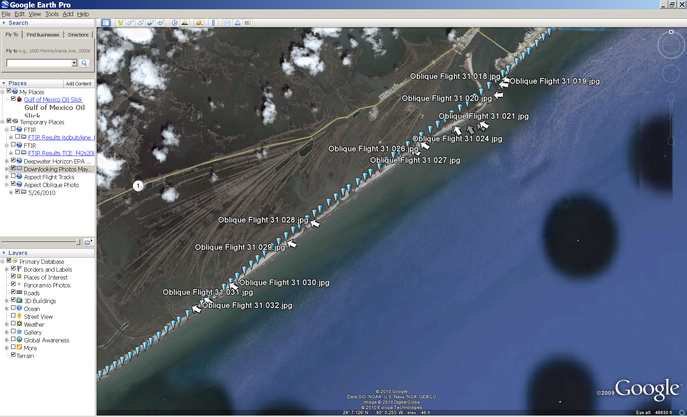
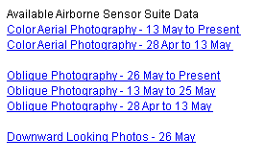
Click on icons to open the photos.
Using “Downward Looking Photos” AND “Oblique Photography” gives you a quick assessment of where the OIL is located.

Slide 5
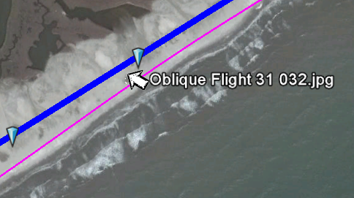
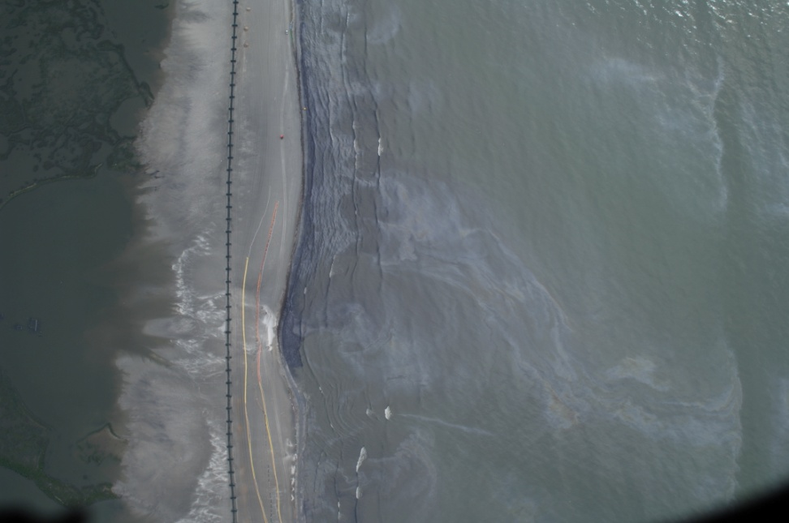
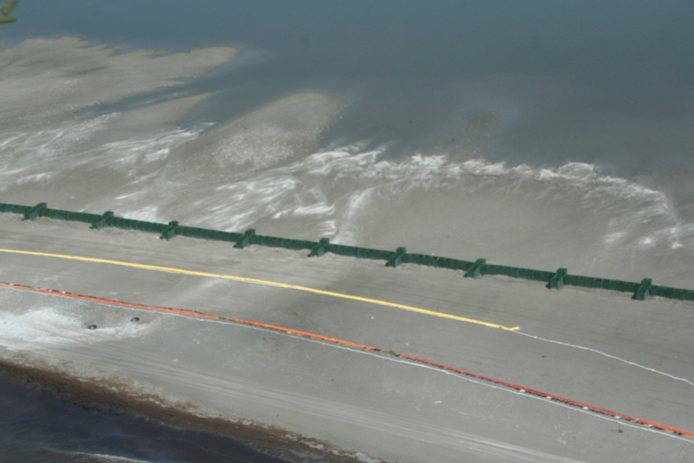
Using ASPECT Google Earth data to narrow search for oil on beaches
May 26, 2010; 9:28 a.m. CST
Google Earth Image
Data can be accessed within 20 minutes from landing.
ASPECT Aerial
“Downward Looking” Photo
ASPECT Oblique Photo

Slide 6
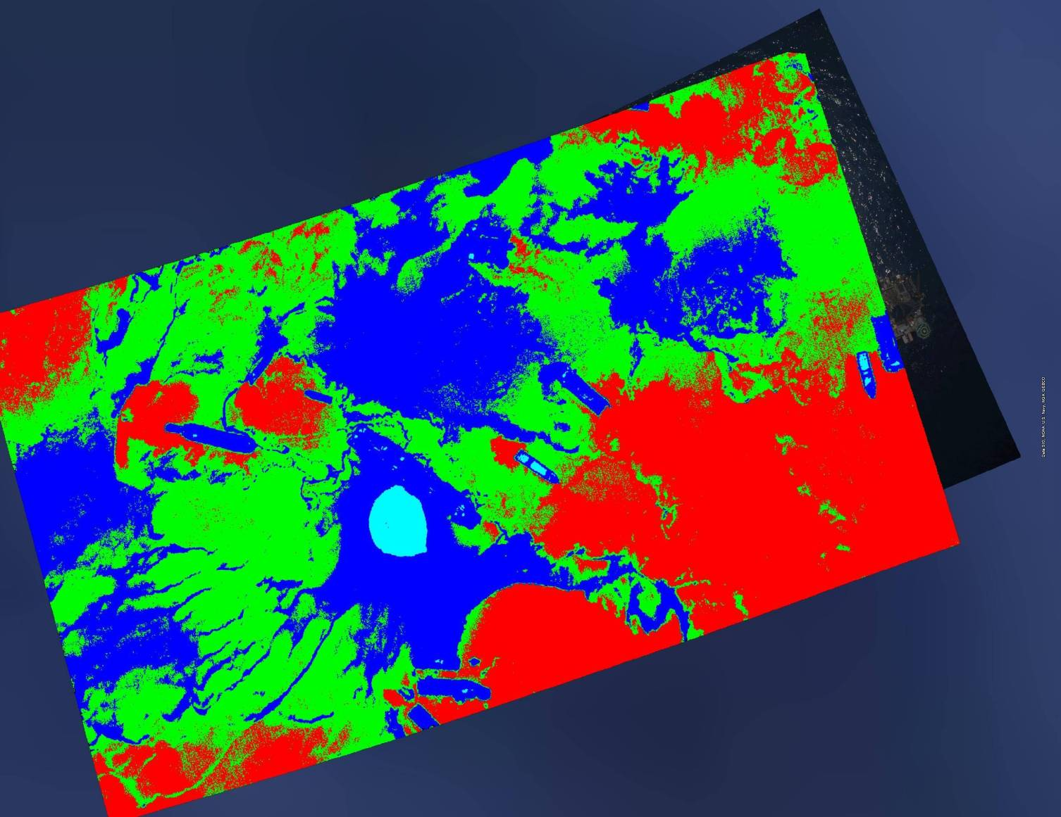
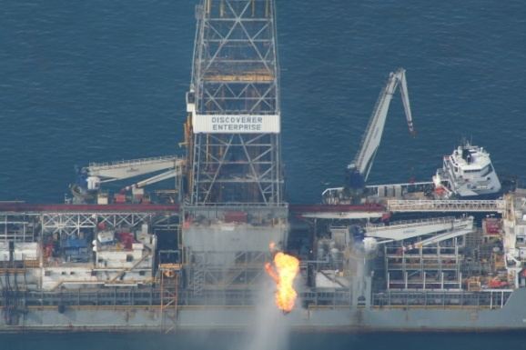
Deep Water Oil Detection
Unsupervised Classification Infrared Image
RED (surface oil)
GREEN (mixed oil/water)
BLUE/ CYAN (water/other)
LIGHT BLUE (flame)

Slide 7
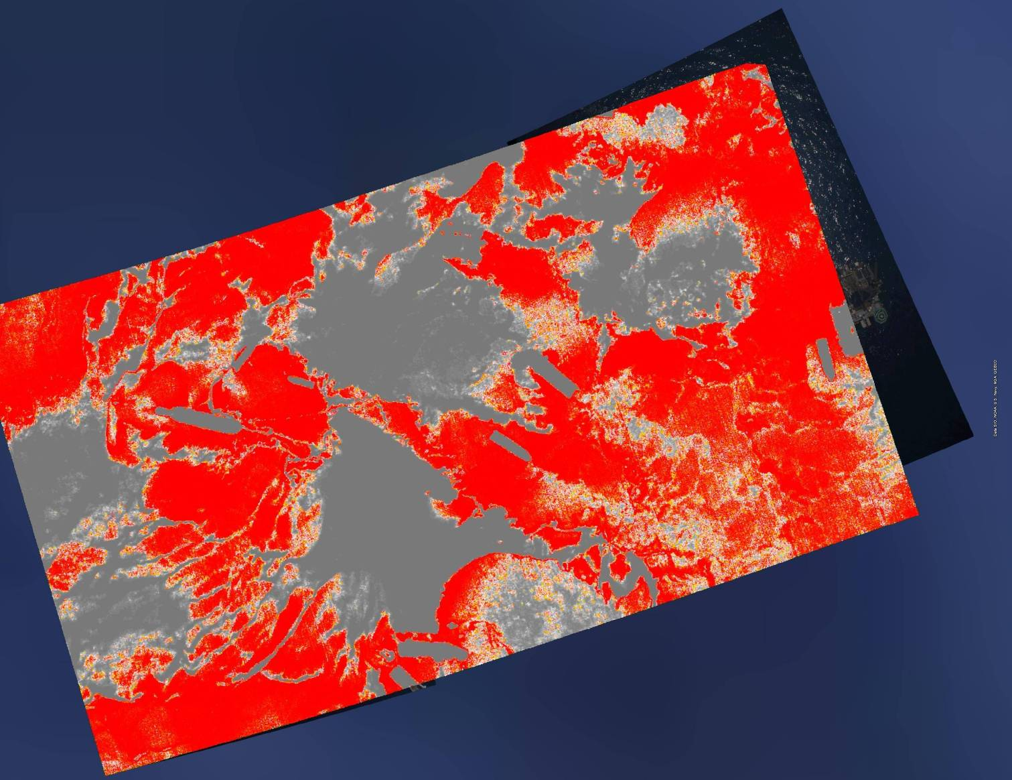
Deep Water Oil Detection
Supervised Pattern Recognition of IR Image
RED (surface oil)
Gray (clean water/land/other)

Slide 8
Near Shore Oil Detection
The ASPECT Team was tasked to explore the possibility to use infrared technology to detect and locate oil in near shore/shallow waters
    Unsupervised Classification
    Spectral Pattern Recognition (Supervised Pattern Recognition)
The Unsupervised Classifier approach was successful in waters greater than 6 feet
For waters less than 6 feet a Spectral Pattern Recognition technique was utilized.

Slide 9
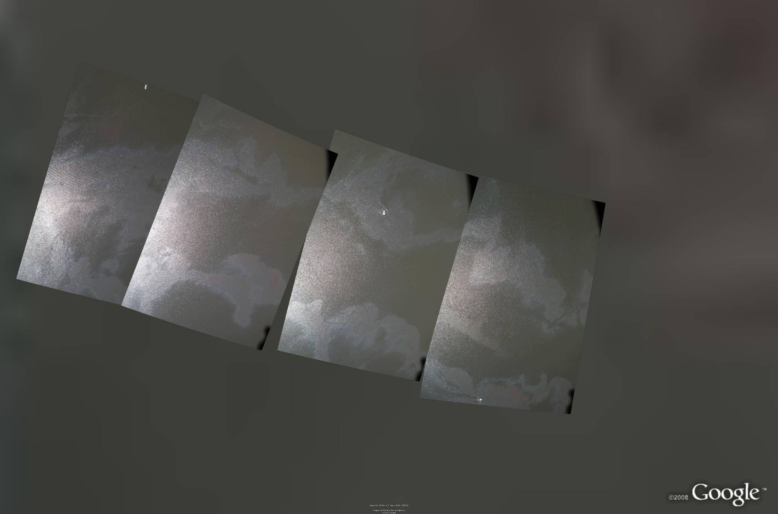
Near Shore Oil Detection
Aerial Imagery – Barataria Bay
Aerial Images at 2880 feet
Skimming Vessel
Heavy Sheen
Thick Oil

Slide 10
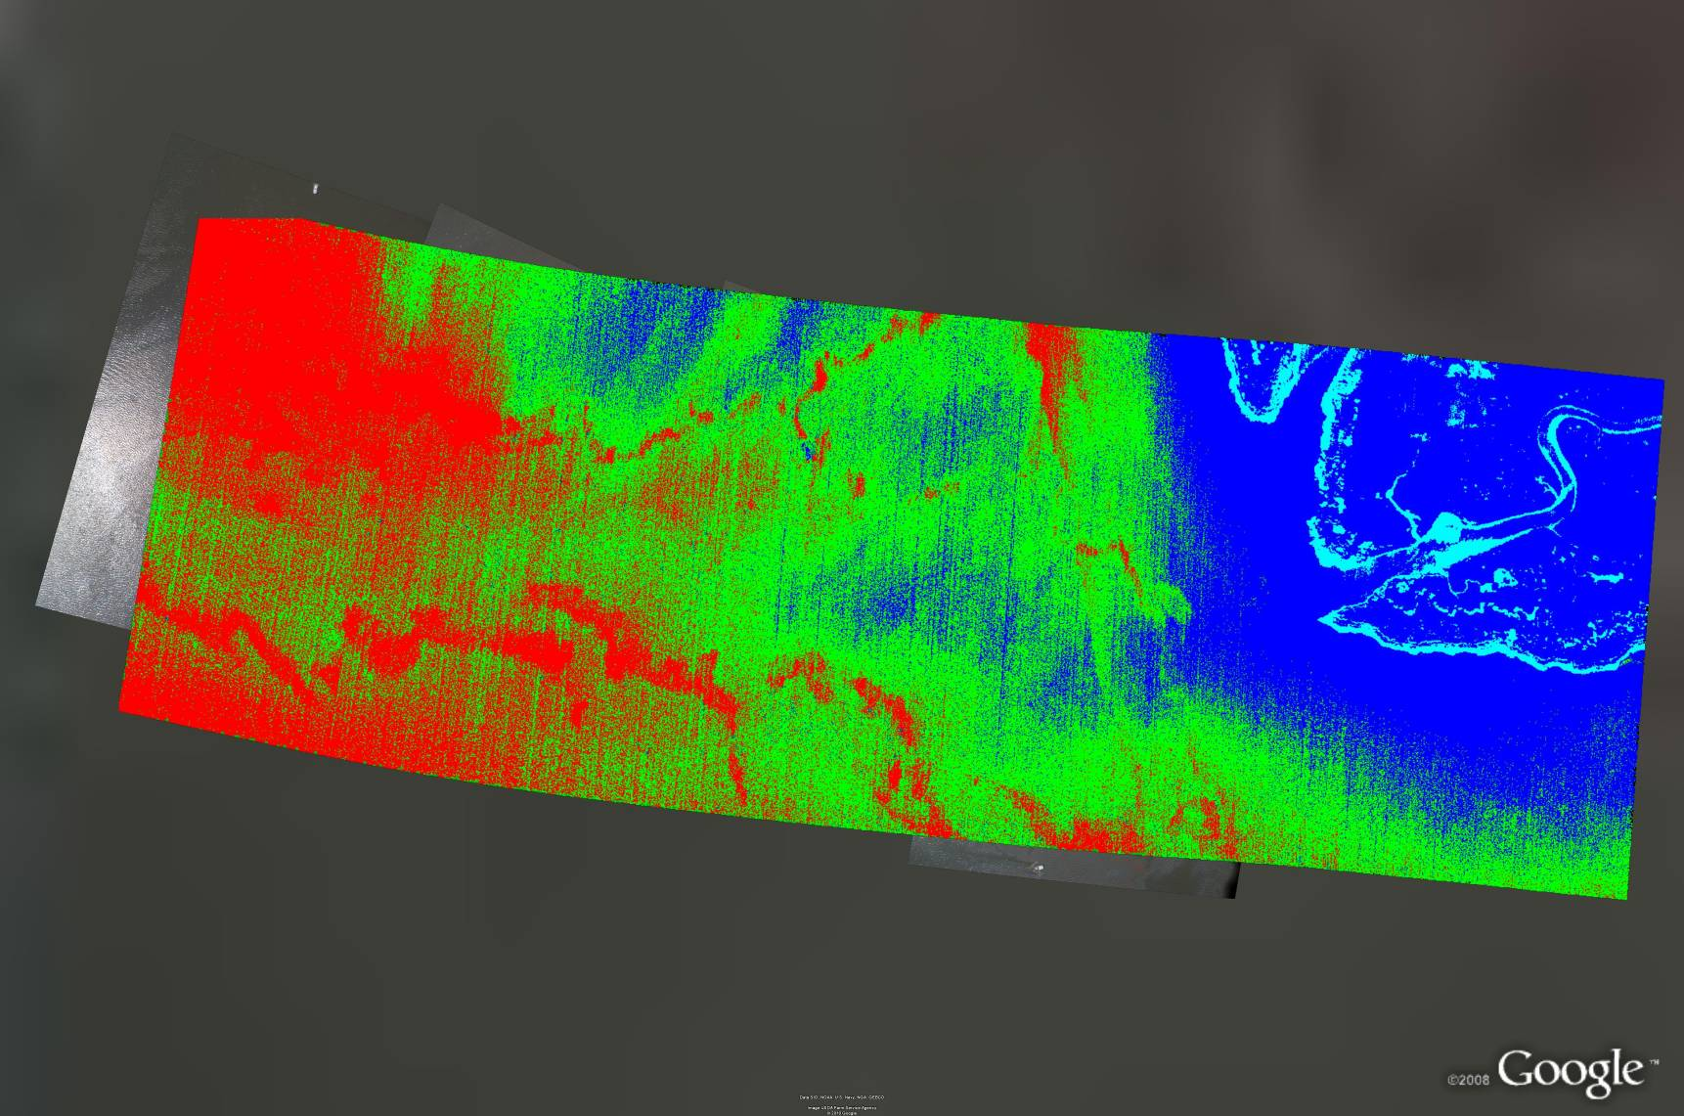
Near Shore Oil Detection
Unsupervised Classification Infrared Image
RED (surface oil)
GREEN (mixed oil/water)
BLUE/CYAN (water/land/other)
Skimming Vessel
Heavy Sheen
Thick Oil
Survey area ≈ 700m x 2100m

Slide 11
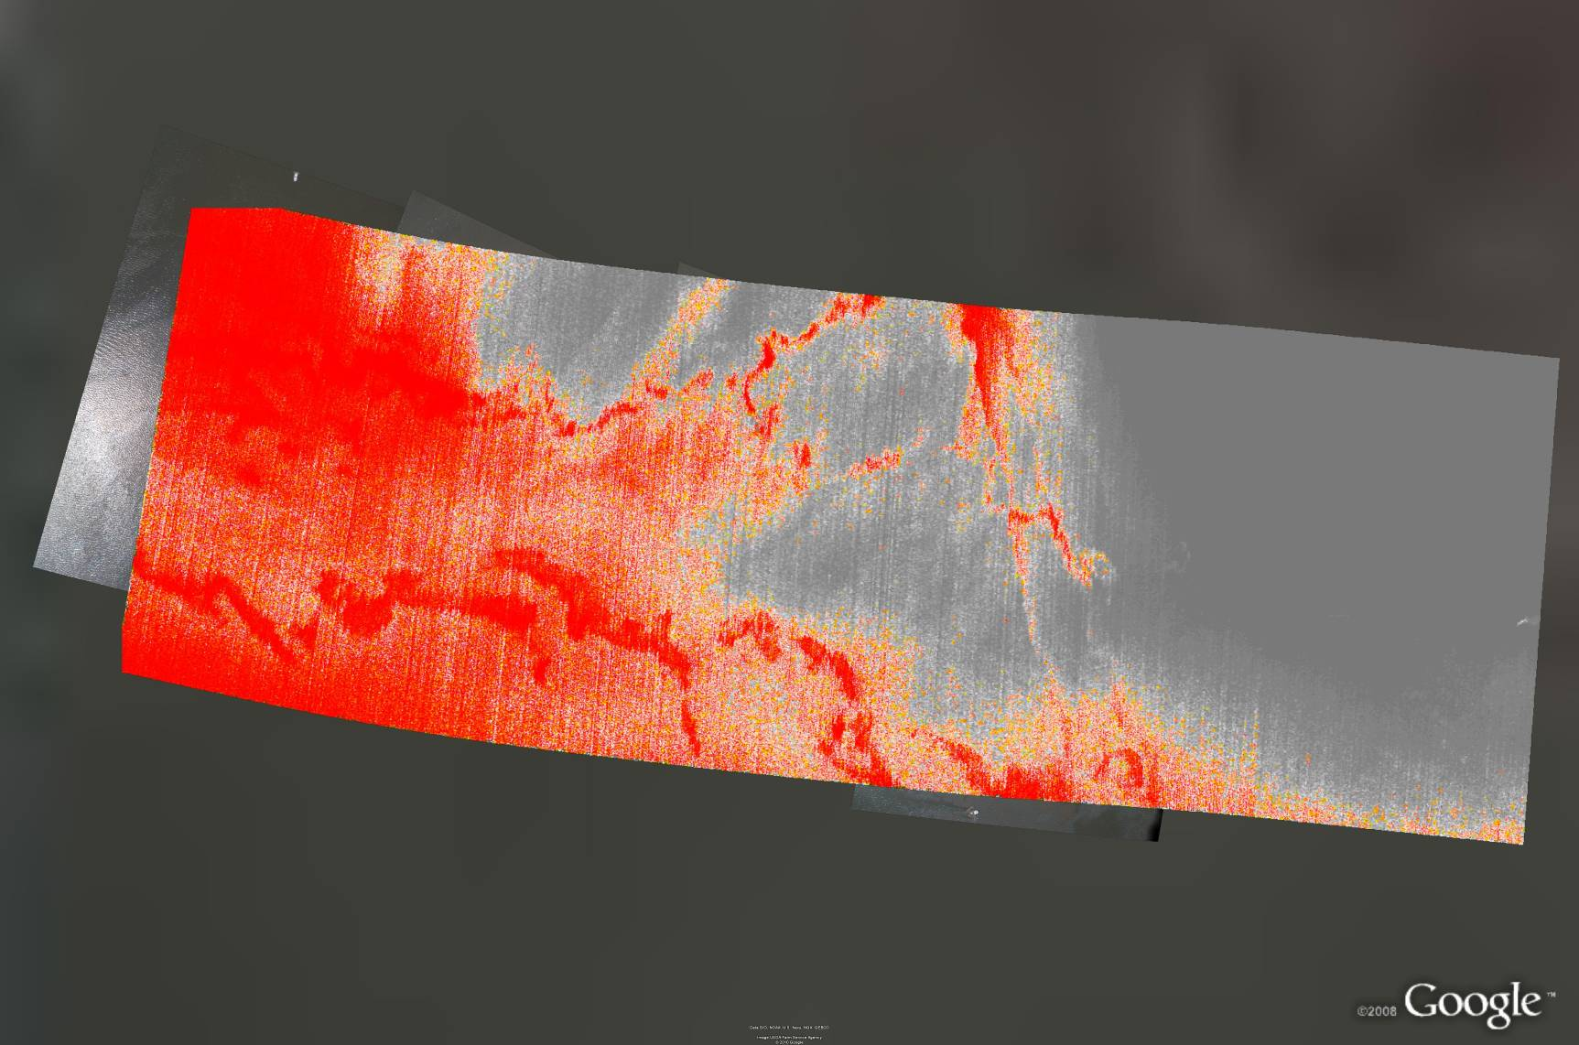
Near Shore Oil Detection
Supervised Pattern Recognition of IR Image
RED (surface oil)
GREY (clean water/land/other)
Skimming Vessel
Heavy Sheen
Thick Oil
Survey area ≈ 700m x 2100m

Slide 12
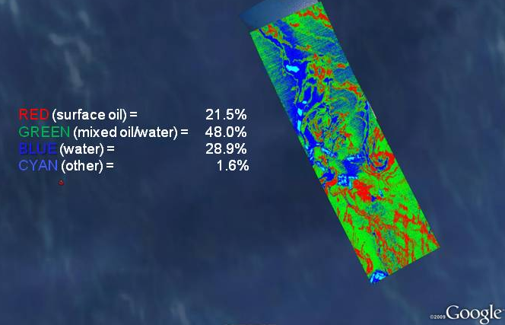
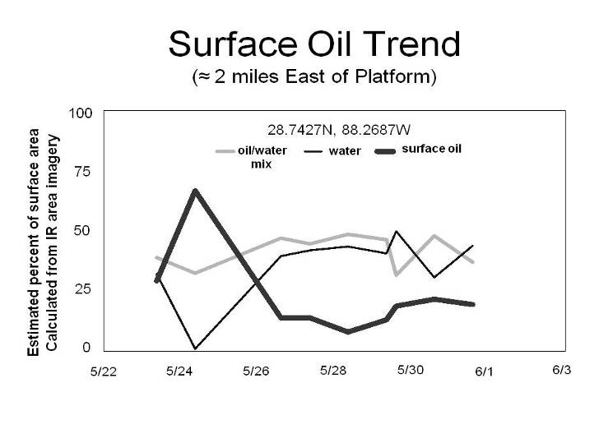
Spectral Analysis of Oil
Oil Coverage and Trend Analysis
The ASPECT team developed a series of IR Spectral tools permitting the type and coverage of oil to be quantified
Over a month period, ASPECT collected data approximately 2 miles east of the recovery site. A trend analysis indicated that between 24 May and 26 May the surface characteristic of the oil changed potentially due to dispersant operations.

