Slide 1
US EPA
Product Type
Agency
Logo
Satellite Image
Automated Product
Plume Emission Sampling
x
Aircraft Image
Man-made Product
Overview
Plume emission sampling via tethered aerostat (balloon) or Unmanned Aerial System (drone). Current system can include aerial visual (GoPro), aerial IR imagery (MicroEpsilon). Historical imagery is surface only: JPG photos, MPG videos
Format: JPG and MPG
Strengths
Weaknesses
Capabilities include comprehensive pollutant real time and batch emission sampling, GPS mapping.
Tethered aerostat requires considerable maneuvering of ship into plumes. Drone significantly increases maneuverability with some sacrifice of flight duration.
Emission data from oil burns are published in Aurell & Gullett, Env. Sci. Technol. 44(24) 2010; Gullett et al., Marine Poll. Bull. 107, 2016 and 117, 2017. Imagery available via email to contact below.
Contact Brian Gullett (919-541-1534, gullett.brian@epa.gov)

Slide 2
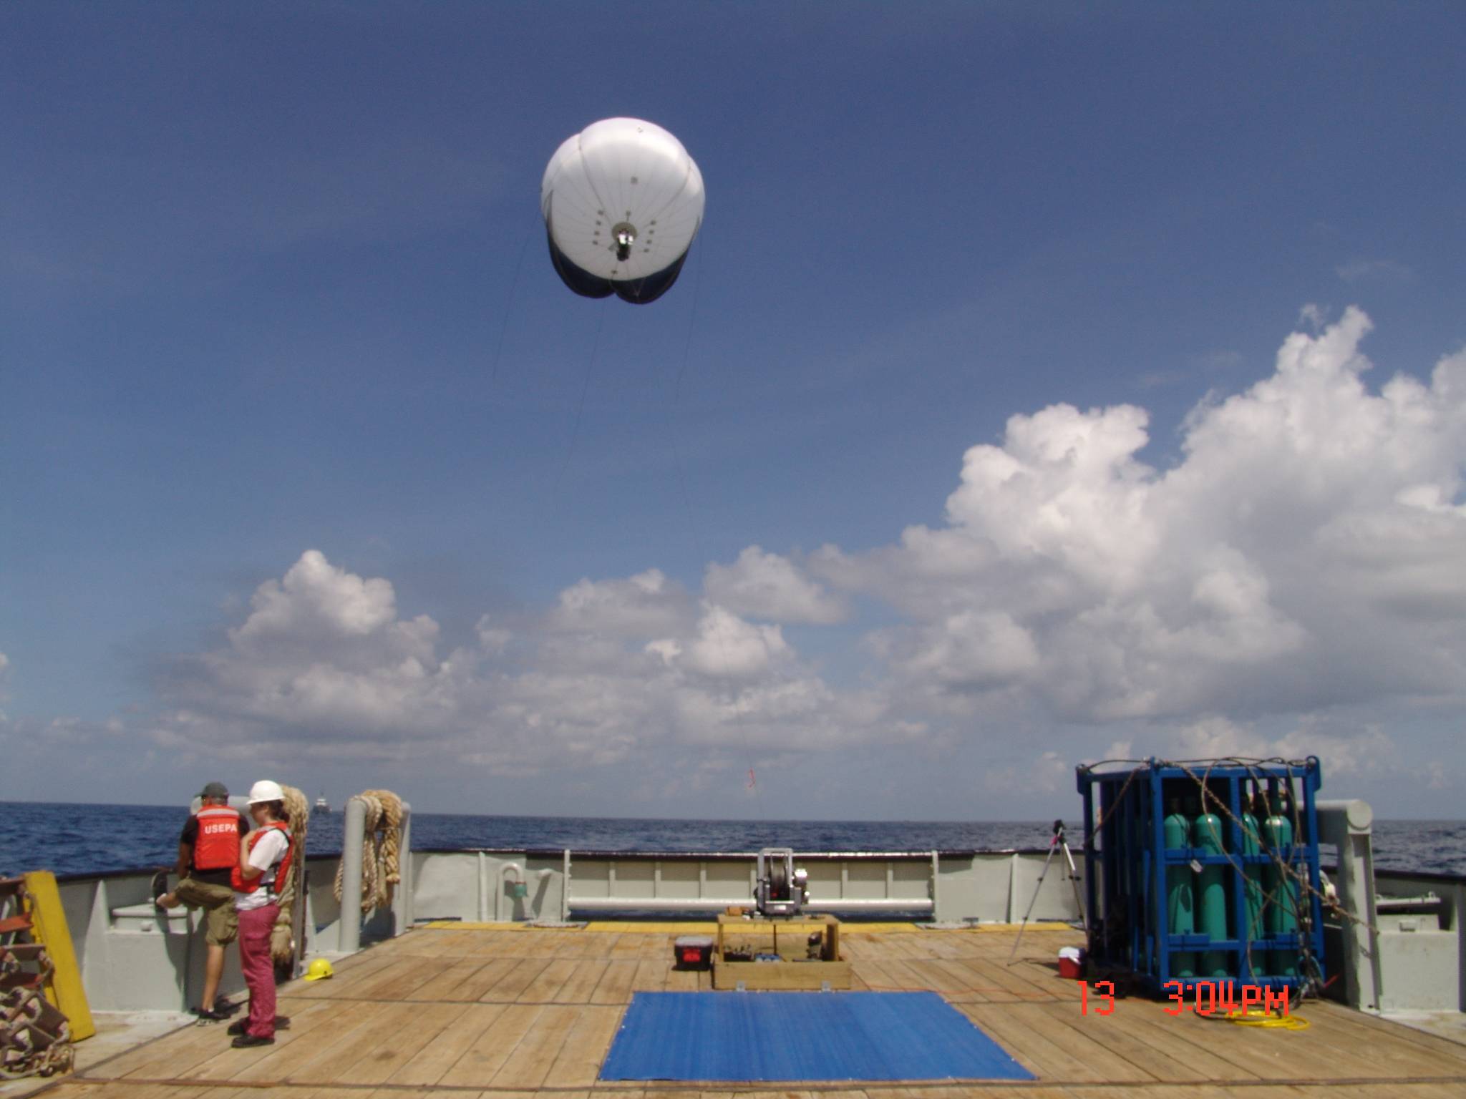
Product Example

Slide 3
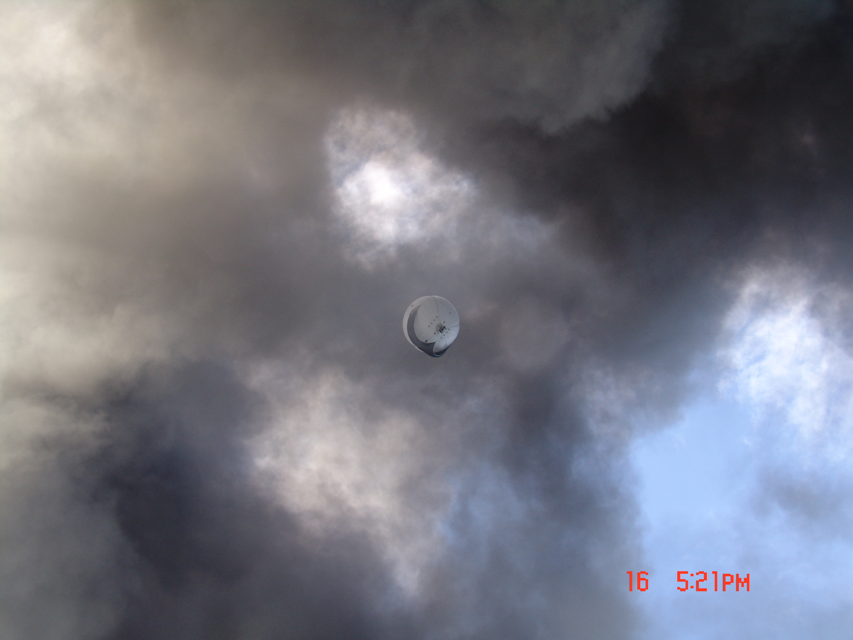
Product Example

Slide 4
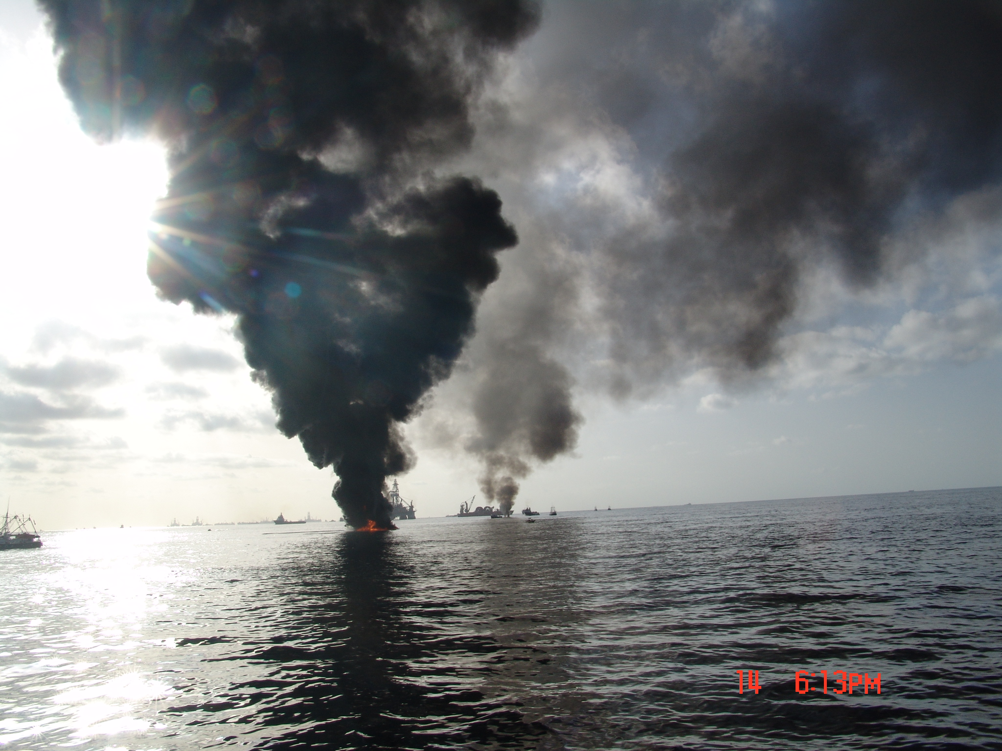
Product Example

Slide 5
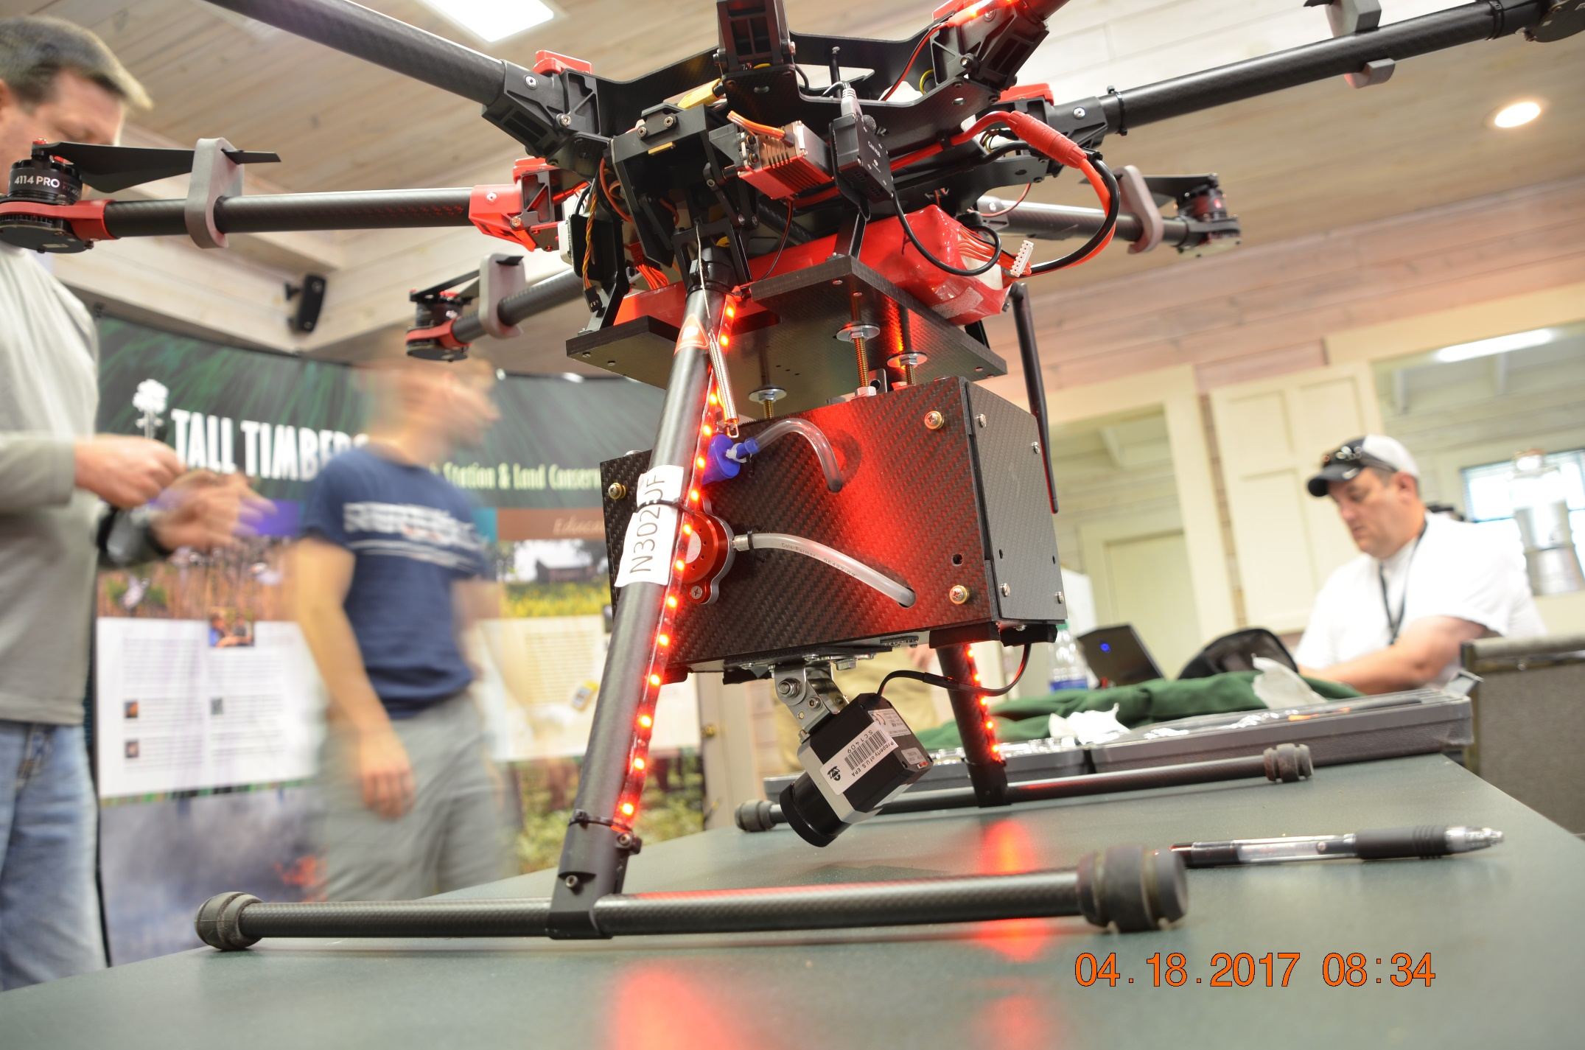
Product Example

