Slide 1
Product Type
NOAA
Satellite Image
Automated Product
NPP VIIRS
Aircraft Image
Man-made Product
Overview
Enhanced Multispectral Image (Visible / IR / Day/Night)
Resolution: I-band: 375 m
Polar Orbiting
Swath Width: 3000 km
Lag time: ~3 hours
Format: TIFF
Strengths
Weaknesses
Nearly Global Coverage Every Day
Fairly low lag time
Low Resolution
Oil difficult to discern in absence of sunglint.
Availability besides on hdds
Contact William Boll or Ellen Ramirez (both 301-683-1400) or David Streett (202-264-0102)

Slide 2
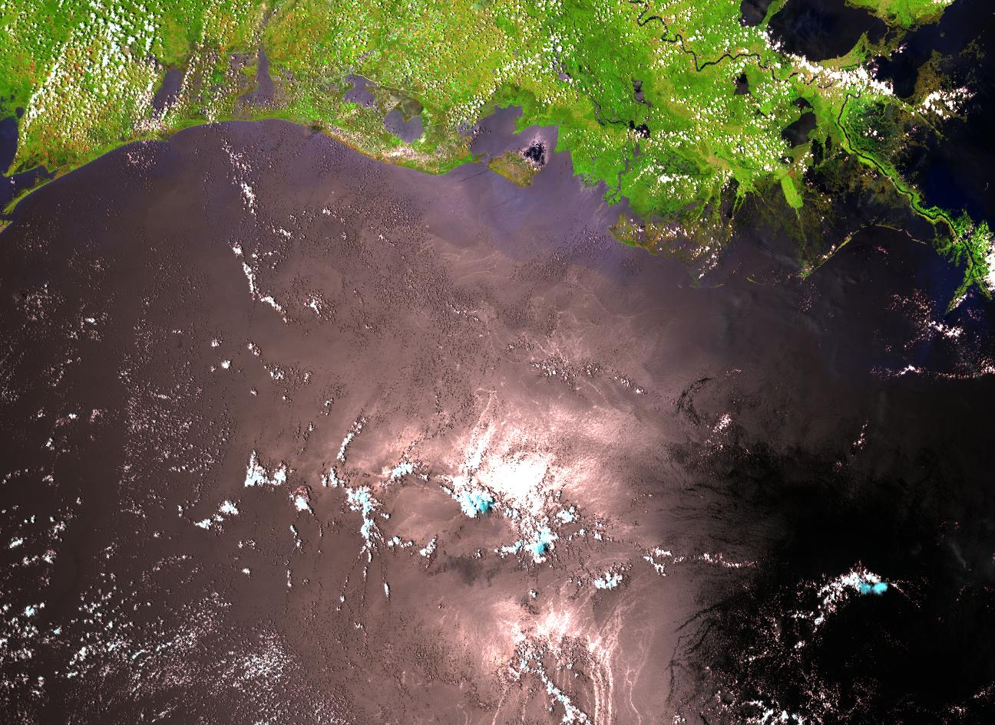
Insert Product Example

