Slide 1
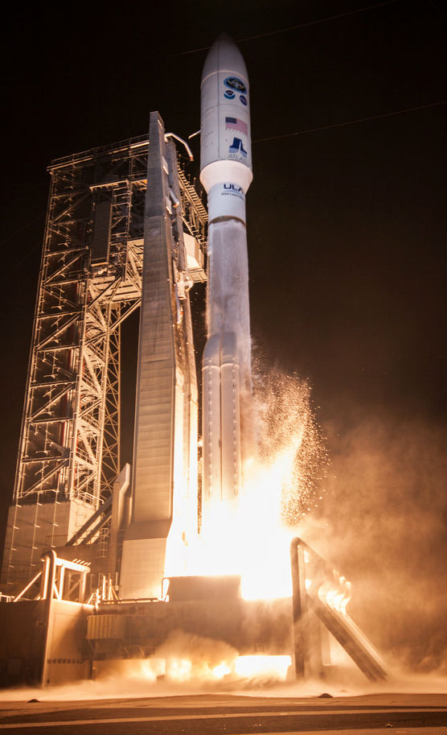
GOES-16 Geostationary Lightning Mapper (GLM)
Full PS-PVR
November 1, 2018
William Koshak¹, Pete Armstrong²,
Doug Mach³, Dennis Buechler⁴, Monte Bateman³
(with important inputs from additional Cal/Val Team Members, & NASA Flight)
GOES-R Calibration Working Group
¹NASA/MSFC, ²MIT-LL, ³USRA, ⁴UAH

Slide 2
Outline
Introduction
Performance Summary
PLPT Review
Field Campaign Overview
Progress Since Provisional Review
Assessment of Maturity
Summary and Recommendations

Slide 3
Outline
Introduction
Performance Summary
PLPT Review
Field Campaign Overview
Progress Since Provisional Review
Assessment of Maturity
Summary and Recommendations

Slide 4
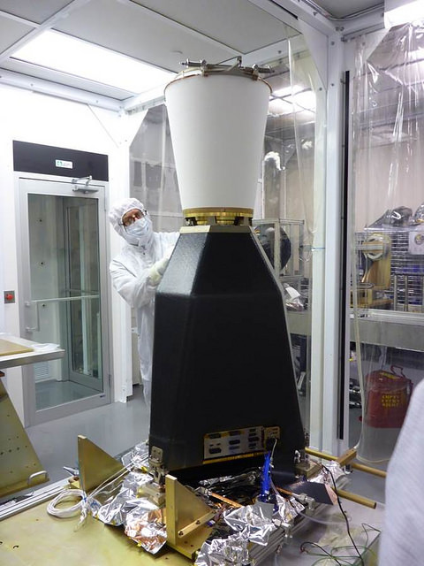
GLM Overview
  REQUIREMENTS:
  Provide continuous, full-disk lightning measurements for storm warning and nowcasting.
  Provide early warning of tornadic activity.
  Accumulate a long-term database to track decadal changes [of lightning].
INSTRUMENT DETAILS:
High-speed nadir-staring camera
CCD imager (1372x1300 pixels)
Near uniform spatial resolution
8 km nadir, 14 km edge of FOV
Coverage up to 52 N latitude
Single band 777.4 nm
2 ms frame rate
7.7 Mbps downlink data rate
  TRMM/LIS only 8 kbps
20 sec product latency
GLM is the first lightning mapper to be flown in geostationary orbit. Heritage LEO sensors include: Optical Transient Detector (1995-2000), and TRMM/LIS (1997-2015)

Slide 5
Important Validation Principles
(see RIMP for more details)
Targets of Opportunity (TOO): VAL of a Lightning Sensor differs from VAL of typical imager; i.e. since lightning transient, VAL is restricted to TOO.
Flash DE & FAR are Estimates: Because reference data normally doesn’t detect all lightning.
Source Physics: GLM detects in the optical (near-IR) and many of the reference datasets are in the RF. (e.g., LMAs see discharge breakdown in the VHF that might not show up in optical → apple/orange).
Source Scattering: Optical is cloud-scattered, but cloud is transparent to radio. So often see GLM detections near cloud edges where no radio sources.
ISS/LIS & FEGS are Critical: More of an apple/apple comparison w/GLM.

Slide 6
Post-Launch Product Tests
Test ID | Abbreviated Test Titles for GLM
PLPT-GLM-001 | Validate DE/FER using med/long-range networks (e.g., NLDN, EN, GLD360)
PLPT-GLM-002 | Validate DE/FER using short-range networks (e.g., LMAs)
PLPT-GLM-003 | Validate Storm DE and Storm FAR using very long range systems (WWLLN, NEXRAD)
PLPT-GLM-004 | Validate DE/FER using very short range optical systems (FEGS)
PLPT-GLM-005 | Validate DE/FER using orbit-based optical systems (e.g., ISS/LIS)
PLPT-GLM-006 | Validate DE/FER using ground-based E-field networks (e.g. HAMMA, LIP)
PLPT-GLM-009 | Validate L1b-L2 Cluster/Filter by comparing w/Spec (i.e. Mach) code
PLPT-GLM-010 | Validate L0-L1b Filter Algorithms by comparing w/Spec (i.e. Mach) code
PLPT-GLM-011 | Validate GLM INR w/comparisons to well-located ground points
PLPT-GLM-012 | Validate GLM BG DCC radiances with trendings & comparisons
PLPT-GLM-013 | Validate GLM Flash Energies with trendings & comparisons
Full test plans and procedures are given in the GLM Readiness, Implementation, and Management Plan (RIMP v1.2; 416-R-RIMP-0313)

Slide 7
Performance Baseline Mapping
MRD | Parameter | MRD Value | Perf. Baseline (Model) |  | Related PLPTs
1259 | Production Mapping Accuracy [INR] | 5km ( = |𝛍+3𝜎| < 140 μrad) | Nav error (7 d averaging) of 89.4 μrad for GOES-E |  | -011, (also -001, -002,-003, -004, -005, -006)
1260 | Product Measurement Range | (0-41900 evts/s, 0-8170 grps/s, 0-600 flsh/s) | Instr Vendor showed can handle peak 100Kevts/s (600flsh/s) |  | -009,-010, (also vendor results)
1261 | Product Measurement Accuracy | 70% total flash detection efficiency (DE) | Instr. Side | BOL* | -001, -002,-003, -004, -005, -006, -009,-010
 |  |  | Primary | 81%
 |  |  | Redundant | 83%
1264 | Product Measurement Precision | 5% | Open, with Flight reporting FAR ~ 0.12%, but open WRs on GS implementation loss |  | -001, -002,-003, -004, -005, -006, -009,-010
PORD | Parameter | PORD Value | Related PLPTs
094 | GLM Navigation Error | 4km ( = |𝛍+3𝜎| < 112 μrad) | -011
098 | Event Time Tag Accuracy | 1 ms | -001, -002,-003, -004, -005, -006
Reference: GLM PORD (Performance and Operational Requirements Document) V2.21, 9 Oct 2018.
MRD1259 & PORD 094: 28 μrad per km.
*BOL = Beginning of Life with reduces flash DE by ~6% due to Coherency Filter removing 1st Group in flash.

Slide 8
Primary PLPT Tools
Item | Tool | Description | Code Language | Developer
1 | VaLiD | Validate Lightning Data tool performs shallow/deep dives of GLM data using wide range of ground-based datasets discussed in RIMP. | C | Bateman/USRA
2 | Cluster/Filter | In-house code for L0-L1b and L1b-L2 processing | Matlab | Mach/USRA
3 | HUDAT | Huntsville Area Marx Meter Array (HAMMA) User Data Analysis Technology with emphasis on lightning energy/physics. | IDL | Bitzer/UAH
4 | STROKE | STorm Retrievals frOm KSC E-Fields examines ground-based electric fields, lightning field changes, and the charges deposited by lightning in KSC, Florida. | IDL | Koshak/MSFC
5 | INR/Parallax | Validates GLM INR with comparisons to well-located ground points and employs GLM background images & lightning, ABI background images, and Laser beacon data | IDL | Buechler/UAH
6 | TT/DCC | Trending Tools for long-term trending of Deep Convective Clouds. | IDL | Buechler/UAH
7 | TT/Lightning | Trending Tools for long-term trending of lightning counts, flash duration, and lightning energy. | IDL | Buechler/UAH Koshak/MSFC
8 | LMT | 24/7 Lightning Monitoring Tool (aka "Product Monitor") that alerts of problematic GLM performance | TBD | Product Area Lead
9 | CompareLLS | Compare Lightning Location System tool performs shallow/deep dives of GLM data using wide range of ground-based datasets discussed in RIMP. | Matlab | Cummins, UA
10 | XLMA | X Lightning Mapping Array tool for making standard 4-D plots of flashes. | IDL | Krehbiel & Rison of NMT
11 | lmatools | Analyzes LMA data [sort VHF source data into flashes; calculate flash areas, volumes, and channel lengths; produce gridded products; time series statistics of flash rate and size data; simulate LMA performance]. | Python | Bruning/TTU
12 | FEGST | Fly's Eye GLM Simulator Tool: Data acquisition, display, storage software, and s/w for analyzing FEGS data & inter-comparing it with other lightning optical datasets (e.g. GLM, ISS/LIS). | IDL | Quick/NPP
13 | ADTs | Ancillary Dataset Tools will be developed for processing datasets such as ABI, NEXRAD, SEVERI, WWLLN; some of these tools will be piggybacked to VaLiD. | Matlab & McIDas scripts | Mach/USRA Bateman/USRA
14 | SITs | Specialized Impromptu Tools written “on-the-fly” to handle any analyses that are needed, but that were unexpected. | C, IDL, Matlab, Mathematica | Cal/Val Team
15 | LATA | Location And Time Accuracy (LATA) Tool: Produces a variety of plots/histograms that characterize the overall location/time accuracy of GLM flashes/groups/events. | Matlab | Virts/NPP

Slide 9
Outline
Introduction
Performance Summary
PLPT Review
Field Campaign Overview
Progress Since Provisional Review
Assessment of Maturity
Summary and Recommendations

Slide 10
Performance Summary
MRD | Parameter | MRD Value | Performance Baseline (Model) | Performance Result
 |  |  |  | VaLiD | LATA | INR | Mach SIT
1259 | Production Mapping Accuracy | 5km ( = |𝛍+3𝜎| < 140 μrad) | 89.4 μrad | n/a | 3km | 101.5& μrad (3.6 km) | n/a
1260 | Product Measurement Range | (0-41900 evts/s, 0-8170 grps/s, 0-600 flsh/s) | 100Kevts/s (600flsh/s) | n/a | n/a | n/a | verified *LCFA can handle above max rate spec
1261 | Product Measurement Accuracy | 70% total flash detection efficiency (DE) | 81% | 78% | n/a | n/a | n/a
1264 | Product Measurement Precision | 5% (flash FAR) [also MRD 639 which states same 5% value] | Open, with Flight reporting FAR ~ 0.12%, but open WRs on GS implementation loss | 22% | n/a | n/a | n/a
PORD | Parameter | PORD Value | Performance Result
 |  |  | LATA | INR
094 | GLM Navigation Error | 4km ( = |𝛍+3𝜎| < 112 μrad) | n/a | 3.6 km
098 | Event Time Tag Accuracy | 1 ms | - 0.8 ms | n/a
*LCFA = Lightning Cluster Filter Algorithm. & 101.5 = 82+19.5 (see PLPT-GLM-011)
- MRD1259 & PORD 094: 28 μrad per km.

Slide 11
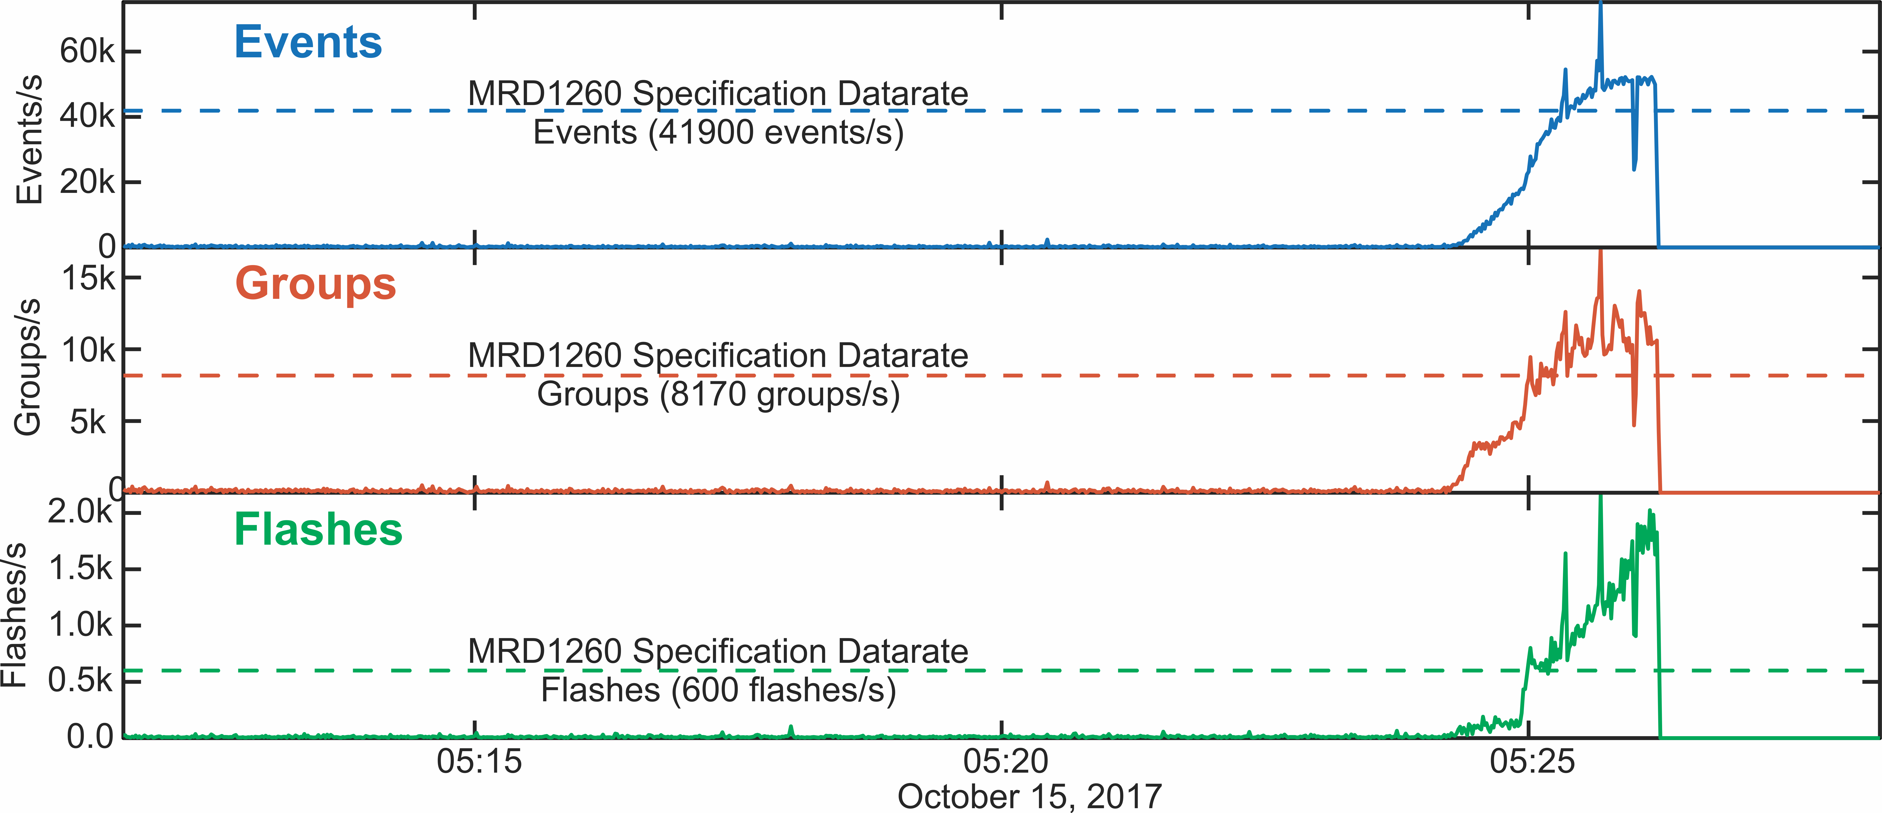
LCFA handles above max Rate Spec
(when rate gets too high [∼51kevts/s, ∼14kgrps/s, ∼1.6kflsh/s] LCFA crashes)
LCFA
crash
LCFA
crash
LCFA
crash

Slide 12
Performance Summary
(Additional Details on Flash Detection Efficiency and Flash False Alarm Rate from VaLiD tool)
Period (2018) | GLM16 vs. GLD360 |  |  | GLM16 vs. Combined Ground Networks
 | Flash DE | Flash DE (day) | Flash DE (night) | Flash DE | Flash DE (day) | Flash DE (night)
Jan | 0.84 | 0.79 | 0.89 | 0.75 | 0.71 | 0.81
Feb | 0.83 | 0.76 | 0.88 | 0.72 | 0.69 | 0.78
Mar | 0.83 | 0.79 | 0.88 | 0.72 | 0.71 | 0.79
Apr | 0.82 | 0.79 | 0.87 | 0.75 | 0.75 | 0.80
May | 0.80 | 0.78 | 0.84 | 0.74 | 0.74 | 0.80
Jun | 0.80 | 0.76 | 0.84 | 0.75 | 0.78 | 0.82
Jul | 0.78 | 0.77 | 0.83 | 0.76 | 0.77 | 0.84
Aug | 0.80 | 0.79 | 0.85 | 0.74 | 0.79 | 0.79
Sep | 0.85 | 0.83 | 0.89 | 0.77 | 0.77 | 0.82
SFGL2 (Sep26-Oct24) | 0.85 | 0.81 | 0.88 | 0.78 | 0.74 | 0.82

Slide 13
Performance Summary
(Additional Details on Flash Detection Efficiency and Flash False Alarm Rate from VaLiD tool)
Period (2018) | GLM16 vs. GLD360 |  |  | GLM16 vs. Combined Ground Networks
 | Flash FAR | Flash FAR (day) | Flash FAR (night) | Flash FAR | Flash FAR (day) | Flash FAR (night)
Jan | 0.31 | 0.33 | 0.25 | 0.25 | 0.29 | 0.19
Feb | 0.35 | 0.36 | 0.28 | 0.28 | 0.31 | 0.22
Mar | 0.35 | 0.34 | 0.28 | 0.28 | 0.29 | 0.21
Apr | 0.35 | 0.32 | 0.29 | 0.25 | 0.25 | 0.20
May | 0.38 | 0.38 | 0.33 | 0.26 | 0.26 | 0.21
Jun | 0.35 | 0.33 | 0.30 | 0.25 | 0.22 | 0.18
Jul | 0.33 | 0.33 | 0.29 | 0.24 | 0.23 | 0.16
Aug | 0.34 | 0.30 | 0.30 | 0.26 | 0.21 | 0.21
Sep | 0.29 | 0.29 | 0.25 | 0.23 | 0.24 | 0.18
SFGL2 (Sep26-Oct24) | 0.27 | 0.30 | 0.22 | 0.22 | 0.27 | 0.18

Slide 14
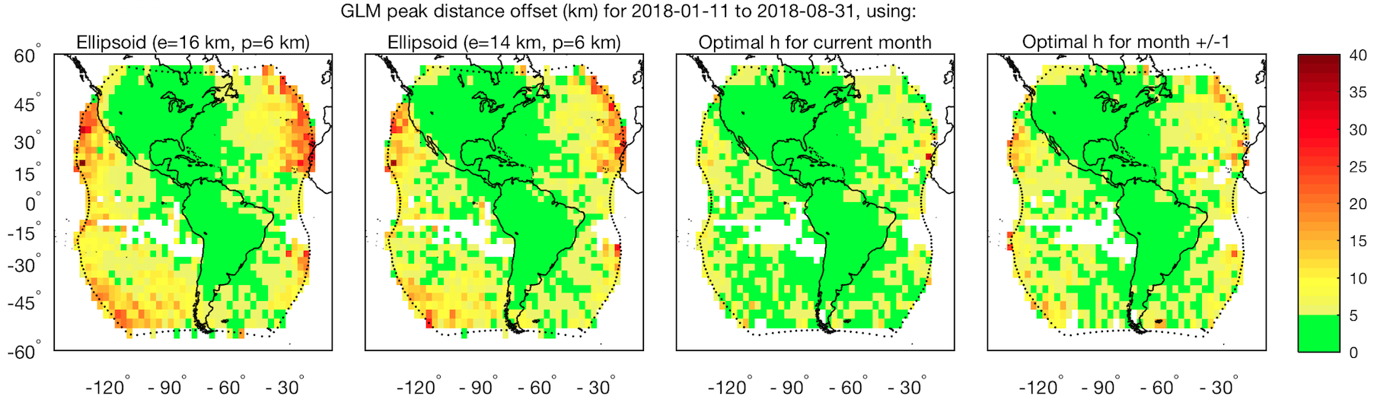
Performance Summary
(Additional Details on Group Location Accuracy [Parallax Mitigation] from Virts’s LATA tool)
Lightning ellipsoid currently used for GLM displaces observations toward nadir; largest location errors near the limb
Lower ellipsoid (e=14 km, p=6 km) is now implemented
Monthly 3º grid resolution optimal lightning emission height maps are available that significantly improve location accuracy near the limb. Simple computer search is used to find the cloud-top height that minimizes location errors in the grid cell.
Future
Future
ADR 728
ADR 645
(km)

Slide 15
Performance Summary
(Additional Details on Group Location and Group Time Accuracy from LATA tool)
Period (2018) | Peak Location Accuracy (km) | Peak Timing Accuracy (ms)
Jan | 3.5 | -0.6
Feb | 3.5 | -0.4
Mar | 3.5 | -0.6
Apr | 3.0 | -0.6
May | 3.0 | -1.0
Jun | 3.0 | -0.6
Jul | 3.0 | -1.0
Aug | 3.0 | -1.0
Sep | 3.0 | -0.6
Sep26-Oct10 | 3.0 | -0.8

Slide 16
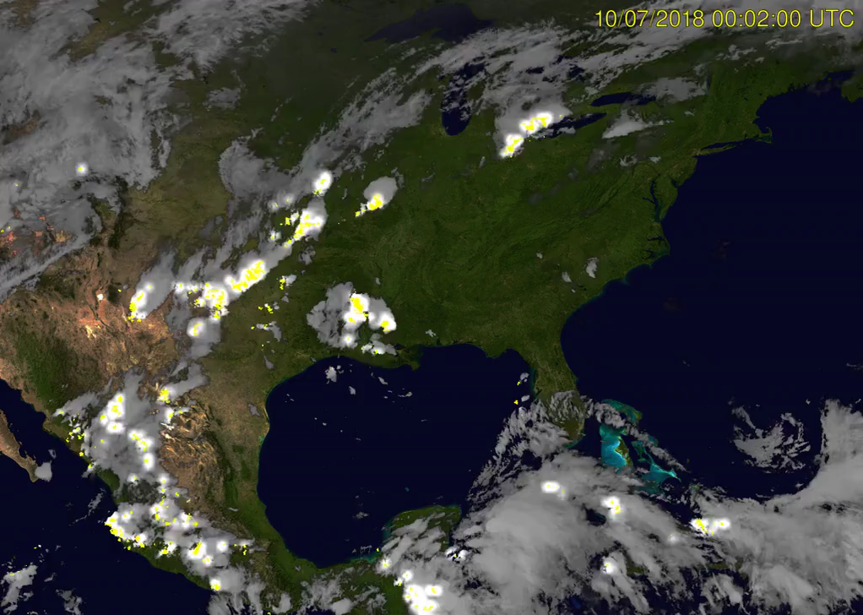
Hurricane Michael Landfall
Arranged by Michael Peterson

Slide 17
Outline
Introduction
Performance Summary
PLPT Review
Field Campaign Overview
Progress Since Provisional Review
Assessment of Maturity
Summary and Recommendations

Slide 18
Review: PLPTs
(primary analysis period is Sep 26 – Oct 26 of 2018, + historical periods)
Test ID | Abbreviated Test Titles for GLM | Nominal FULL Val Flash Target | Nominal Target Met
PLPT-GLM-001 | Validate DE/FAR using med/long-range networks (e.g., NLDN, EN, GLD360) | 1000 | Yes
PLPT-GLM-002 | Validate DE/FAR using short-range networks (e.g., LMAs) | 1000 | Yes
PLPT-GLM-003 | Validate Storm DE and Storm FAR using very long range systems (WWLLN, NEXRAD) | 200 (storms) | Yes
PLPT-GLM-004 | Validate DE/FAR using very short range optical systems (FEGS) | 1000 | Yes
PLPT-GLM-005 | Validate DE/FAR using orbit-based optical systems (e.g., ISS/LIS) | 1000 | Yes
PLPT-GLM-006 | Validate DE/FAR using ground-based E-field networks (e.g. HAMMA, LIP) | 1000 | Yes
PLPT-GLM-009 | Validate L1b-L2 Cluster/Filter by comparing w/Spec (i.e. Mach) code | 1000 | Yes
PLPT-GLM-010 | Validate L0-L1b Filter Algorithms by comparing w/Spec (i.e. Mach) code | 1000 | Yes
PLPT-GLM-011 | Validate GLM INR w/comparisons to well-located ground points | 1000 | Yes
PLPT-GLM-012 | Validate GLM BG DCC radiances with trendings & comparisons | 10000 (pixels) | Yes
PLPT-GLM-013 | Validate GLM Flash Energies with trendings & comparisons | 1000 | Yes
All PLPTs successful in meeting nominal sample sizes, and in providing needed numerical results !
Targets of Opportunity (TOO): VAL of a Lightning Sensor differs from VAL of typical imager; i.e. since lightning transient, VAL restricted to TOO.
Full test plans and procedures are given in the GLM Readiness, Implementation, and Management Plan (RIMP v1.2;416-R-RIMP-0313)
Section 5 of RIMP: “ … not all regions will be rigidly held to these fixed flash count (10, 100, 1000) values.”
DE here refers to Flash Detection Efficiency
FAR here refers to Flash False Alarm Rate

Slide 19
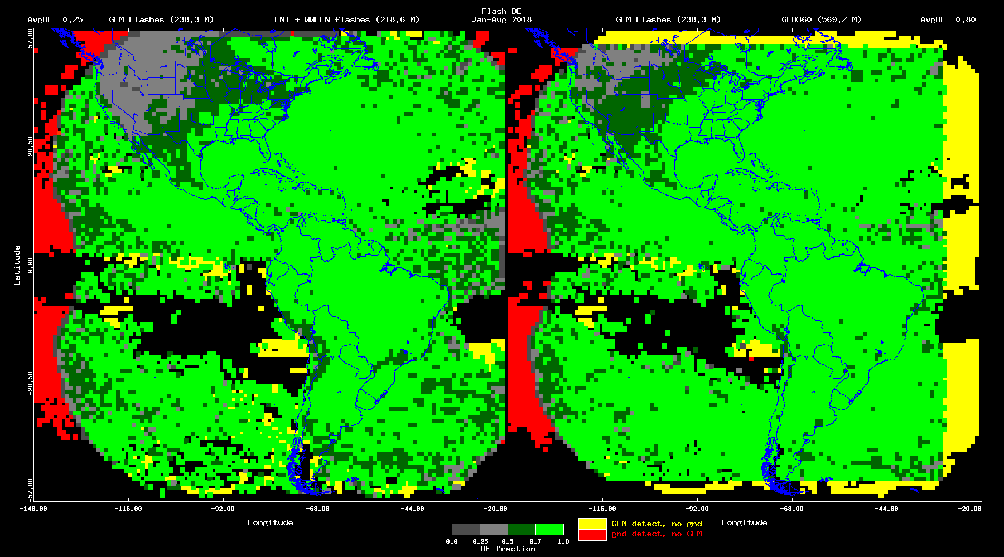
PLPT-GLM-001
GLM DE Map, Jan-Aug 2018 (Bateman)
75% DE (vs. ENTLN) 80% DE (vs. GLD360)
~240 million GLM Flashes

Slide 20
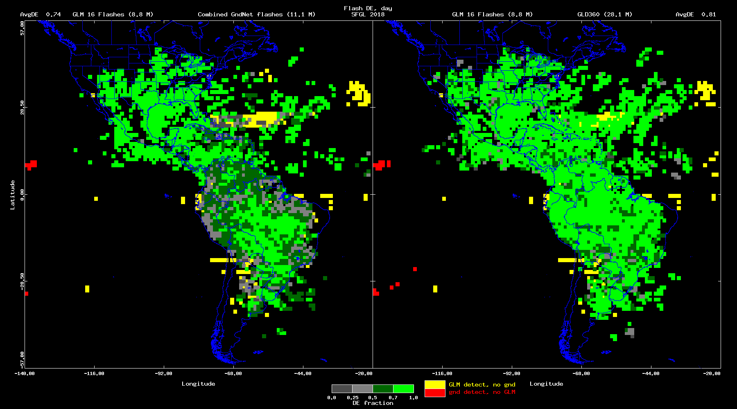
Flash DE, daytime
SFGL2 (9/26 – 10/24)
PLPT-GLM-001 (cont.)
GLM16 vs Combined Grnd Networks (0.74)
GLM16 vs GLD360 (0.81)

Slide 21
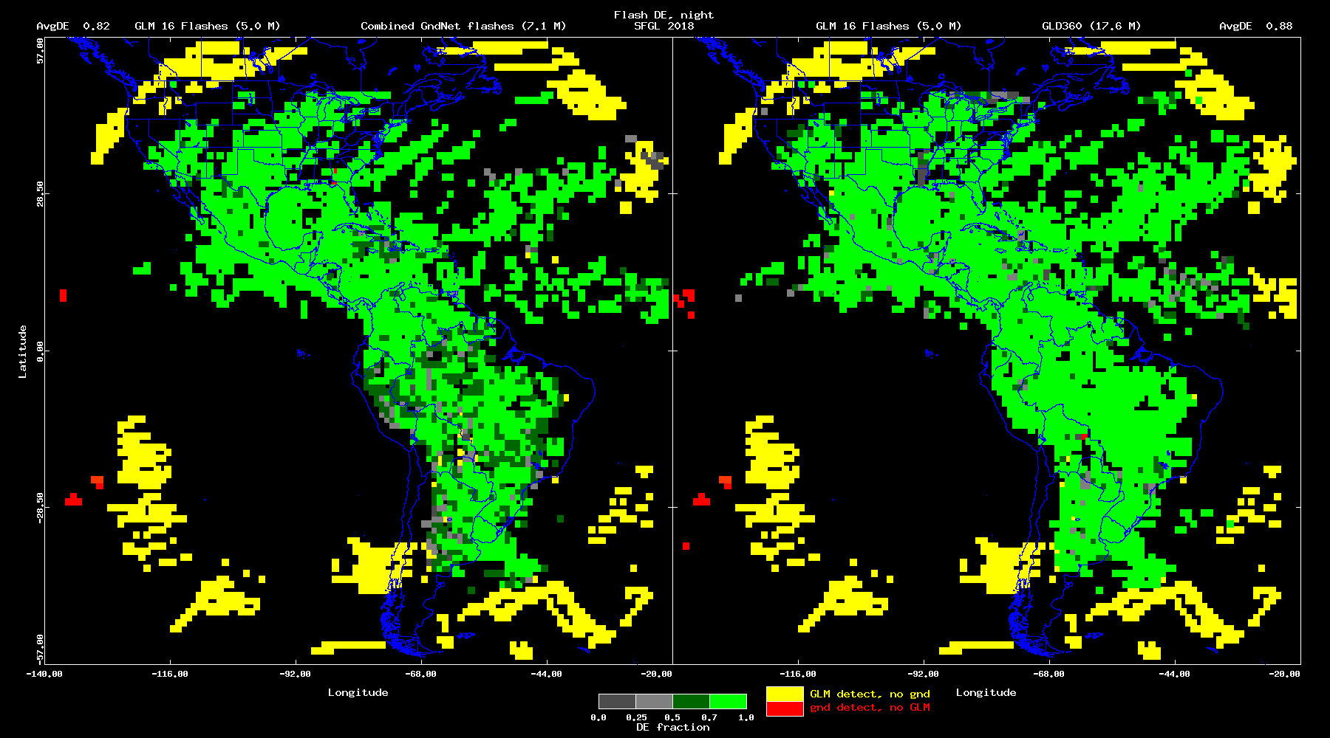
Flash DE, nighttime
SFGL2 (9/26 – 10/24)
PLPT-GLM-001 (cont.)
GLM16 vs Combined Grnd Networks (0.82)
GLM16 vs GLD360 (0.88)
Point 1
Point 2
Point 3
.
.

Slide 22
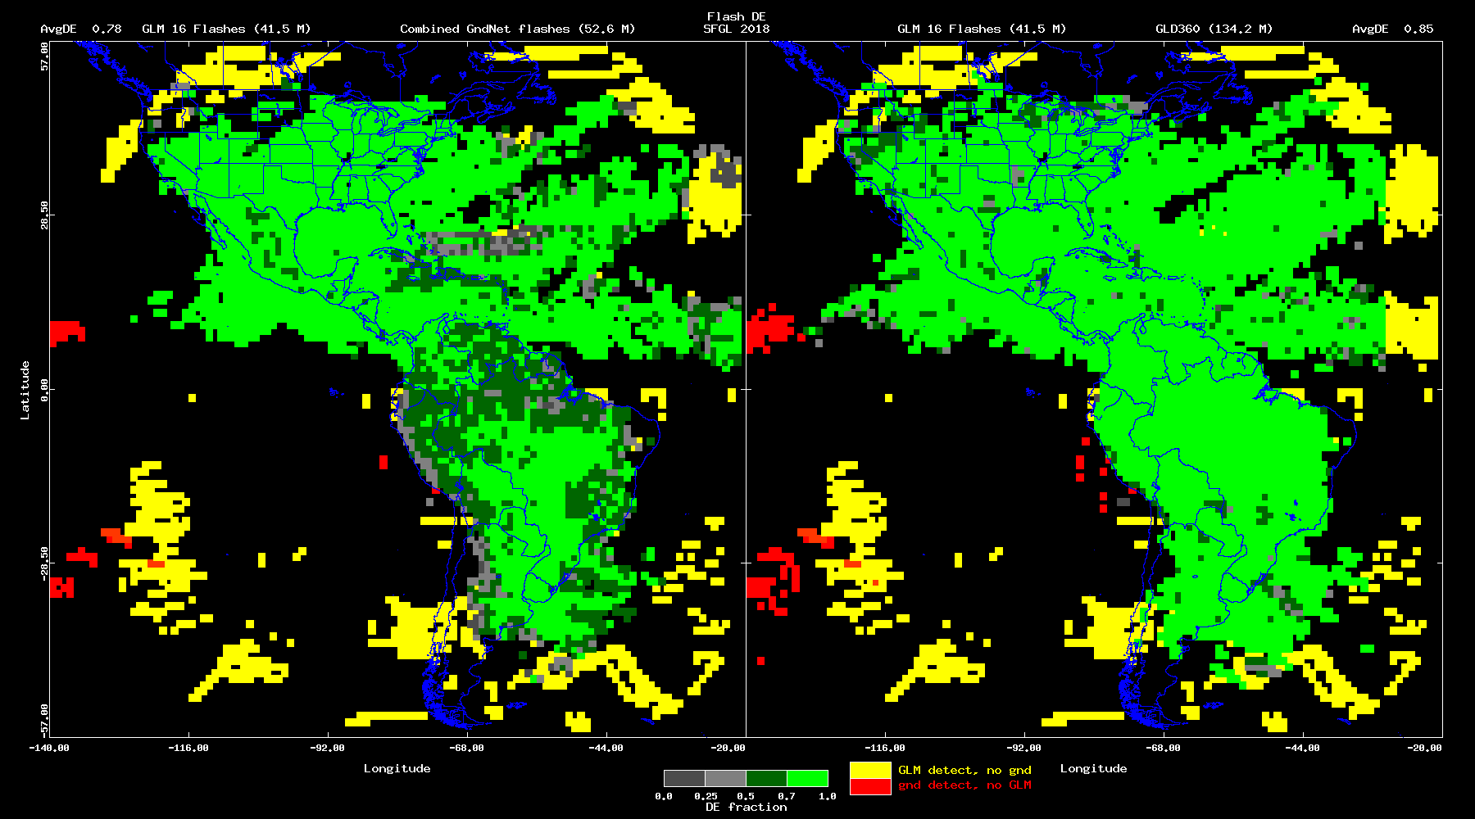
Flash DE
SFGL2 (9/26 – 10/24)
PLPT-GLM-001 (cont.)
GLM16 vs Combined Grnd Networks (0.78)
GLM16 vs GLD360 (0.85)
Point 1
Point 2
Point 3
.
.

Slide 23
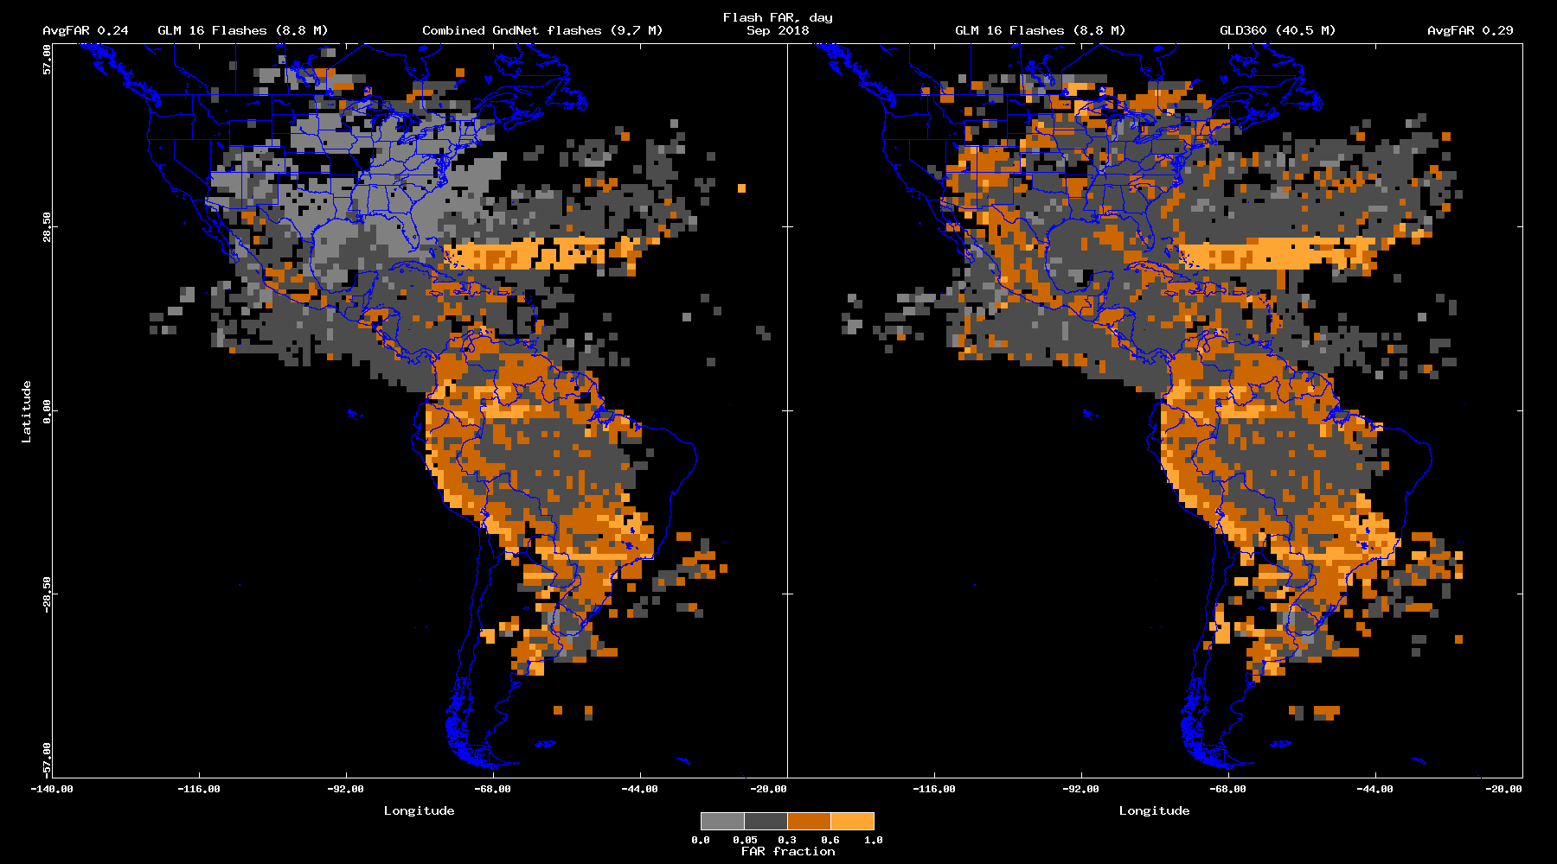
Flash FAR, daytime
Sep 2018
PLPT-GLM-001 (cont.)
GLM16 vs Combined Grnd Networks (0.24)
GLM16 vs GLD360 (0.29)
Point 1
Point 2
Point 3
.
.
CWG believes that larger FAR in S. America linked to reduced DE of ref Grnd Networks there.

Slide 24
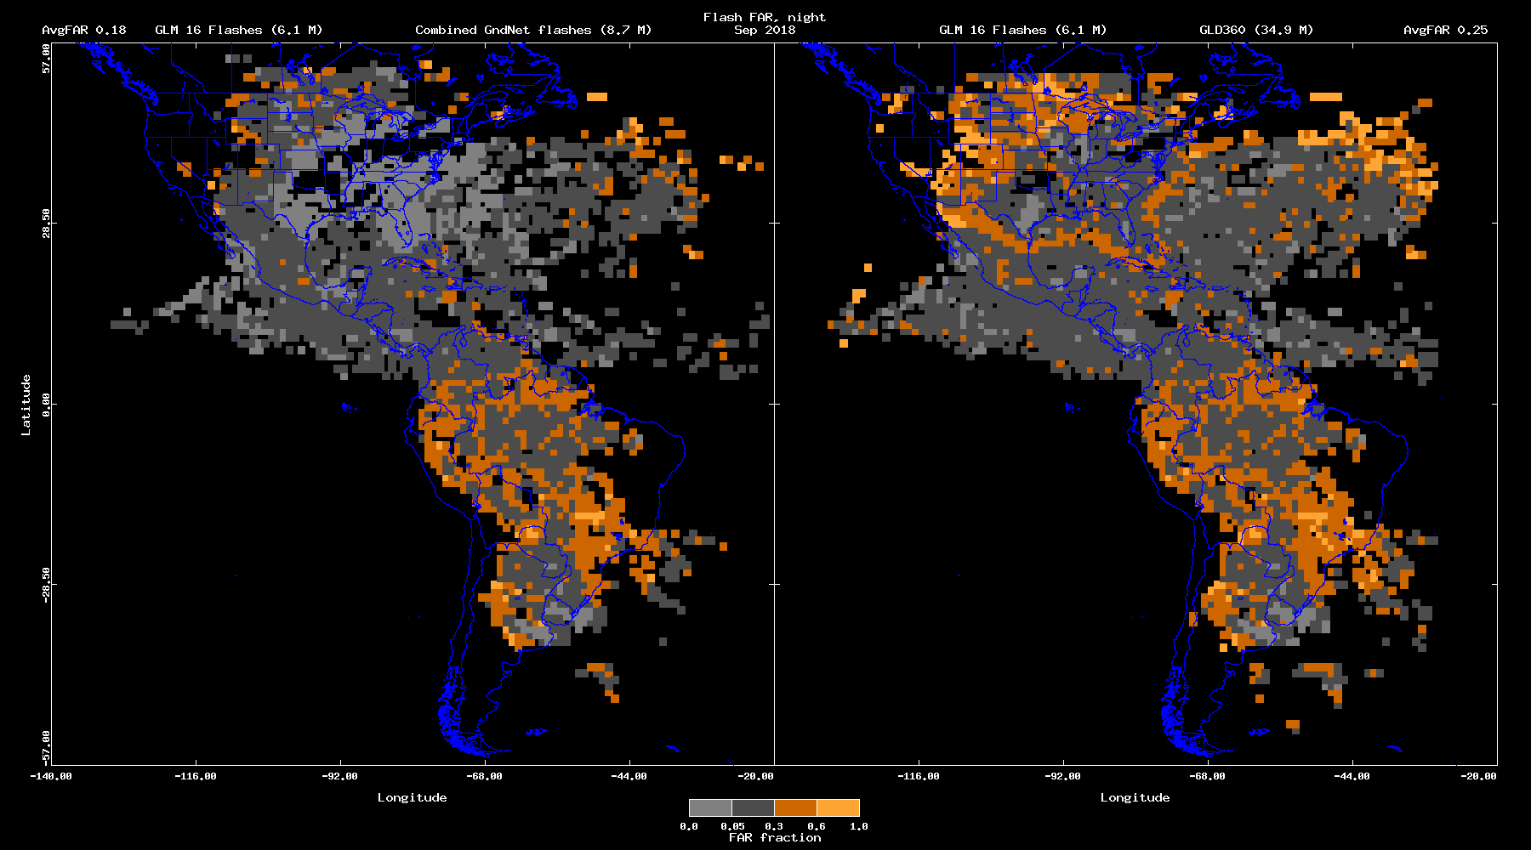
Flash FAR, nighttime
Sep 2018
PLPT-GLM-001 (cont.)
GLM16 vs Combined Grnd Networks (0.18)
GLM16 vs GLD360 (0.25)
Point 1
Point 2
Point 3
.
.
CWG believes that larger FAR in S. America linked to reduced DE of ref Grnd Networks there.

Slide 25
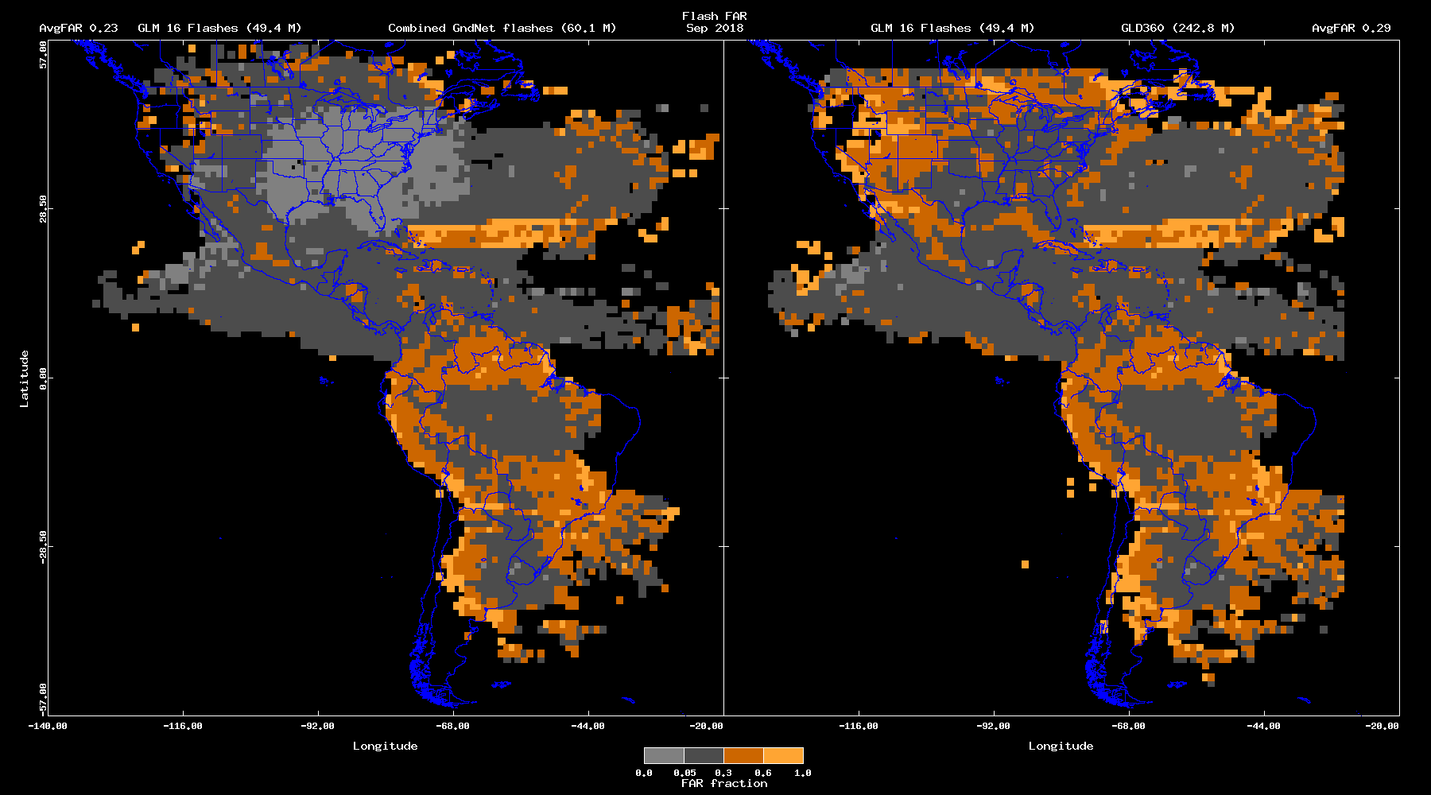
Flash FAR
Sep 2018
PLPT-GLM-001 (cont.)
GLM16 vs Combined Grnd Networks (0.23)
GLM16 vs GLD360 (0.29)
Point 1
Point 2
Point 3
.
.
CWG believes that larger FAR in S. America linked to reduced DE of ref Grnd Networks there.

Slide 26
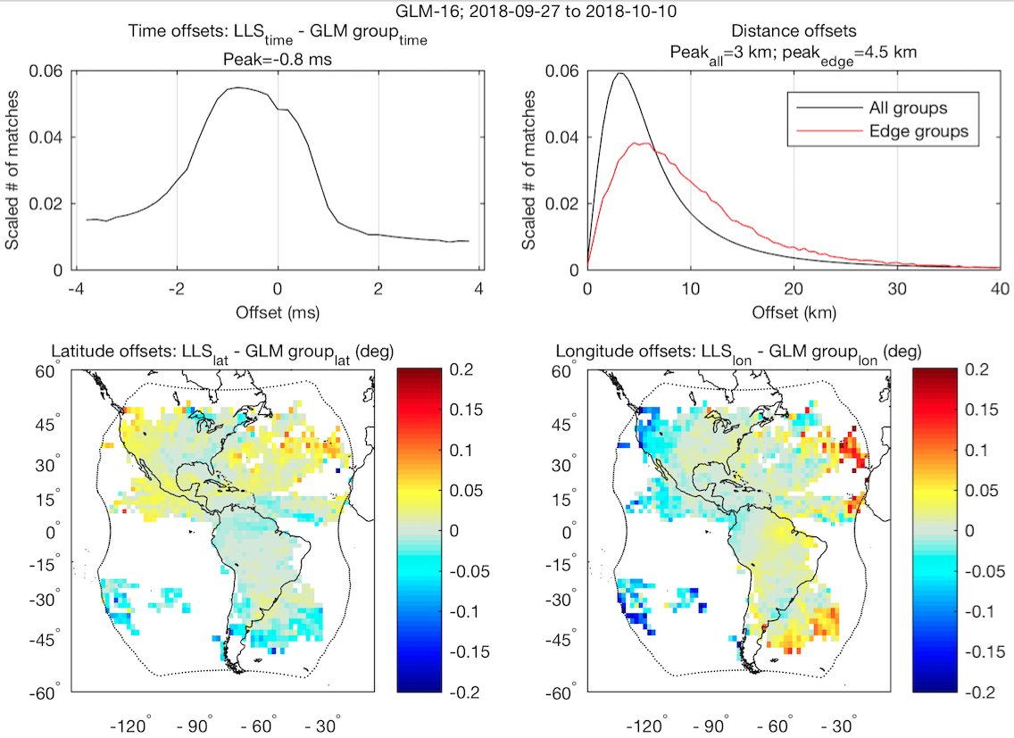
PLPT-GLM-001
Time/Location Accuracy (Virts/NPP)
GLM-16 vs. ENTLN and GLD360
Offsets between GLM and “best” reference match
Sub-ms timing accuracy
Sub-pixel location accuracy over most of domain
~300 million groups, or ~90 million flashes
Black Curve:
mean = 8 km
std. dev. = 7.8 km

Slide 27
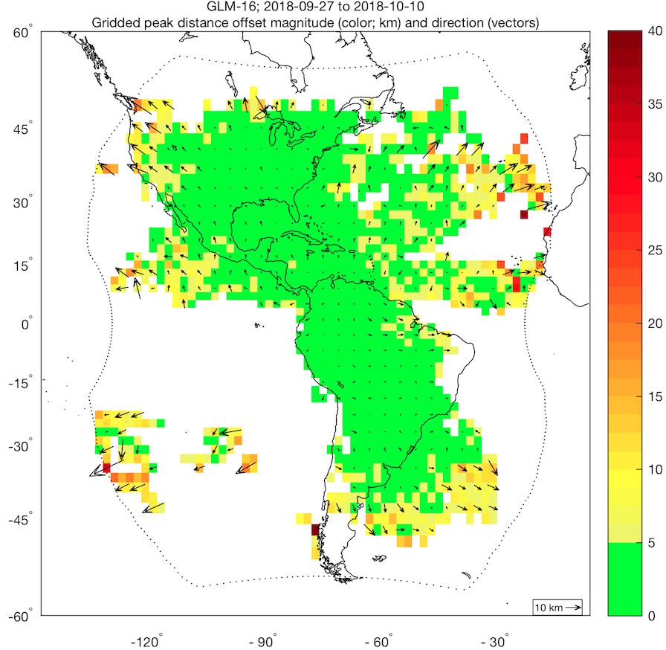
PLPT-GLM-001
Location Accuracy (Virts/NPP)
GLM-16 vs. ENTLN and GLD360
Sub-pixel location accuracy over most of domain
Lower ellipsoid has improved location accuracy near the limb
Groups near limb must still be shifted outward to match reference data
~300 million groups, or ~90 million flashes

Slide 28
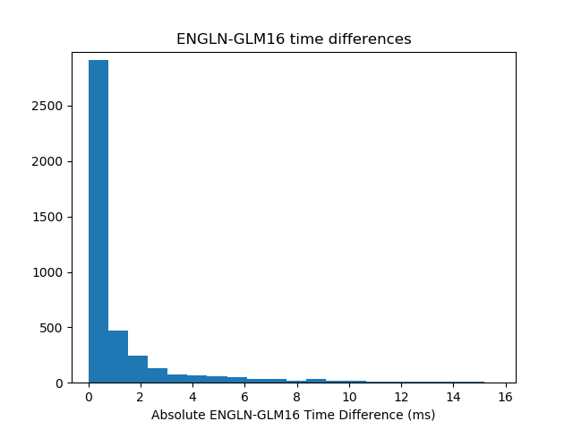
PLPT-GLM-001
Time Accuracy (Lapierre/EarthNetworks)
GLM Data from SFGL2 Dataset was used between 09/26 – 10/10 and 10/13 – 10/16
GLM Data from Operational Dataset was used between 10/16 – 10/24
On 10/11 and 10/12 there was antenna maintenance work
Time difference for most groups
< 1ms

Slide 29
PLPT-GLM-001
Timing Accuracy (McCarthy & Holzworth/Univ WA)
Flash timing looks slightly better.
1 ms shift towards zero for distribution of flash-stoke time differences; distribution is slightly narrower
Distributions of time differences for matching WWLLN stroke/GLM flash times are from 01-31 July, and 26Sep-24Oct

Slide 30
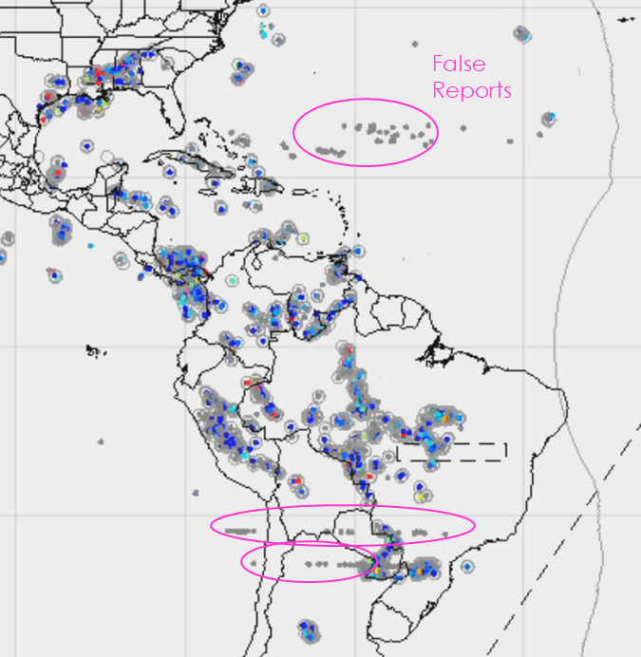
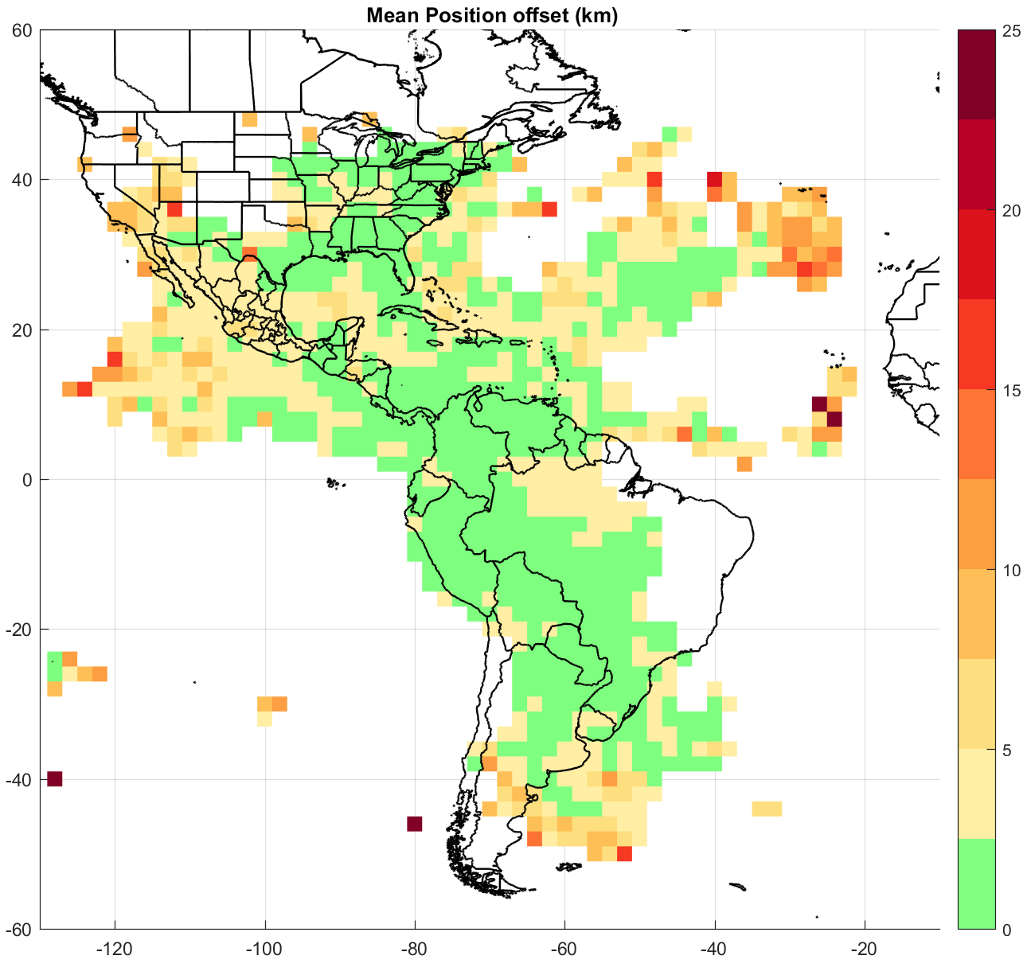
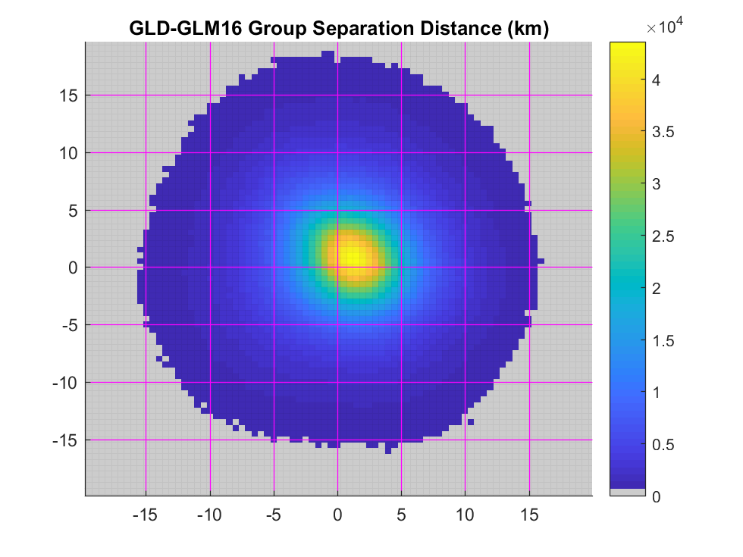
PLPT-GLM-001
DE/Location/Time Accuracy (Cummins/Univ Az)
GLM-16 vs. GLD360
GLM vs. GLD360 (full domain Sep. 26-Oct. 2)
Best Performance to-date
Location difference < 5 km over 2/3 of domain
GLM “Absolute” Flash DE
  7-day average: 76.7%
  Diurnal Variation: 20%
Corrected Time-of-Flight
  Mean offset ~ 200 µs
  Time difference variation ~+/-1 ms
Moderate Concerns:
  False reports in some regions
  Location offsets at lat/lon extremes
  Possible low Flash DE in NW CONUS
Week-average Diurnal Flash DE(Full Domain)
Intermittent False Reports
Group Position Differences (Full Domain)

Slide 31
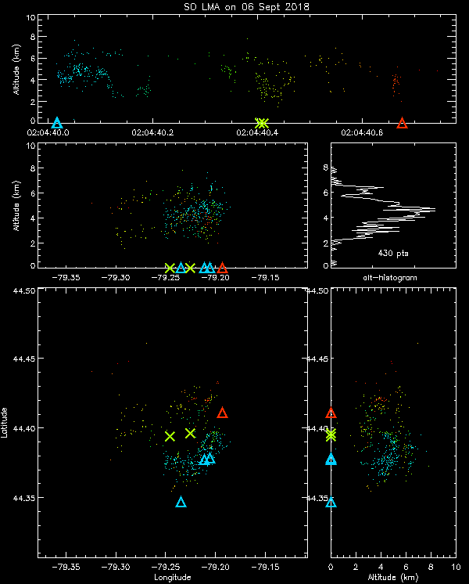
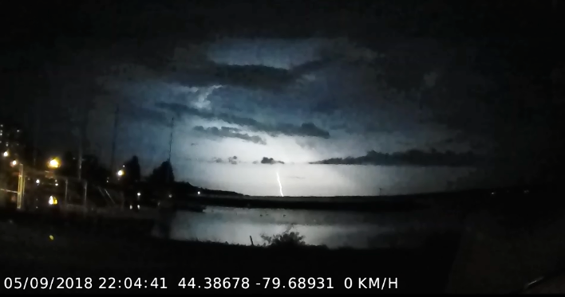
PLPT-GLM-002
6 Sep 2018 N of Toronto (Sills/ECCC)
Nighttime (~10 PM local)
Northern edge of LMA
Low echo top ~9 km
SOLMA: one 0.7s flash
CLDN: six single-stroke flashes (-CG, 5 IC)
GLM: one 0.7s flash,
49 groups, 182 events
DE (in this case): 100%
Time
Vertical
Plan View
Visual CG
Vertical

Slide 32
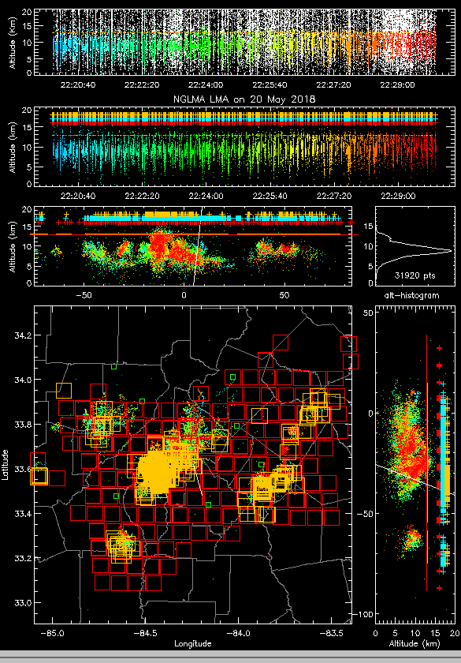
PLPT-GLM-002 (cont)
May 20, 2018 - NGLMA and GLM16 for 22:20-22:30 (Trostel/Ga Tech)
 | GLM16
Flashes | 312
Events | 12,306
Offset-lon (km) | 0.30
Offset-lat (km) | 3.52
DE for lma flashes > 10 pts | 71%
DE for big lma flashes w/≥ 75 pts | 90%
DE for bigger lma flashes w/≥ 200 pts | 97%
DE for medium lma flashes w/11-74 pts | 65%
“pts” = # of VHF sources

Slide 33

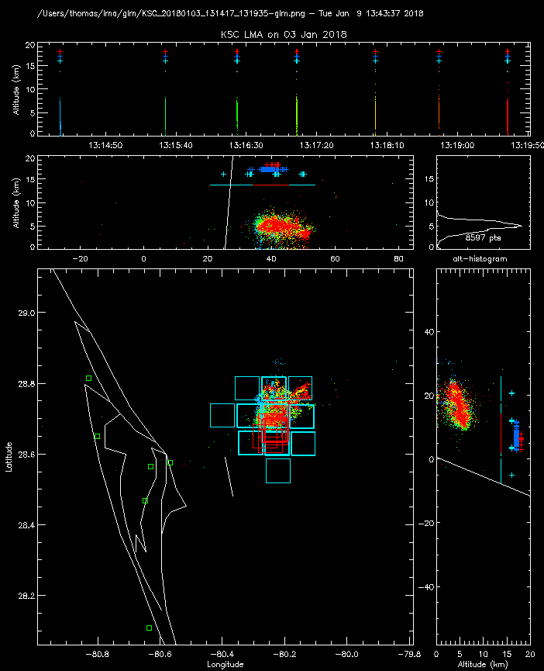
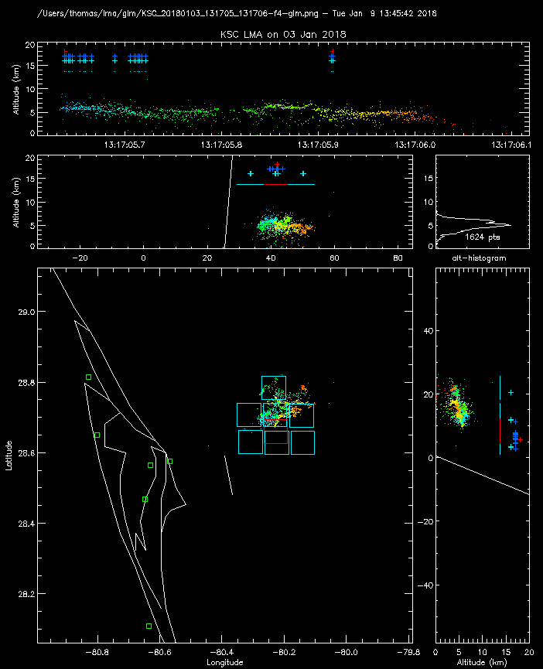
Historical Example of 0% FAR
(PLPT: 002)
KSCLMA
3 January 2018 Small storm 40 km ENE of Kennedy Space Center
GLM detected all 7 flashes (DE=100%)
(7 min time interval)
GLM locates the flashes
7 km to the south due to
parallax & clouds being at
low altitude
GLM correctly grouped events into flashes
First GLM event about
5 ms after LMA start
Single flash
GLM Flash-red
groups-dark blue
events-light blue
Entire Period
(7 flashes)
analyses: Thomas/NMT
33

Slide 34
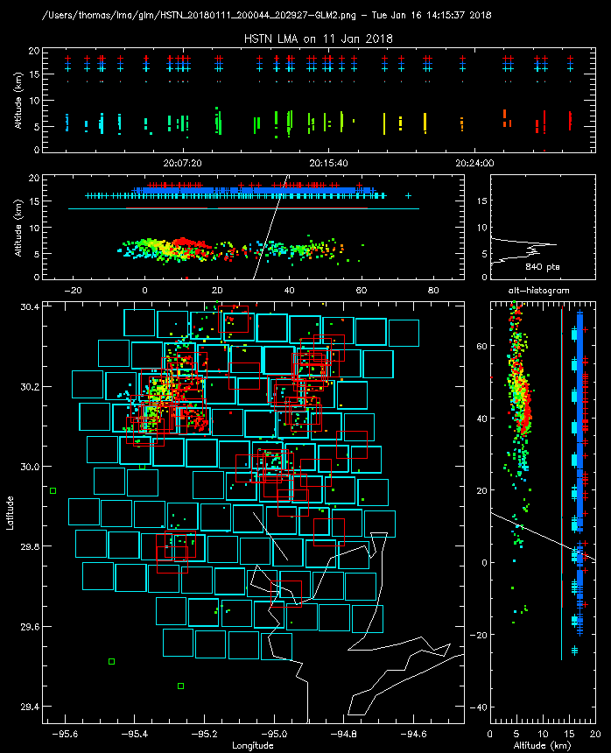
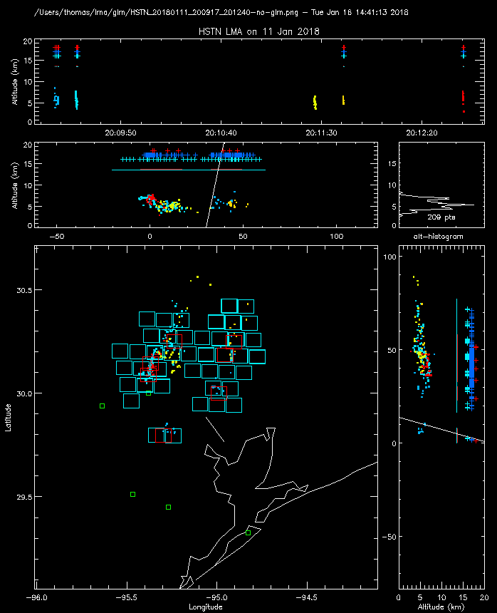
Historical Example of 7% FAR
(PLPT: 002)
HSTLMA
11 January 2018 Small storm over Houston, TX
GLM detected 19 0f 20 flashes (DE=95%) False Alarm rate 7%
(30 min time interval)
GLM locates the flashes 2 km to the south and 3 km to the west due to parallax & clouds being at
low altitude
flash not detected by GLM
GLM Flash-red
groups-dark blue
events-light blue
30 Minutes
20 flashes
analyses: Thomas/NMT
1
34

Slide 35
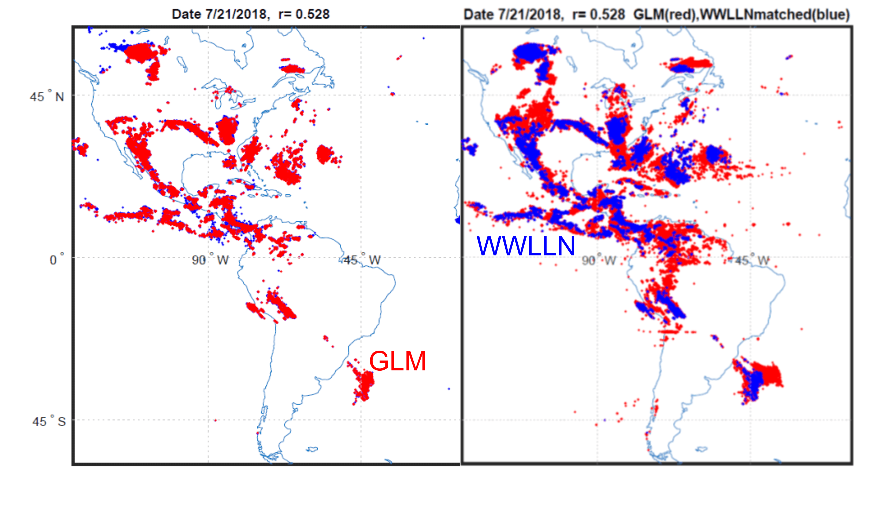
PLPT-GLM-003
WWLLN (Holzworth/UW)
LEFT: ALL WWLLN (blue) over plotted with GLM matches
RIGHT: OPPOSITE: ALL GLM-16 (red) over plotted with WWLLN matches
Total Stroke Counts: 11.8 million WWLLN, 6.8 million GLM

Slide 36
PLPT-GLM-004
FEGS (Quick/UMd*)
-Note: The FEGS detected over 10,000 flashes
(* formerly UAH)

Slide 37
PLPT-GLM-004 (cont)
FEGS (Quick/UMd*)
(*formerly UAH)
The 62% DE includes very dim pulses (i.e., below nominal flash energies)

Slide 38
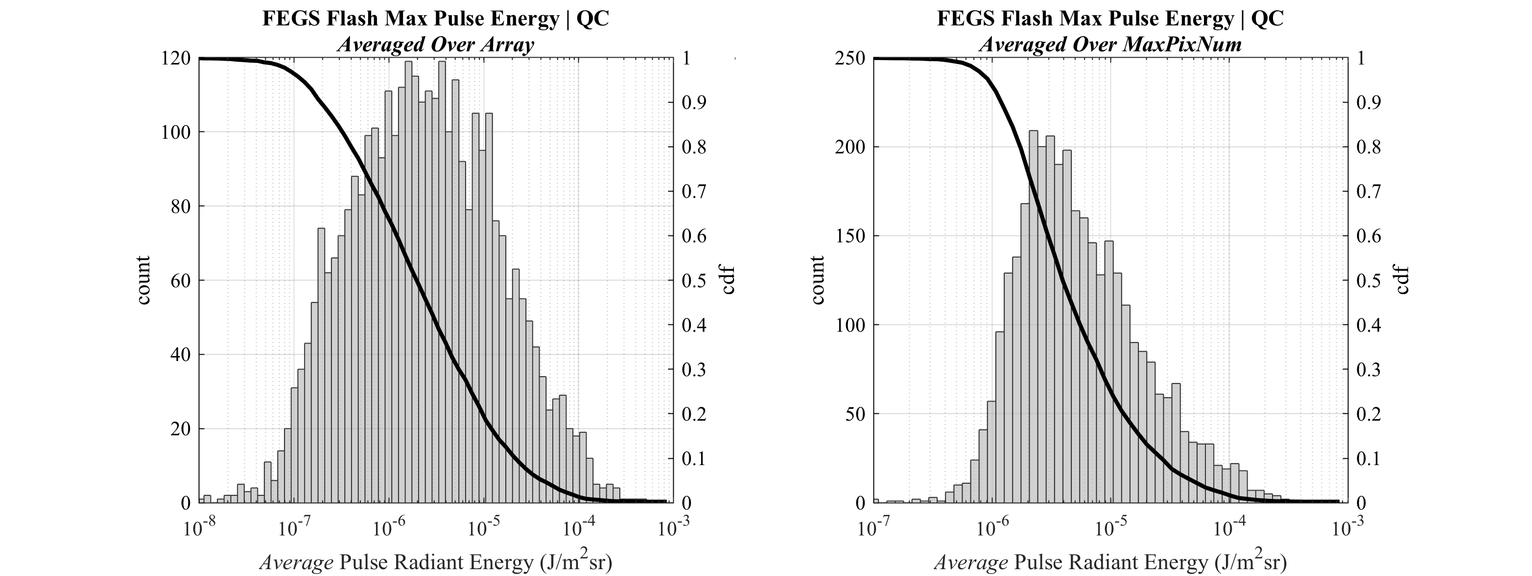
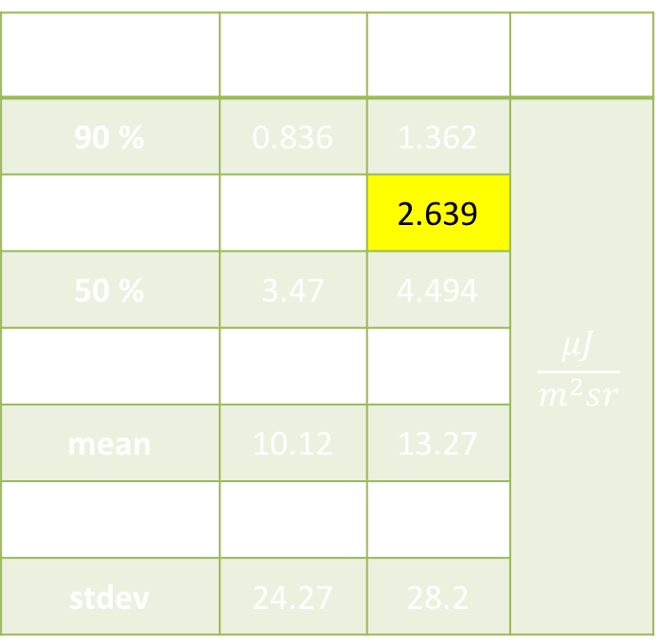
PLPT-GLM-004 (cont)
FEGS (Quick/UMd*)
Stat | All (11472) | QC’ed (3377) | Units
90 % | 0.836 | 1.362 | $$\frac{μJ}{m^{2}sr}$$
70 % | 1.87 | 2.639
50 % | 3.47 | 4.494
maximum | 877 | 519
mean | 10.12 | 13.27
median | 3.29 | 4.577
stdev | 24.27 | 28.2
(*formerly UAH)

Slide 39
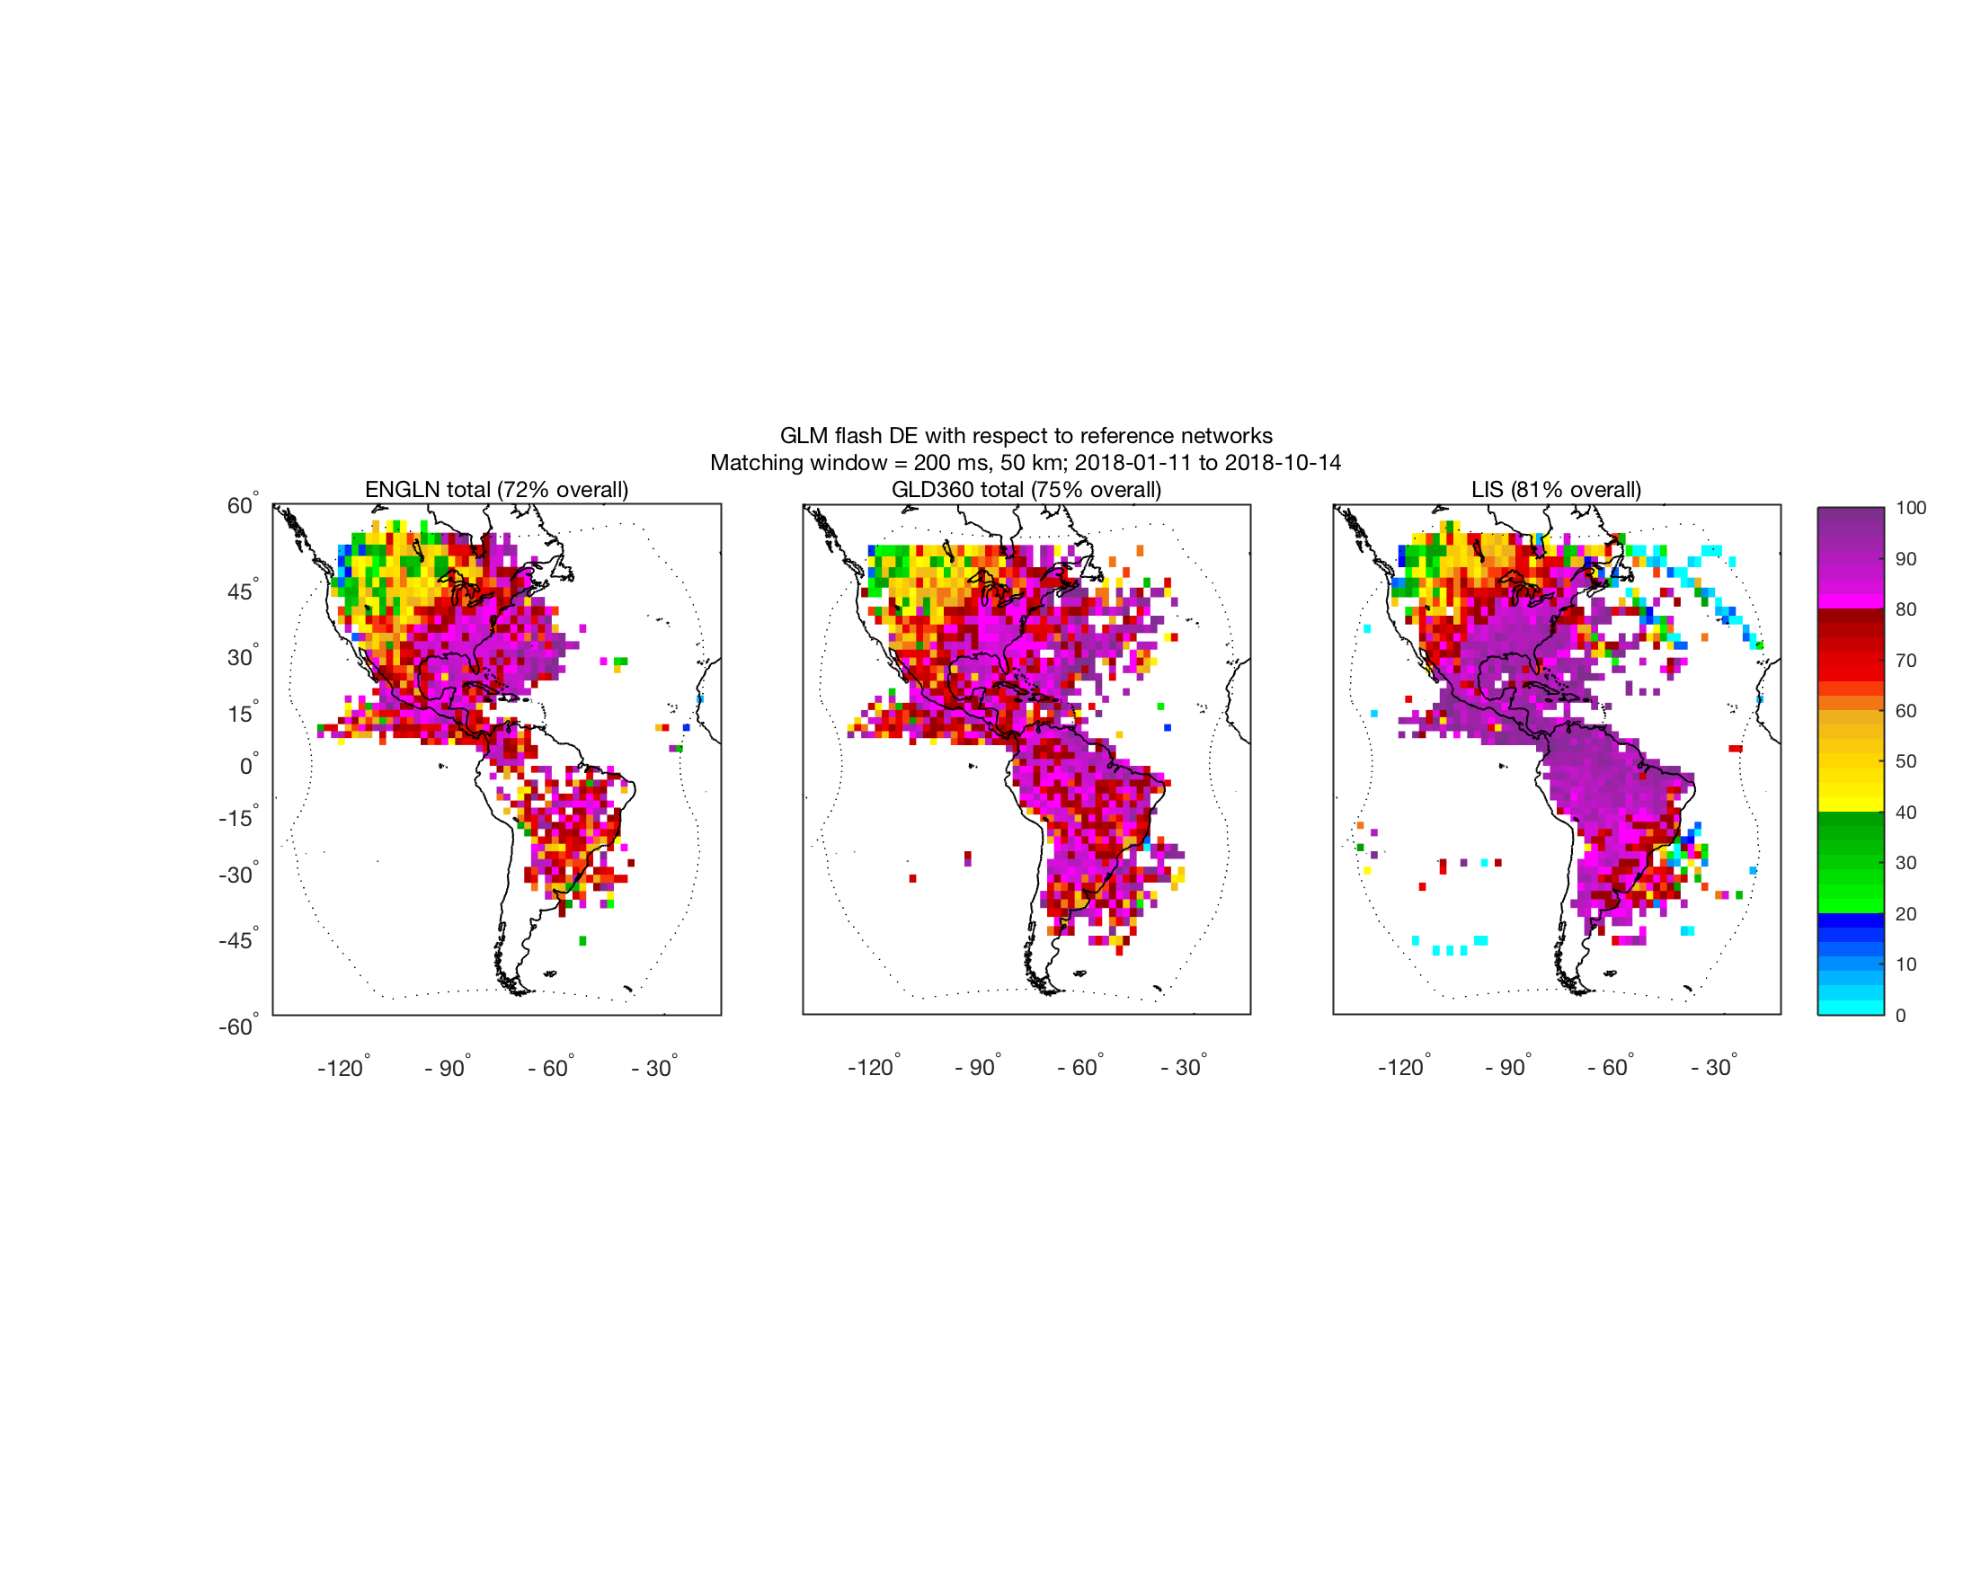
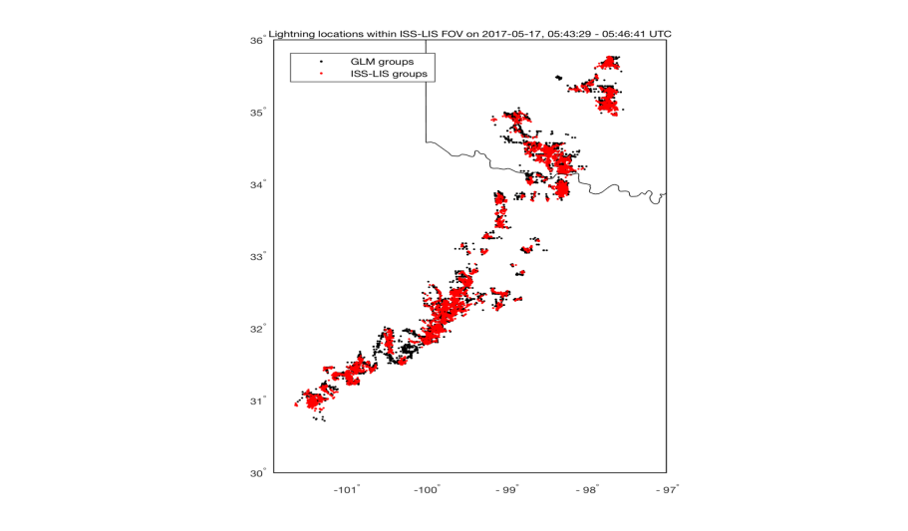
PLPT-GLM-005
GLM Flash DE & Location w/ref ISS/LIS (Virts/NPP)
Full analysis (of which this is a part) ~188,000 flashes
Full analysis included ~250,000 flashes

Slide 40
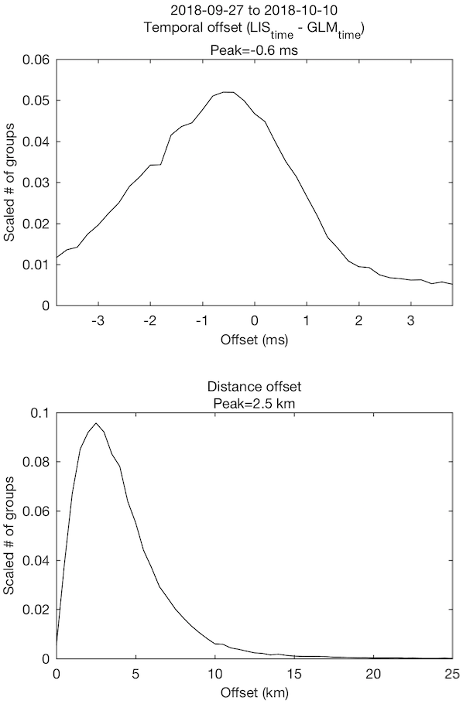
PLPT-GLM-005
Time/Location Accuracy (Virts/NPP)
GLM-16 vs. ISS/LIS
Comparison with group data from independent space-based optical sensor
Sub-ms timing accuracy
Peak distance errors < 3 km
~75,000 groups, or ~25,000 flashes

Slide 41
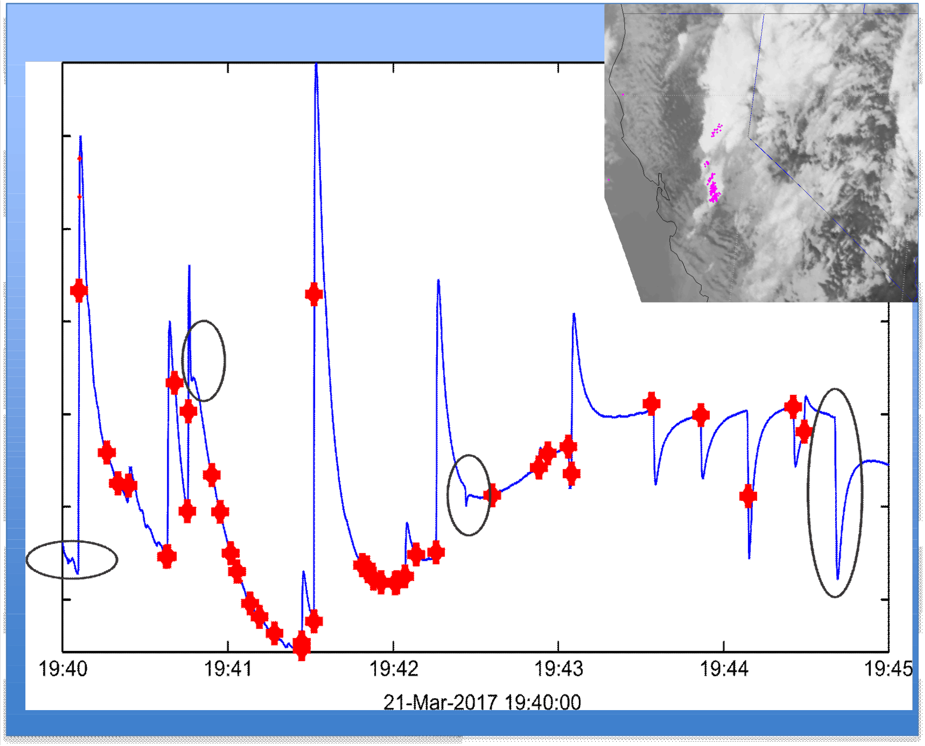
PLPT-GLM-006
LIP (Mach/USRA)
21-March-2017
Out of the 47 flashes seen by the LIP (discontinuities in the electric field), 42 were detected by GLM (red crosses)
89% DE
Many more similar results

Slide 42
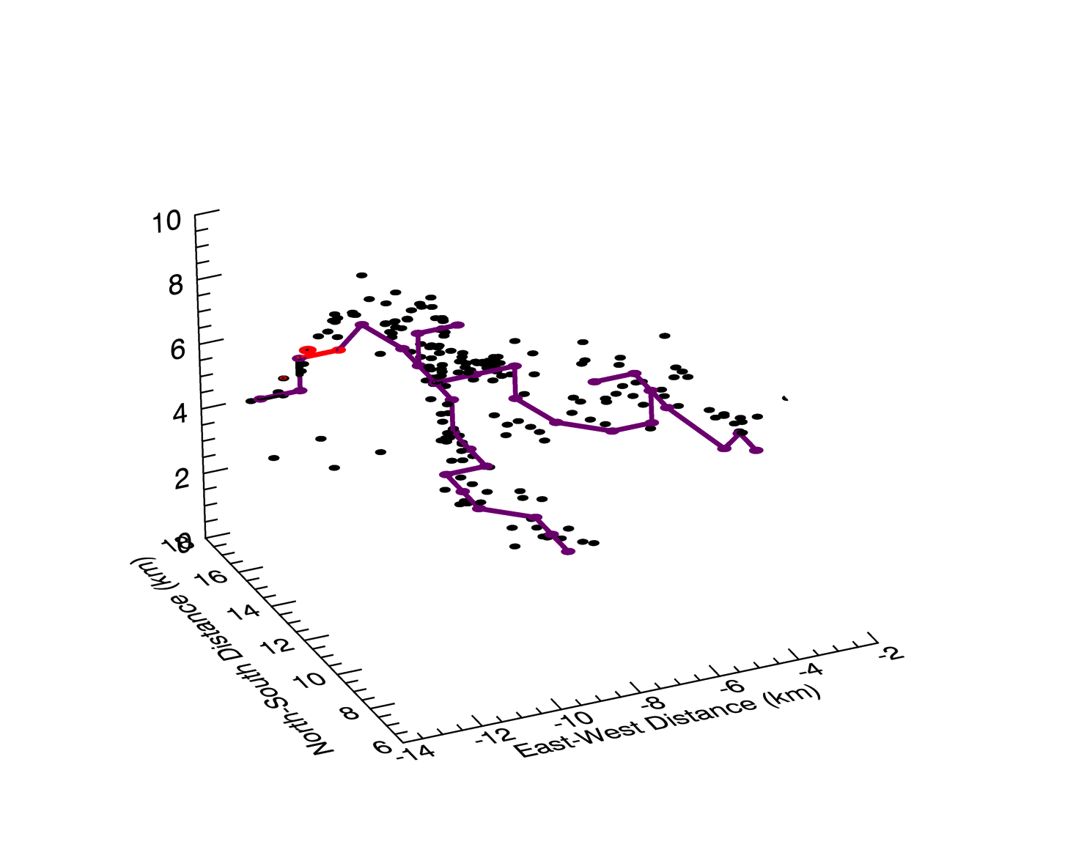
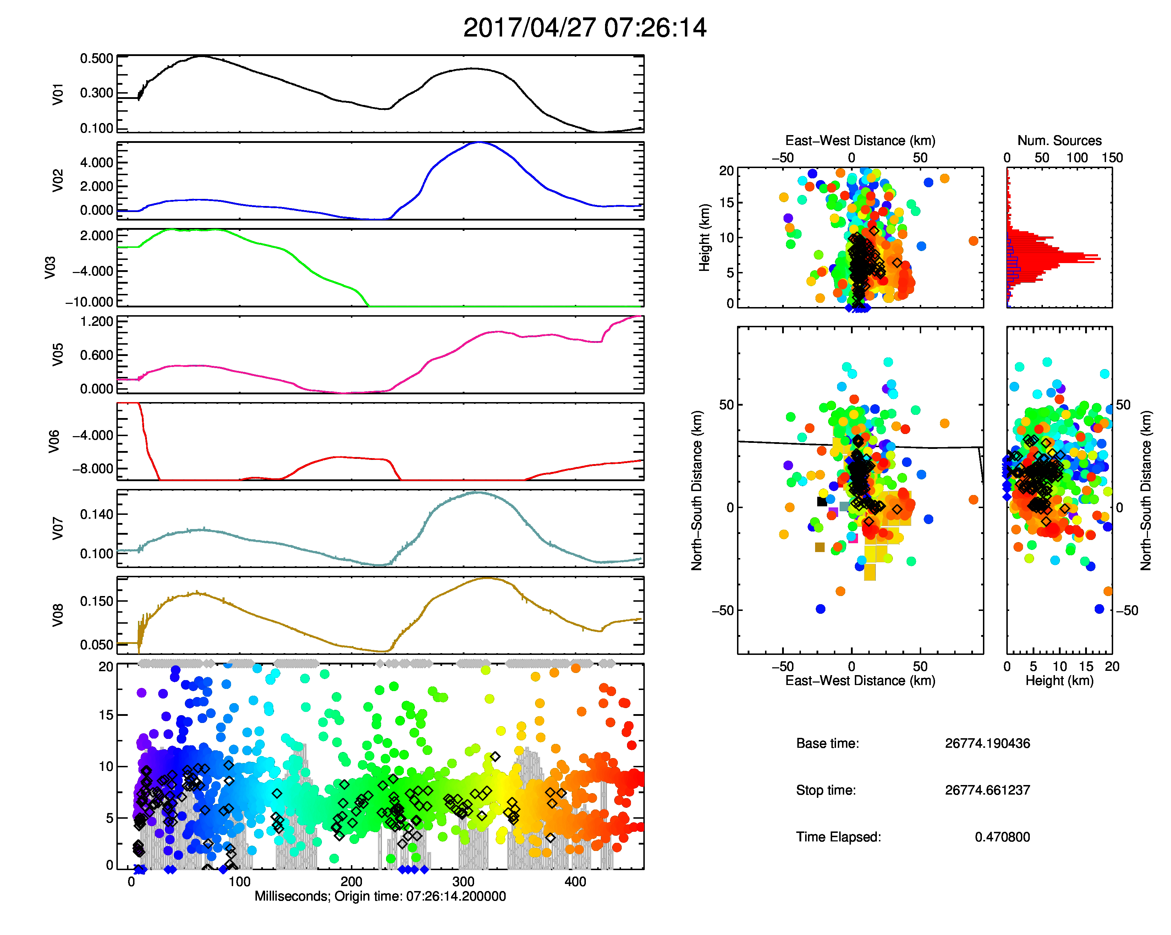
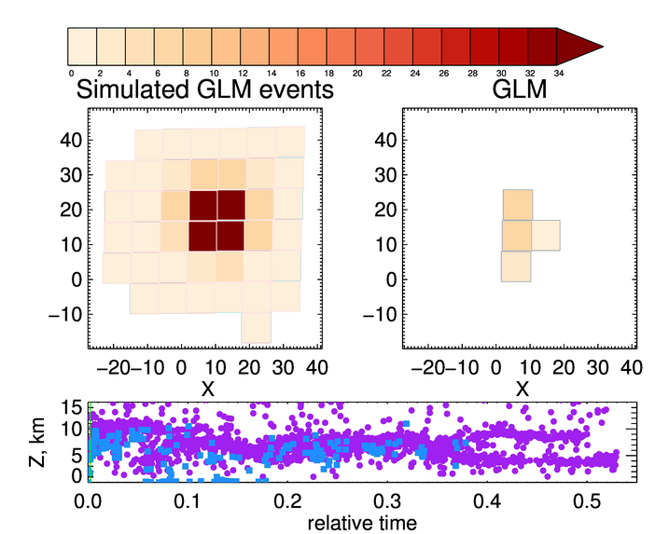
PLPT-GLM-006
HAMMA (Brunner & Bitzer, UAH)
LMA
HAMMA
HAMMA/LMA being used to better understand GLM DE:
  LMA sources combined, gridded, & connected channels are formed.
  HAMMA E-field data used to estimate source photon strength
  Photons spread over frame-relevant channel segments
  Monte Carlo forward radiative transfer performed
  Photons gridded at cloud-top to simulate GLM events
  Simulation compared to real GLM data

Slide 43
PLPT-GLM-009
LCFA (Mach/USRA)
For the vast majority of flashes (which we have analyzed well over a million), the operational Lightning Cluster Filter Algorithm (LCFA) is working correctly
  There are still a few minor issues (which are being addressed with WR’s and ADR’s, listed elsewhere)
The first “filter” of the LCFA is working well (eliminating all single group flashes)
  There is a WR/ADR to improve the filter (current version is a “bit” too aggressive)
  “Remove all 1 event flashes”

Slide 44
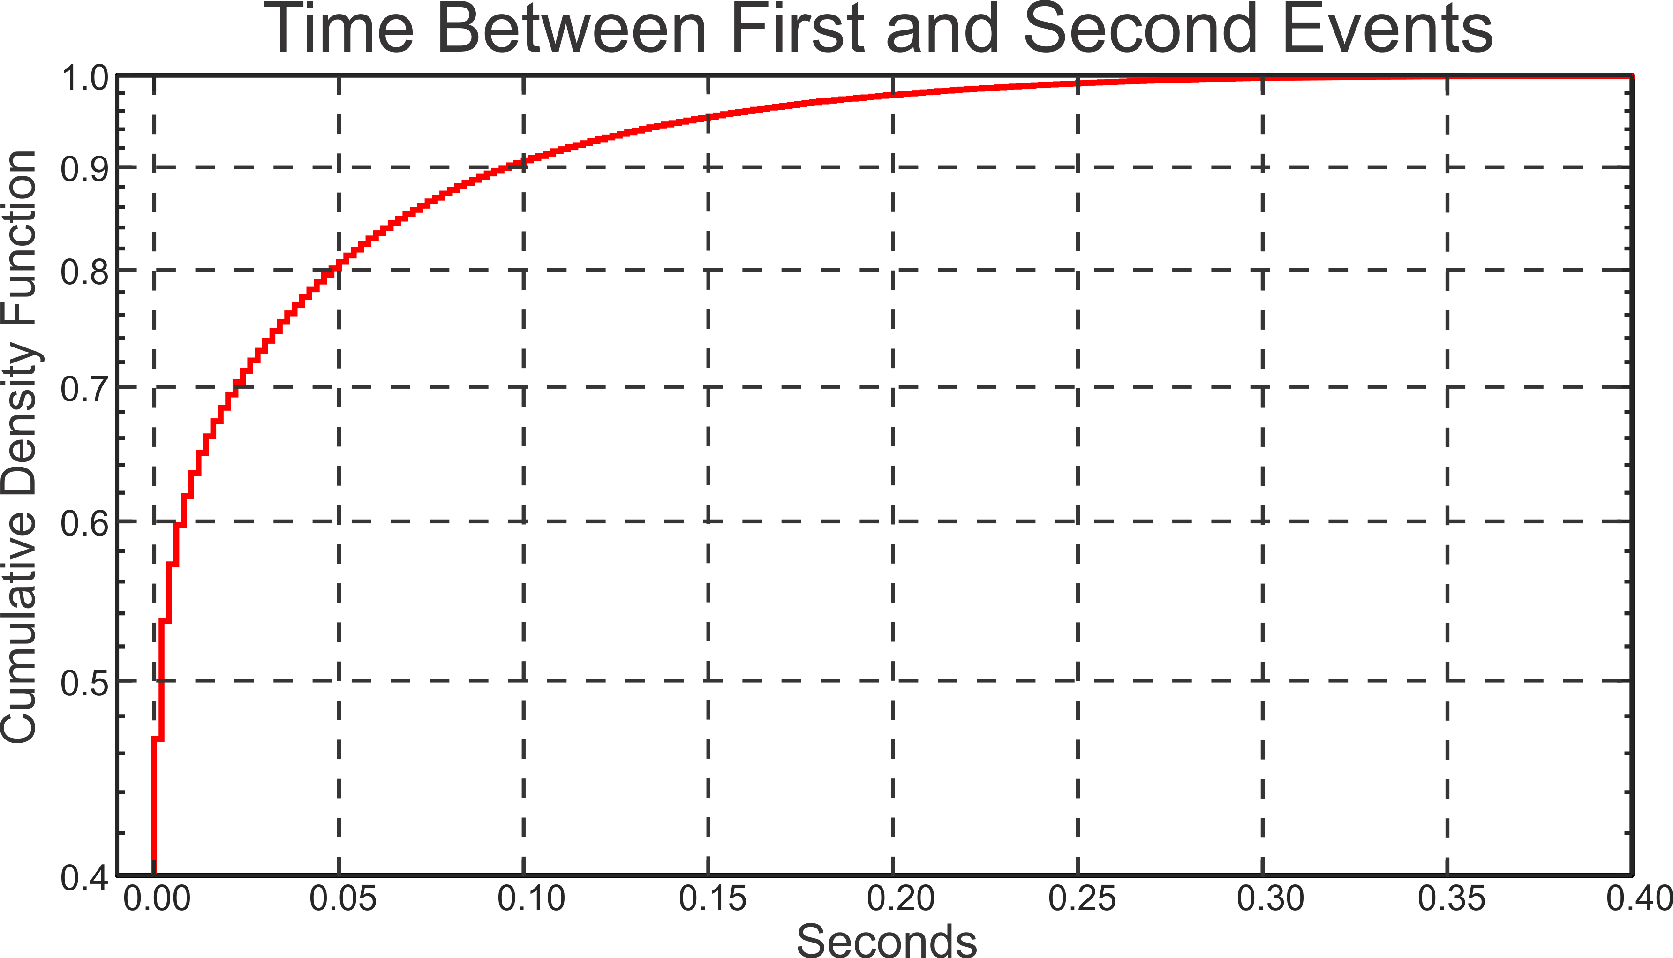
PLPT-GLM-010
L0-L1b Code (Mach/USRA)
Overall, the code is working pursuant to specification
  Again, a few minor issues are being addressed by WR’s and ADR’s
  improvements beyond spec still possible
The loss of the first pulse (coherency algorithm) does not make a major impact on the timing of GLM flashes (see figure)
  The mean time change for the flash is 30 ms
  The median time change is 4 ms
  The start time of 47% of GLM flashes would change by less than 2 ms
  Dataset: ~200,000 flashes

Slide 45
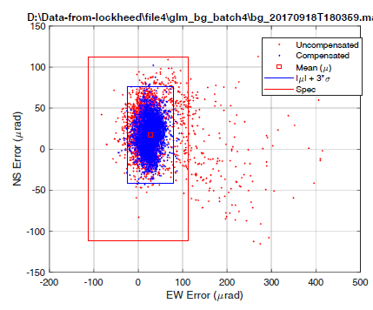
PLPT-GLM-011
INR (Flight and GS Projects)
Carr Astronautics/Harris/LMATC show GLM meets PORD-level event navigation requirement (upper-right)
  Navigated GLM background images compared to ABI Band 3 images, compensated for cloud motion
  PORD 094 requirement (|μ+3σ| < 112 μrad = 4 km)
  More rigorous than MRD 1259 requirement (|μ+3σ| < 140 μrad
  = 5 km)
  82 μrad(5km/140 urad) = 2.9 km
Excellent overlap of GS flashes to flashes generated by offline LMATC-GPA-LCFA output (lower-right)
  Offset = 19.5 μrad = 0.7 km
~ 82 𝛍rad

Slide 46
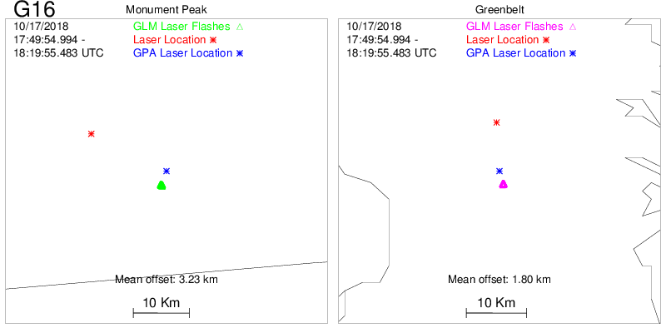
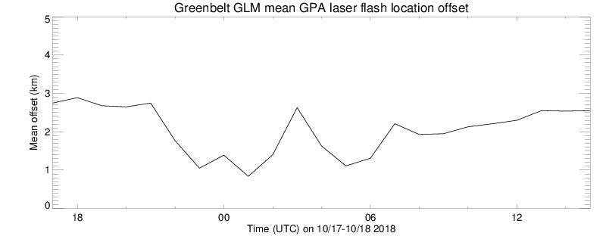
PLPT-GLM-011
Laser Beacon INR (Buechler/UAH)
GOES-16 24 Hour Test
17-18 Oct 2018
  Can be used to help meet the MRD 5 km pointing requirement
Lower Plot Shows Laser Beacon Locations in GLM data (30-Nov-2017)

Slide 47
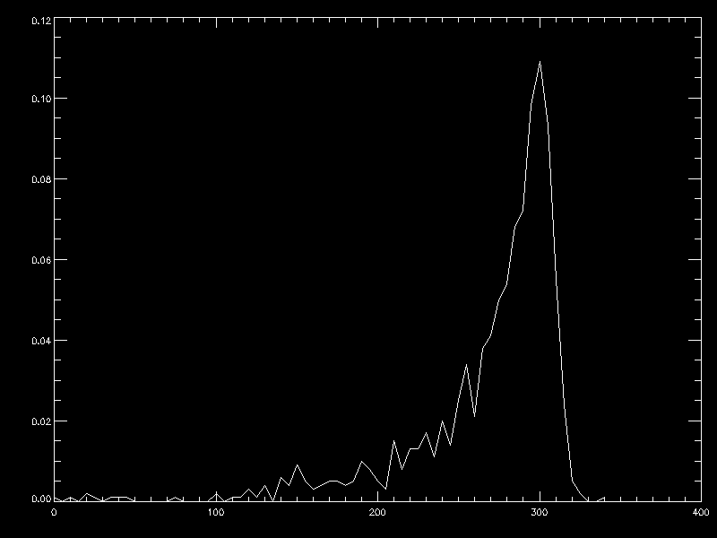
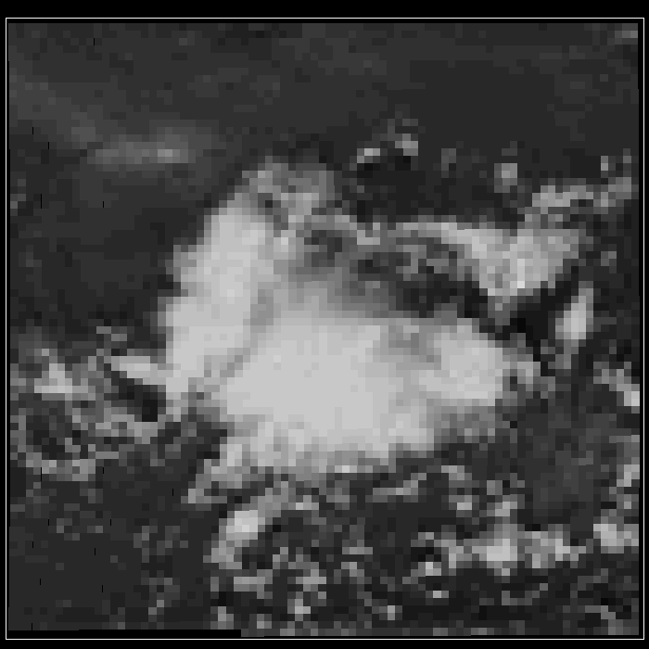
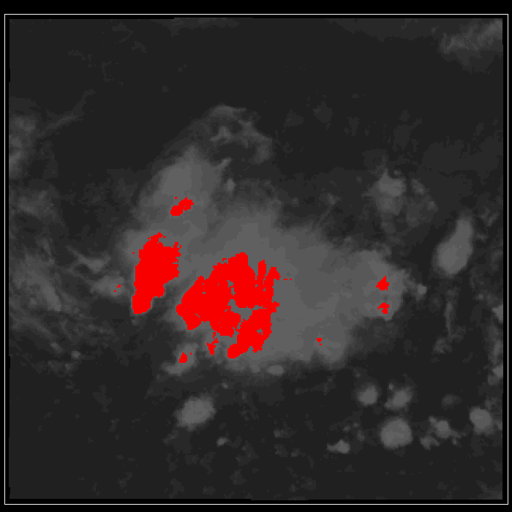
PLPT-GLM-012
GLM BG DCC Radiances (Buechler/UAH)
Values are
~ 300 W/m2/sr/um
Values are lower than expected compared to LIS
Technique established for trending long-term
L1b cal BG product is very useful
ABI IR 11 μm
GLM BG
Frequency
DCC Radiance (W/m2/sr/um)

Slide 48
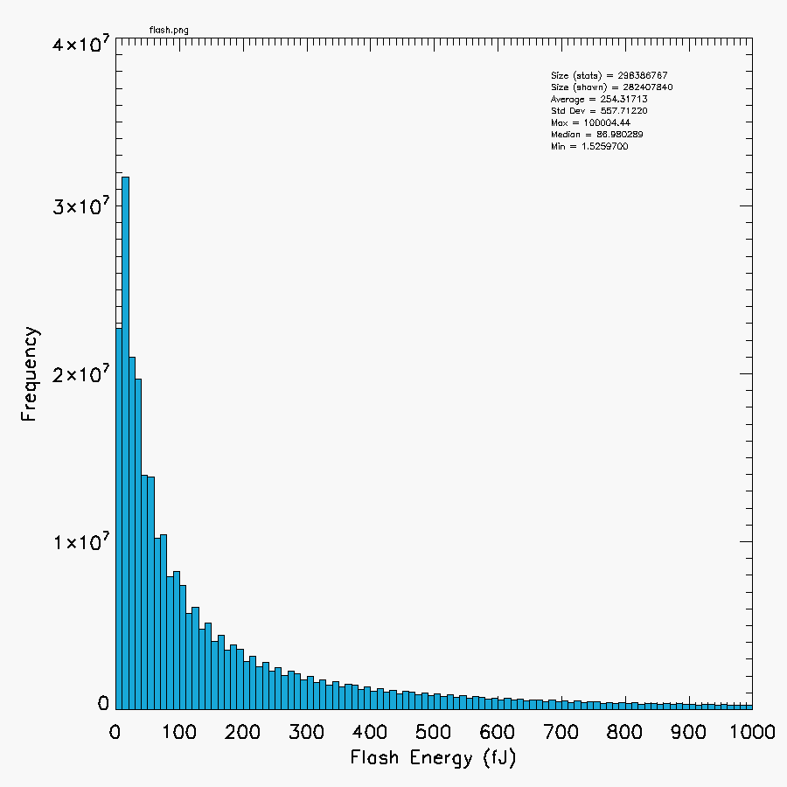
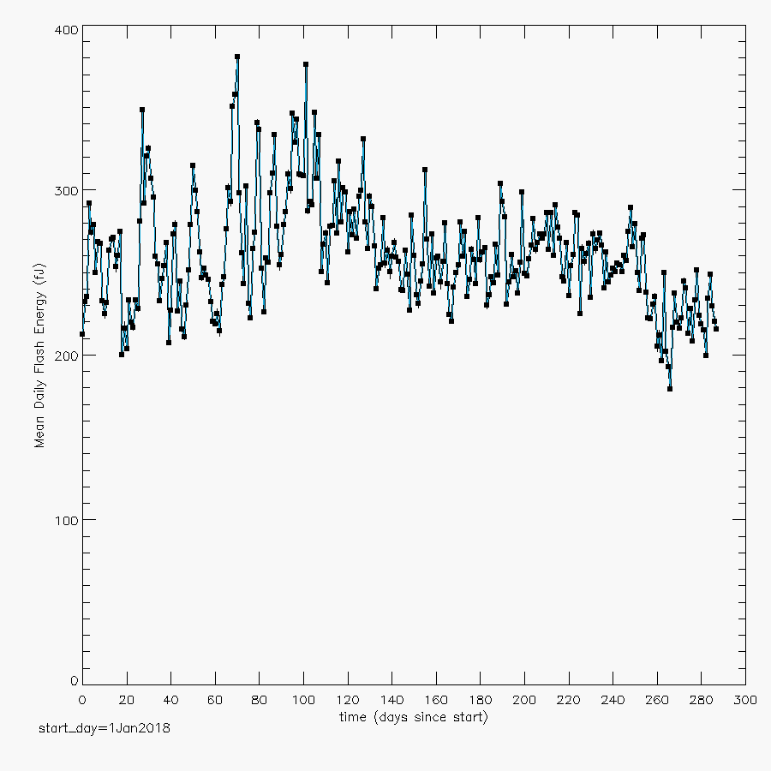
PLPT-GLM-013
Flash Energy Trending: TT/Lightning (Koshak/MSFC)
Analysis Period:
2018: Jan 1 – Oct 15
(9.5 months)
Almost 300 M flashes
removed flashes with flash_quality_flag ⧧ 0 to help remove high-bias from blooming/glint
Mean of 254.3 f J well in range of expectation based on heritage LIS obs.
Size = 298,386,767
Mean = 254.3 fJ
Std. Dev. = 557.7 fJ
Max = 100,004.4 fJ
Median = 87.0 fJ
Min = 1.5 fJ
Flash Energy
Freq. Dist.
400
300
f J
200
100
Mean Daily Flash Energy TREND
0
48

Slide 49
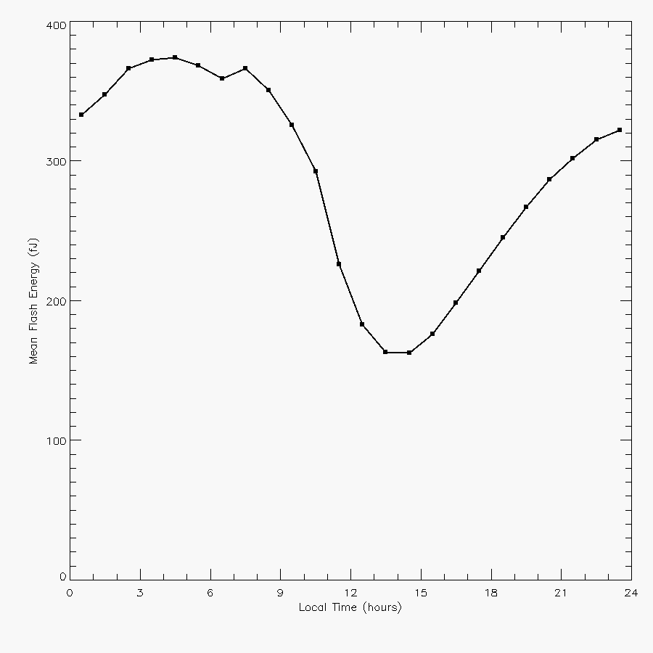
PLPT-GLM-013 (cont)
Flash Energy: TT/Lightning (Koshak/MSFC)
Diurnal Variation of Flash Energy
From Same Analysis:
2018: Jan 1 – Oct 15
(9.5 months, 300 M flashes)
Qualitatively similar to LIS radiance (Chronis & Koshak, BAMS 2017).
Investigation of causes of pattern is ongoing. Some factors:
  day/night detection
  flash rate v. flash strength
  storm type
  etc.
local
noon
49

Slide 50
Outline
Introduction
Performance Summary
PLPT Review
Field Campaign Overview
Progress Since Provisional Review
Assessment of Maturity
Summary and Recommendations

Slide 51
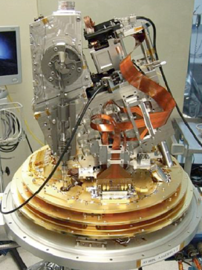
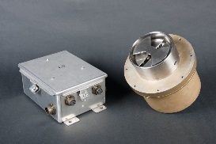
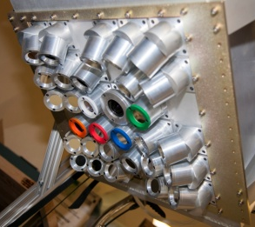
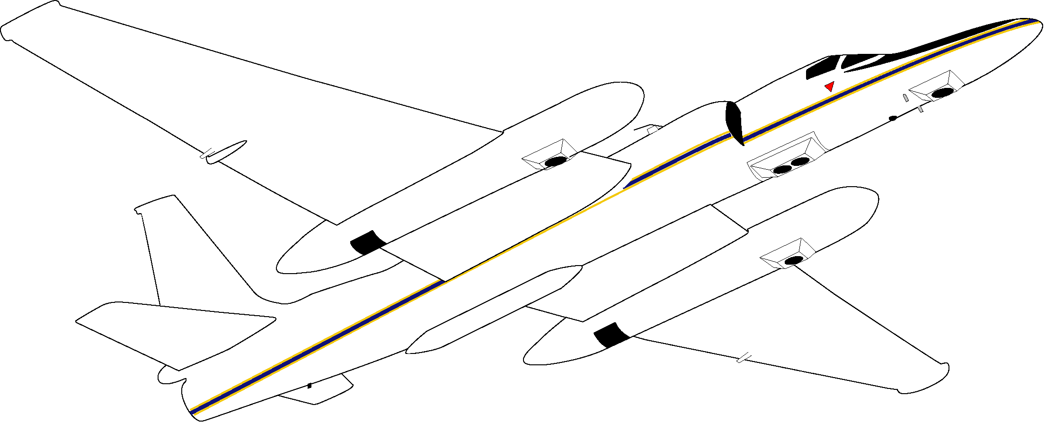
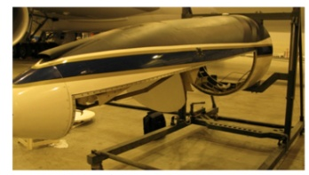




Field Campaign
Aircraft Instrumentation
AVIRIS-NG
LIP
FEGS
LIP
INMARSAT
EXRAD
CRS
S-HIS
GCAS
CPL
LIP

Slide 52

GLM Field Campaign
(March 21 – May 17, 2017)
GOES-R ABI & GLM Field Campaign Great Success! … Much Lightning!
13
8
3
6
4
9
11
7
1
2
16
14
12
15
Slide courtesy of Frank Padula
5
*Flight #10 - April 27, 2017 - Huntsville, AL not shown due to aircraft navigation not reporting

Slide 53

GLM Field Campaign
(March 21 – May 17, 2017)
Example data plots from storm overflights
Not noise, just VERY high lightning rates
Thousands and thousands of flashes (still have not counted them all)

Slide 54
Field Campaign
GLM Data Collection Matrix
 | GLM Collection Matrix [hours of lightning observed]
Location | Day Operations (Total: 21 hrs) ~53 % of total lightning obs |  |  |  | Night Operations (Total: 15 hrs) ~38 % of total lightning obs |  |  |  | Twilight Operations (Total: 3.5 hrs) ~9 % of total lightning obs
 | Compact | Horizontally Extensive | Flash Rate Low | Flash Rate High | Compact | Horizontally Extensive | Flash Rate Low | Flash Rate High | Compact | Horizontally Extensive | Flash Rate Low | Flash Rate High
Northern, AL | 4.5 |  | 1 | 3.5 |  | 2.5 | 2.5 |  | 1.5 |  |  | 1.5
Norman, OK |  | 0.5 |  | 0.5 | 0.5 | 8.5 | 1 | 8 |  | 1 | 0.5 | 0.5
Lubbock, TX |  |  |  |  |  | 0.5 |  | 0.5
KSC, FL | 1 |  | 1
Ft. Collins, CO | 2 | 0.5 |  | 2.5 |  |  |  |  |  | 0.5 |  | 0.5
Atlanta, GA | 1 |  | 1
Toronto, Ca. |  |  |  |  |  | 3 | 1.5 | 1.5 |  | 0.5 |  | 0.5
Land | 1.5 | 4.5 | 3 | 3
Ocean | 3.5 | 2 | 5.5
ISS Overpasses over Lightning: 3 cases (2 daytime and 1 night)
Slide courtesy of Frank Padula

Slide 55
GLM Field Campaign Key Results
No wasted/failed flights!
FEGS provided detailed GLM DE as function of pulse amplitude
Over 10,000 FEGS flashes obtained with coincident E-field
Several critical FEGS overflights of LMA systems, resulting in rich inter-comparison datasets that will literally take years to analyze
Very robust collection matrix, with multiple storm types, across the diurnal cycle
  First overpass of TLMA coverage area
  California tornadic storm overflight

Slide 56
Outline
Introduction
Performance Summary
PLPT Review
Field Campaign Overview
Progress Since Provisional Review
Assessment of Maturity
Summary and Recommendations

Slide 57
Progress Since Provisional Review
False Alarm Mitigation
Understanding Depleted DE in CONUS NW
Summary ADRs/WRs & Maturity Status
Additional Details on Data Quality

Slide 58
False Event Rate
2018-01-11 07:00 -10:00 UTC (Armstrong/MIT-LL)
Executed offline GLM GPA event filters on solar glint period with (yellow) and without (orange) blooming filter for three-hour period
Without blooming filter, the number of false lightning events is the difference between the OFF and ON cases
  False event rate (w/o BlmgF) = Lightning Events (OFF –ON)/Lightning Events(OFF)
FER = 74 %
Treating all lightning events outside of 3-hr glint period as true lightning, the 24-hr false event rate
FER(24-Hr) = 25 %
FER correlated as an upper-bound to False Alarm Rate
5% FAR is not met without blooming filter
 | Blooming Filter Status
 | OFF | ON
Lightning Events | 22,440,003 | 5,867,642
False Events | 12,081,709 | 28,654,070
Total Events | 34,521,712 | 34,521,712

Slide 59
GLM FAR Summary & Path Forward
(Armstrong/MIT-LL)
Significant improvement to False Event Rate demonstrated with offline-GPA using the GLM-vendor blooming filter
  FER reduction correlated with an upper-bound to False Alarm Rate reduction
  Reduces data dropouts from solar glint and solar intrusion conditions
Ground Segment scheduled implementation of blooming filter for data operations nominally in April 2019 (DO.08)
  Implementation to occur before Full Validation PS-PVR (GLM-17)
Peer Stakeholder Product Validation Review
  CWG to test GLM data following GS blooming filter implementation for operational false alarm rate

Slide 60
Progress Since Provisional Review
False Alarm Mitigation
Understanding Depleted DE in CONUS NW
Summary ADRs/WRs & Maturity Status
Additional Details on Data Quality

Slide 61

Understanding Depleted DE in NW CONUS
Flash Energy: TT/Lightning (Koshak/MSFC): Spatial Distribution of Flash Energy
From Same Analysis:
  2018: Jan 1 – Oct 15
  (9.5 months, 300 M flashes)
Two Known Effects:
  Nature: Flashes more energetic over ocean than land
  Instrument: More energy needed @ higher boresight angle to detect
Expect: more difficult to detect at large boresight angle over land; i.e. depletion of flash DE in NW CONUS
LIS: should have higher flash DE over NW CONUS than GLM since no large boresight effect with LIS (except locally)

Slide 62
Understanding Depleted DE in NW CONUS
ISS/LIS Flash DE (Virts/NPP)
As expected: ISS/LIS Has Better DE over NW CONUS than GLM
NW CONUS: ISS/LIS 57% compared to 25-50% for GLM
Full analysis included ~250,000 flashes
62

Slide 63
Progress Since Provisional Review
False Alarm Mitigation
Understanding Depleted DE in CONUS NW
Summary ADRs/WRs & Maturity Status
Additional Details on Data Quality

Slide 64
Status at Provisional Maturity
 | Past Performance | Current Status | Future Outlook
DE | Accurate and stable. Multiple updates to RTEP LUTs have optimized sensitivity Acceptable gain, dynamic range, bias, and diurnal stability from beginning. Critical issues: None. | Performance has been good and stable without critical issues. Major remaining issues: Want more assessments over other regions, seasons Flashes from Inverted polarity storms proving difficult to detect but such storms not as common | Good instrument Team expertise Flash splitting is rare, well understood, but needs mitigation with current WR
FAR | Large, and continuous Critical issues: High energy particles causing radiation “dots” L0 data mishandling in GS creating duplicative “dots” Large regions have these noise sources (particularly evident over ocean where little lightning) Blooming | Critical issues have been resolved (see example next slide). Overall performance acceptable. Improvements being tested: “Put back” filter to recapture flashes removed by Single Group Flash (SGF) filter Vendor L0-L1b filter to remove noise Basic Blooming Filter approaches exist, but details still to be clarified | Good Instrument Team expertise. Good understanding of major issues. Want to further improve noise reduction by L2 “put back algorithm” and/or revised L0-L1 filtering (so some algorithm changes desired) Want working Blooming Filter
INR/time | Large and variable location errors Critical issues: proper setting of INR LUTs including lens distortion coeffs Time-of-Flight correction Time (order, scale-factor, offset) settings Time in filename | Critical issues have been resolved. Recent performance is acceptable. Major remaining issues: Time-of-Flight correction still needed in L2 (is implemented in L1b) Time order still an issue | Good Instrument Team expertise. Good understanding of major issues. Corrections are in various stages of implementation in GS.

Slide 65
Progress Since Provisional
(and defining the Full analysis period)
G16 PROV PS-PVR was on 19 Jan 2018
PR.06/07 & DO.06 Fixes Since PROV:
WR | ADR | Title | PRO Release or DO | Date in OE | Impact
5244 | 485 | Metadata contain non-ascii quote marks | PR.06.07.00 | 29 Jan 2018 | other
4948 | 421 | Lightning L2 event time scale_factor is incorrect- PRO Type 1 | DO.06.03.00 | 19 Jun 2018 | time
5399 | - | GLM L1 EFRC service periodically crashes when processing live GRB data | DO.06.03.00 | 19 Jun 2018 | other
5573F | 540 | Metadata change for satellite subpoint | PR.06.16.00 | 07 Aug 2018 | other
5996 | 628 | GLM - Add Parenthetical Information to CALINR LUTs | PR.07.00.01 | 15 Oct 2018 | other
6217 | 728 | Update GOES-16 GLM LUT to CDRL 79 Rev J; swallows ADR637 (Parallax Lite) | PR.07.01.00 | early Nov | DE/FAR/ location
Priority Key | 1 | 2 | 3 | 4 | 5 | 6 | 7
But ADR 728 went into DE on Sept 25
So Selected Analyses Period in 2018: Sep 26 – Oct 26
Special DE Portal (Sep 26 – Oct 15); Normal PDA OE feed (Oct 15 – Oct 26)

Slide 66
Progress Since Provisional (cont.)
(WRs for DO.07.00.00; DE: 21 Aug 2018, OE: 15 Oct 2018)
WR | ADR | Title | Impact
3561 | 674 | Update GLM EFRC Algorithm to use updated CALINR format provided by GLM Flight | other
4477 | -- | GLM L2 LCFA product has ‘n/a’ for production_data_source | other
4507 | 338 | Use adjusted event times in Lightning L2+ product (TOF & associated) | time
4696 | 382 | Group and flash areas GLM L2 (Discrepancy 20% between GS & LM) | areas
5545 | 538 | GLM L1b LUT update for East- PRO Release Type 1 | DE/FAR
5525 & 4695 | 376* | [Orphan and childless event and groups in GLM L2] & [Family Links] | family links
Priority Key | 1 | 2 | 3 | 4 | 5 | 6 | 7

Slide 67
Future Fixes
(WRs for DO.08.00.00; DE: ~ April 2019, OE: ~Late June 2019)
WR | ADR | Title | PR Type 2 * | Impacts
5937/4697F | 374 | GLM Blooming Filter | No | FAR
5930 | 615 | Burst of GLM events caused GLM L2+ outage (e.g., EXIS cruciform scans) | Yes | FAR/DE
6097 | 647 | Implement GLM 2nd-level threshold (for optimal threshold adjust) | Yes | DE/FAR
5981F | 648 | GLM GPA Coherency Filter LUT [depends on code implementation of ADR 647] | Yes | DE/FAR
6098 | 649 | Implement updated GLM Data Burst Filter | Yes | FAR/DE
6073 | 638 | GLM glint box updated/fixed | Yes | FAR/DE
4705 (on hold) | 375 | Time Order, GLM L2 | No | time
4758 | 373 | GLM event geolocation does not match vendor results | No | location
5016 | -- | GLM Coastline algorithm falls behind, BG images are missed | TBD | other
5640 | -- | GLM EFRC failing to properly read in L1alpha BG object | TBD | other
6116 | 701 | GLM L2+ LCFA product’s yaw flip flag is fill | TBD | other
Priority Key | 1 | 2 | 3 | 4 | 5 | 6 | 7

Slide 68
Future Fixes (cont.)
(Possibly for DO.08.00.00, or else either earlier or later)
WR | ADR | Title | PR Type 2 * | Impacts
4662F | 461 | GLM Data Quality Product [ADDITIONAL PRODUCT REQUIRES SPSRB APPROVAL] | No | user interpretation
not created | 646 | GLM Gridded Product [ADDITIONAL PRODUCT REQUIRES SPSRB APPROVAL] | No | user interpretation
6460F | 645 | GLM Parallax | No | location
5983F | 650 | GLM GPA INR: Account for diurnal variation [in analysis by Flight, low priority] | TBD | location
5480 | 519 | GLM LCFA lightning radiation filter threshold (regarding SGF) [in analysis] | TBD | DE
5984F | 652 | GLM GPA keep first event in flash [in analysis by Flight, low priority] | TBD | data loss
6465 | 738 | Optical Energy Distortions in PDA Stream (from Michigan bolide analysis) [better energy range estimates being found] | Yes | energetics
not created | 739 | Dark Flashes (flashes with 0 energy, i.e. <1.5fJ) [likely to be merged w/738] | TBD | DE/FAR
6466 | 740 | Duplicate Groups & Events Found in GLM L2 files [in analysis] | TBD | energetics
Priority Key | 1 | 2 | 3 | 4 | 5 | 6 | 7

Slide 69
Status at Full Maturity
 | Past Status | Current Status | Future Outlook
DE | Performance has been good and stable without critical issues. Major remaining issues: Want more assessments over other regions, seasons Flashes from Inverted polarity storms proving difficult to detect but such storms not as common | Performance verified to meet spec (bulk full FOV values obtained). Substantially more validation data accumulated across all seasons. Regional gaps filled. Understanding of CONUS NW depletion improved. Additional examples from inverted polarity & hail storms documented. | G16 was configured with elevated RTEP thresholds (GLM06167 CDRL089 Rev J) to handle “bar” false event artifacts. After DO.08 2nd Lev Thresh deployed, thresholds will be lower resulting in better DE. Keep 1st event in flash in DO.08
FAR | Critical issues have been resolved (see example next slide). Overall performance acceptable. Improvements being tested: “Put back” filter to recapture flashes removed by Single Group Flash (SGF) filter Vendor L0-L1b filter to remove noise Basic Blooming Filter approaches exist, but details still to be clarified | GLM FAR requirement not met across full FOV since blooming filter & other noise reduction methods not yet implemented. Blooming & Glint Filter design details and testing are mature; minor optimization expected. Blooming and Glint filter should be in place for DO.08 (in April 2019). “Put Back” filter is still under development. | Implementation of Blooming Filter will mitigate solar glint/intrusion and improve FAR. Want to further improve noise reduction by adding L2 “put back algorithm” and/or revised L0-L1 filtering. Bruning Gridded Product (incl. data quality) Meta-code to become ADR submission.
INR/time | Critical issues have been resolved. Recent performance is acceptable. Major remaining issues: Time-of-Flight correction still needed in L2 (is implemented in L1b) Time order still an issue | Mode of location/timing error distributions meet (intended) spec. Much more val data obtained for all seasons. Regional gaps filled. Lightning ellipsoid parameters optimized to mitigate parallax. Time-of-Flight correction now implemented in L2. Time order still an issue (considered low priority) | Monthly 3 degree grid cloud-top height maps desired to further reduce parallax. Account for diurnal variation of INR in DO.08 Time order to be fixed in DO.08.

Slide 70
Progress Since Provisional Review
False Alarm Mitigation
Understanding Depleted DE in CONUS NW
Summary ADRs/WRs & Maturity Status
Additional Details on Data Quality

Slide 71


Energy Scale/Offset & Dark Flashes (ADR 738/739)
From Rudlosky/LMATC/Peterson …
Granularity Problem discovered by Koshak in comparing LMATC/Rudlosky Jan 2018 Michigan Bolide to PDA data.
Solution: Armstrong/Koshak/Buechler to update below table when better max energy values obtained:
GLM L2 Group Energy
from PDA
 | Current (L2+PUG values) |  | Recommended Update
Lightning | scale_factor | add_offset | scale_factor | add_offset
Events | 1.52597E-15 | 0 | 9.567E-18 | 2.870E-16
Groups | 1.52597E-15 | 0 | 4.275E-16 | 2.870E-16
Flashes | 1.52597E-15 | 0 | 3.750E-15 | 2.870E-16

Slide 72
Outline
Introduction
Performance Summary
PLPT Review
Field Campaign Overview
Progress Since Provisional Review
Assessment of Maturity
Summary and Recommendations

Slide 73
Product Maturity Assessment
Preparation Activities | Assessment
Validation, Q&A, and anomaly resolution activities are ongoing | PLPTs have been completed. Validation in the form of near real time monitoring and periodic summary will continue. Anomaly resolution is ongoing.
Incremental product improvements may still be occurring | ADRs and WRs continue to be generated and resolved, as expected in normal operation.
Users are engaged and user feedback is assessed | [User feedback]
End State | Assessment
Product performance for all products is defined and documented over a wide range of representative conditions via ongoing ground-truth and validation efforts | All aspects of performance for all GLM L2 products have been defined in MRD and prelaunch baseline, evaluated with a series of PLPTs at Provisional and recently over a wide range of representative conditions via ongoing validation efforts.
Products are operationally optimized, as necessary, considering mission parameters of cost, schedule, and technical competence as compared to user expectations | GLM L2 products have been produced operational by the GS according to spec.
All known product anomalies are documented and shared with the user community | ReadMe and the PS-PVR presentation are documented and shared with user community.
Product is operational | GLM L2 products have been operational since 19 Jan 2018 (PROV PS-PVR).

Slide 74
Outline
Introduction
Performance Summary
PLPT Review
Field Campaign Overview
Progress Since Provisional Review
Assessment of Maturity
Summary and Recommendations

Slide 75
Recommendation for Full Maturity
Introduced CWG principles & approaches to GLM Val pursuant to the RIMP.
Provided Performance Baselines to be validated, and summarized overall compliance with requirements.
Summarized results from pertinent PLPTs that further detail compliance, (including details of Spring 2017 Field Campaign and associated recent ongoing analyses).
Reviewed progress since PROV (including any fixes of issues identified at PROV PS-PVR), and assessed current status (including open ADRs/WRs).
Made Assessment of the Full Validation Maturity per GOES-R program.
CWG recommends that GOES-16 GLM L2 products be transitioned to the Full Validation Maturity status at this time.

