Slide 1
Peer Stakeholder-Product Validation Review (PS-PVR) For the Provisional Maturity of GOES-16 GLM L2 Lightning Product
19 January 2018
GOES-R Calibration Working Group (CWG)
William Koshak¹, Pete Armstrong²,
Doug Mach³, Dennis Buechler⁴, Monte Bateman³
(and with inputs from additional Cal/Val Team Members)
GOES-R Calibration Working Group
¹NASA/MSFC, ²MIT-LL, ³USRA, ⁴UAH

Slide 2
Outline
Review of Beta Maturity
Product Quality Evaluation
General approach
Major Issues Remaining
National Weather Service Perspective
Provisional Maturity Assessment
Path to Full Validation Maturity
Issues and status
PLPTs
Risks
Summary and Recommendations
Backup – Highlights of Individual PLPTs

Slide 3
Review of Beta Maturity
GOES-16 GLM L2 Product Provisional PS-PVR

Slide 4
Review: Time-Line/Context
19 Nov 2016 GOES-R Launch
29 Nov 2016 GEO orbit attained (became GOES-16)
19 Dec 2016 1st RTEP table uploaded
04 Jan 2017 Opened GLM Door
Jan - late Apr 2017: Too many GS software issues … VAL could not begin.
24 Apr 2017 @ 19:52 UTC (DO.04.04.00) GLM Beta Validation Began
Clearquest shows 29 fixes associated with DO.04 (+ patches/emergency)
09 Jun 2017 PS-PVR Beta
05 Jul 2017 GLM data to GRB (i.e. delay to GRB to mitigate noise/position errors w/patches)

Slide 5
Review: PLPTs
Test ID | Abbreviated Test Titles for GLM
PLPT-GLM-001 | Validate DE/FAR using med/long-range networks (e.g., NLDN, EN, GLD360)
PLPT-GLM-002 | Validate DE/FAR using short-range networks (e.g., LMAs)
PLPT-GLM-003 | Validate Storm DE and Storm FAR using very long range systems (WWLLN, NEXRAD)
PLPT-GLM-004 | Validate DE/FAR using very short range optical systems (FEGS)
PLPT-GLM-005 | Validate DE/FAR using orbit-based optical systems (e.g., ISS/LIS)
PLPT-GLM-006 | Validate DE/FAR using ground-based E-field networks (e.g. HAMMA)
PLPT-GLM-009 | Validate L1b-L2 Cluster/Filter by comparing w/Spec (i.e. Mach) code
PLPT-GLM-010 | Validate L0-L1b Filter Algorithms by comparing w/Spec (i.e. Mach) code
PLPT-GLM-011 | Validate GLM INR w/comparisons to well-located ground points
PLPT-GLM-012 | Validate GLM BG DCC radiances with trendings & comparisons
PLPT-GLM-013 | Validate GLM Event Energies with trendings & comparisons
MSFC/MIT-LL CWG is conducting these tests to evaluate the L2 product quality.
Full test plans and procedures are given in the GLM Readiness, Implementation, and Management Plan (RIMP v1.2; 416-R-RIMP-0313)
FAR here refers to Flash False Alarm Rate

Slide 6
Path to Provisional - Risks (Summary Status at PS-PVR Beta)
Risk | Description | Impact | Mitigation | Priority
Radiation “dots” (unexpected) | High energy particle noise | Increases FAR; Obstructs VAL (spacetime correlation made difficult) | WR4430 (substantial fix) ADR372 (full fix) | 1
Position Error (unexpected) | ~ 20 km SW location error | poor severe Wx warning; Obstructs VAL | ADR373 | 2
Blooming events (unexpected) | too many during glint and/or solar intrusion | Excessive false event rate possible during storms (esp. nocturnal MCS) | ADR374 | 3 or 4
Timestamp | TOF | Obstructs VAL | DO.06/07.00 .00 (WR4507/4589) | 3 or 4
 | Time order | Obstructs VAL | ADR375
 | Scale factor | Obstructs VAL | DO.05.00.00 (WR1937/ADR378)
 | time offsets (found by LMATC) | Obstructs VAL | ADR379
Family Links | small % of members missing; downward link missing | Missing data; can’t deep-dive a flash; Obstructs VAL | ADR376 | 5
Group Areas (unexpected) | Abnormally large group areas | Forecasting; Obstructs VAL | DO.06.00.00 (WR2691/ADR377/ADR382/ADR384/ADR385) | 6
All ADR requests occurred at reasonable times given Apr 24 start of PLPT, and recent reception of Vendor PLT Final Reports (which had to be obtained as expedited draft versions; no report draft or final received for Solar Intrusion).
Little Impact
Moderate Impact
Severe Impact

Slide 7
WRs Needing Resolution for Provisional (Known on 09 Jun 2017 Beta PS-PVR)
WR | Title | Build
1935 | GLM Eastern RTEP mapping appears incorrect | DO.05.00.00 (24 Jul 2017) Summer
1937 | GLM L2+ product metadata errors | DO.05.00.00
2376 | Apparently spurious error logged from GLM L0 services | DO.05.00.00
2411 | Intermittent “bad_alloc” errors in GLM L1 Geolocate | DO.05.00.00
3498 | GLM RPY measurement instrument activities in PM DB not associated with GLM BG image | DO.05.00.00
3502 | GLM BG image navigation grids are incorrect | DO.05.00.00
3556 | Update GLM Navigation Parameters | DO.05.00.00
3557 | Update GLM RTEP Map | DO.05.00.00
4430 | GLM CALINR update to CDRL79 Rev G – ADR 325 (superseded by CDRL79 Rev H in WR 4709 listed in Slide 8) | N/A
… note here & next 2 slides that row entries are color-coded according to DO number.

Slide 8
WRs Needing Resolution for Provisional (Known on 09 Jun 2017 Beta PS-PVR) … cont.
WR | Title | Build
2062 | GLM OP – Implement Data Formatter Burst Filter | DO.06.00.00 (31 Oct 2017) Halloween
2691 | Abnormally large group areas in GLM L2+ products | DO.06.00.00
3669 | The GLM Downsampled BG image does not contain radiance fill values | DO.06.00.00
4017 | GLM INR update to CDRL 46 Rev K – ADR 227 | DO.06.00.00
4330 | GLM L0 Service produces empty objects after a data gap | DO.06.00.00
4589 | GLM L1b event time stamps are incorrect – ADR 379 | DO.06.00.00
4709 | GLM CALINR update to CDRL79 Rev H – ADR 392 | DO.06.00.00
5140 | Banded Structure in Group Geolocation, GLM L2- ADR 385-PRO Release Type 2 | DO.06.00.00
4857 | GLM INR update to CDRL 46 Rev L – ADR 406 | N/A (closed 04 Oct 2017)
4948 | Lightning L2 event time scale_factor is incorrect – PRO Type 1 – ADR 421 | Algorithm*
4762 | Radiation “dots” GLM L2- ADR 372 | DO.06.02.00 (28 Nov 2017)
* Technically not “closed” per CQ, but this has not prevented completing Provisional.

Slide 9
WRs Needing Resolution for Provisional (Discovered since Beta PS-PVR)
WR | Title | Build
4780 | Duplicated events in GLM L2 Lightning product- ADR 401 | DO.06.02.00
5162 | GLM E-W Event Navigation Error | DO.06.02.00
5284 | Interim solution - GLM Event Geolocation Does Not Match Vendor Results | DO.06.02.00
So continue our timeline …
24 Jul 2017 DO.05.00.00
31 Oct 2017 DO.06.00.00
28 Nov 2017 DO.06.02.00
Some INR averaging but interrupted for …
Spacecraft Drift to East Slot
7 d INR averaging
20 Dec 2017 Begin Crunching Data for PS-PVR PROV
19 Jan 2018 PS-PVR

Slide 10
Product quality evaluation
GOES-16 GLM L2 Product Provisional PS-PVR

Slide 11
Top Level Evaluation
 | Past Performance | Current Status | Future Outlook
DE | Accurate and stable. Multiple updates to RTEP LUTs have optimized sensitivity Acceptable gain, dynamic range, bias, and diurnal stability from beginning. Critical issues: None. | Performance has been good and stable without critical issues. Major remaining issues: Want more assessments over other regions, seasons Flashes from Inverted polarity storms proving difficult to detect but such storms not as common | Good instrument Team expertise Flash splitting is rare, well understood, but needs mitigation with current WR
FAR | Large, and continuous Critical issues: High energy particles causing radiation “dots” L0 data mishandling in GS creating duplicative “dots” Large regions have these noise sources (particularly evident over ocean where little lightning) Blooming | Critical issues have been resolved (see example next slide). Overall performance acceptable. Improvements being tested: “Put back” filter to recapture flashes removed by Single Group Flash (SGF) filter Vendor L0-L1b filter to remove noise Basic Blooming Filter approaches exist, but details still to be clarified | Good Instrument Team expertise. Good understanding of major issues. Want to further improve noise reduction by L2 “put back algorithm” and/or revised L0-L1 filtering (so some algorithm changes desired) Want working Blooming Filter
INR/time | Large and variable location errors Critical issues: proper setting of INR LUTs including lens distortion coeffs Time-of-Flight correction Time (order, scale-factor, offset) settings Time in filename | Critical issues have been resolved. Recent performance is acceptable. Major remaining issues: Time-of-Flight correction still needed in L2 (is implemented in L1b) Time order still an issue | Good Instrument Team expertise. Good understanding of major issues. Corrections are in various stages of implementation in GS.

Slide 12
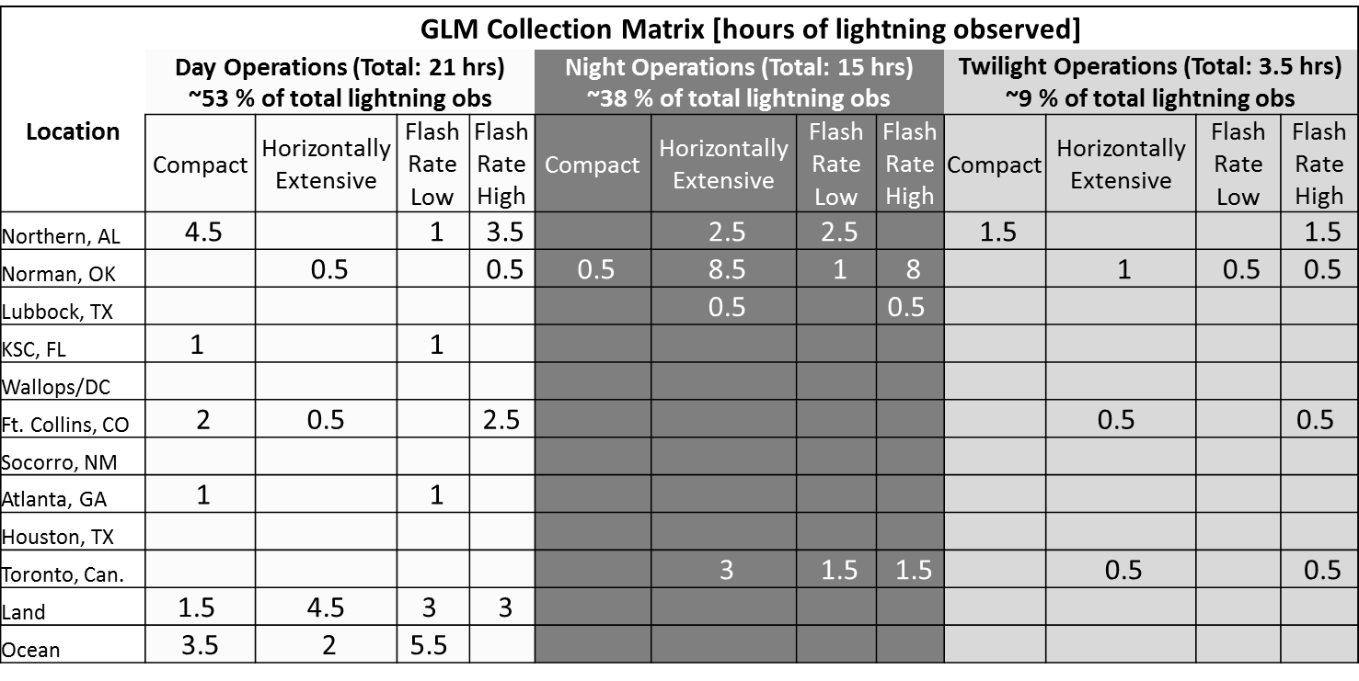
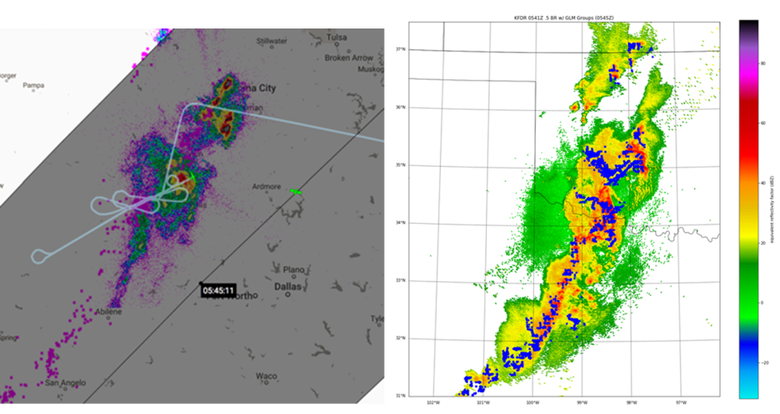
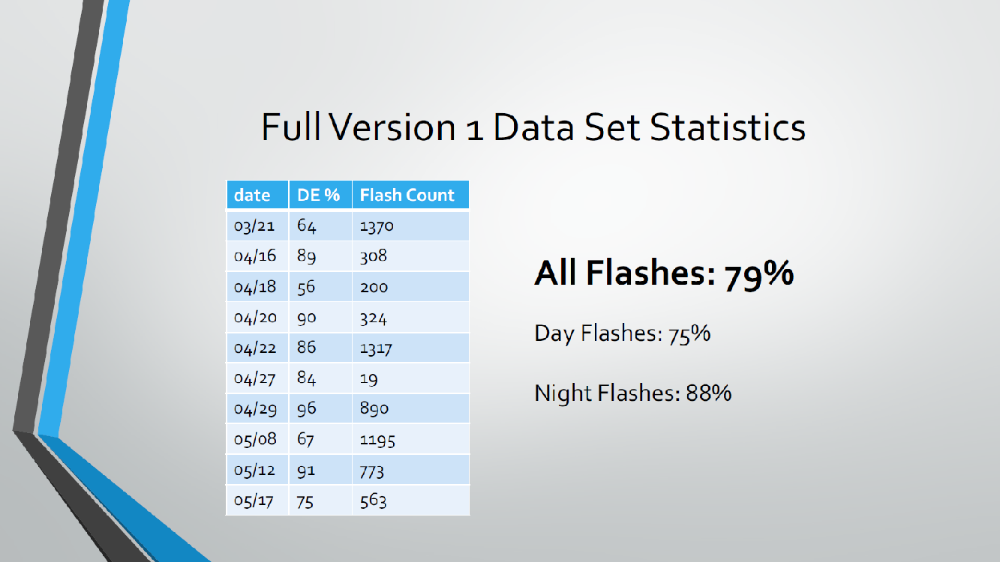
GOES-R Field Campaign Contributions to GLM
Above: Coincident GLM, ER-2 (FEGS), and ISS-LIS overpasses. FEGS confirmed
a 0.1 s offset in the GLM GS data (see
backup slide 56).

Slide 13
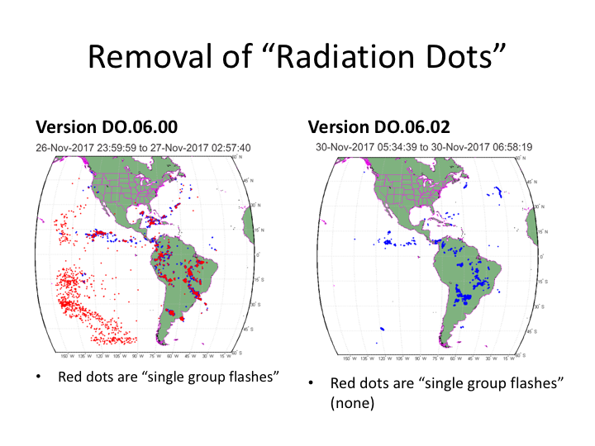
Recent Success: Reduced FAR (PLPTs: 009, 010)
PASSED
Example of DO.06.02
patch improvement
FAR below 5% as needed
Single Group Flash Filter removes radiation noise
Some real flashes (e.g.
S. Amer) do get removed
Removing flashes with
a group of <= N events
gives only marginal
improvements in FAR
Further Improvements being Tested:
L2 LCFA “put back” algorithm
Vendor L0-L1 filtering approach
analyses: Mach
These GOES-16 data are preliminary, non-operational data and are undergoing testing. Users bear
all responsibility for inspecting the data prior to use and for the manner in which the data are utilized.

Slide 14
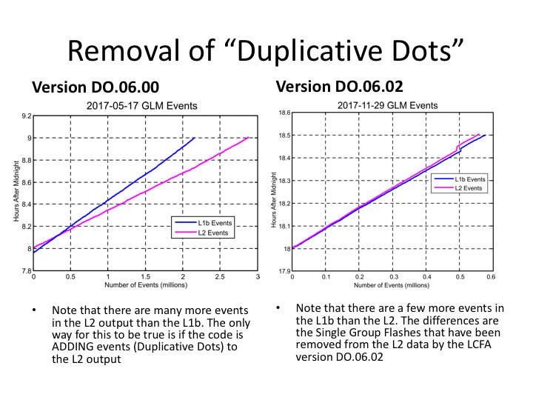
Recent Success: Reduced FAR (PLPTs: 009, 010)
PASSED
Example of DO.06.02
patch improvement
FAR below 5% as needed
Cause of duplicative dots fixed.
Reduction (blue to pink in right plot) is due to SGF filter, otherwise blue/pink almost the same (implies Duplicative Dots fixed)
analyses: Mach
These GOES-16 data are preliminary, non-operational data and are undergoing testing. Users bear
all responsibility for inspecting the data prior to use and for the manner in which the data are utilized.

Slide 15
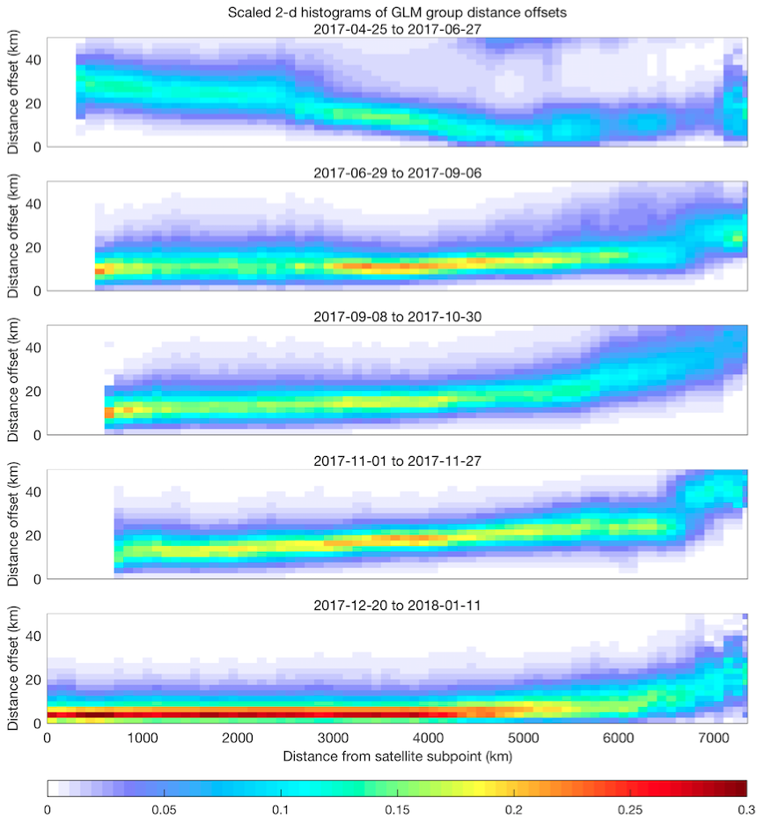
Recent Success: Reduced Location Errors (PLPTs: 011)
PASSED
Historical
Post DO.06.02.00
patch
(after drift + 7d
INR averaging)
scaled counts
analyses: Virts
These GOES-16 data are preliminary, non-operational data and are undergoing testing. Users bear
all responsibility for inspecting the data prior to use and for the manner in which the data are utilized.

Slide 16
National weather service perspective
GOES-16 GLM L2 Product Provisional PS-PVR

Slide 17
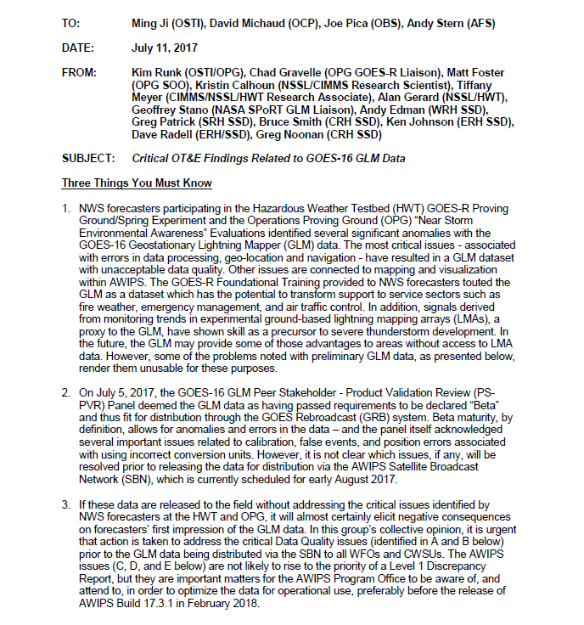
National Weather Service Perspective (Scott Rudlosky)
Early, limited NWS demonstration elicited a three-things memo describing issues with the initial GLM data quality and product implementation in AWIPS (i.e., operational NWS software)
A team was assembled to address these concerns and their response describes the planned AWIPS implementation during 2018

Slide 18
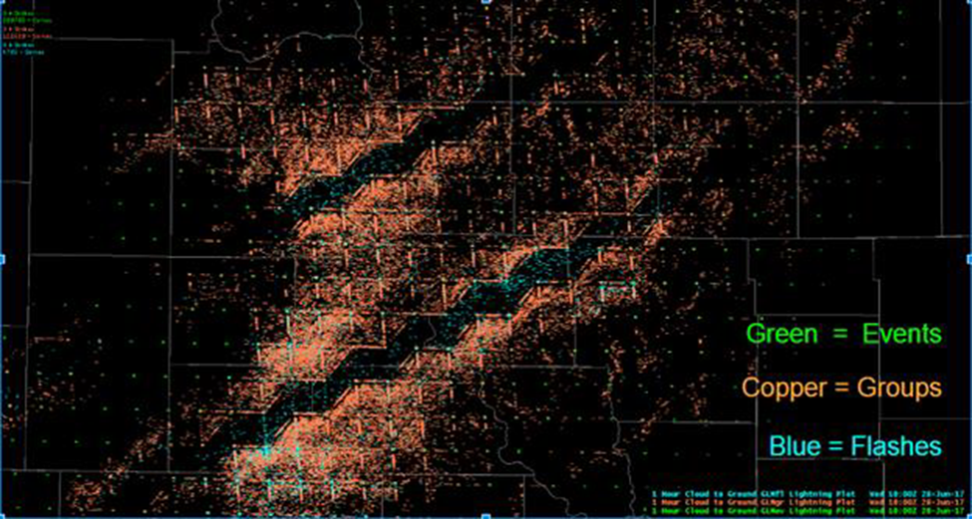
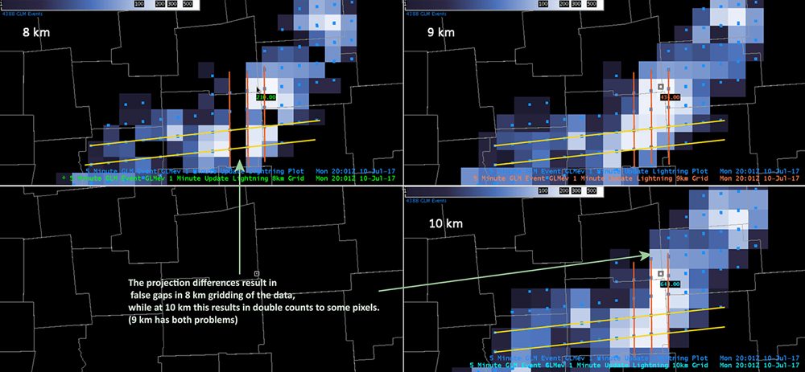
NWS GLM Three-Things Memo
Memo: Critical OT&E Findings Related to GOES-16 GLM Data
Series of critical issues and recommendations (7/11/17)
Data Quality Issues
Erroneous Plotting of GLM Data
Erroneous Geo-Location
AWIPS Issues
GLM Grid Resolutions and AWIPS Menu Choices
Visualization Issues Associated with Misaligned Grid Domains
Visualization Problems Associated with Erroneous Labeling

Slide 19
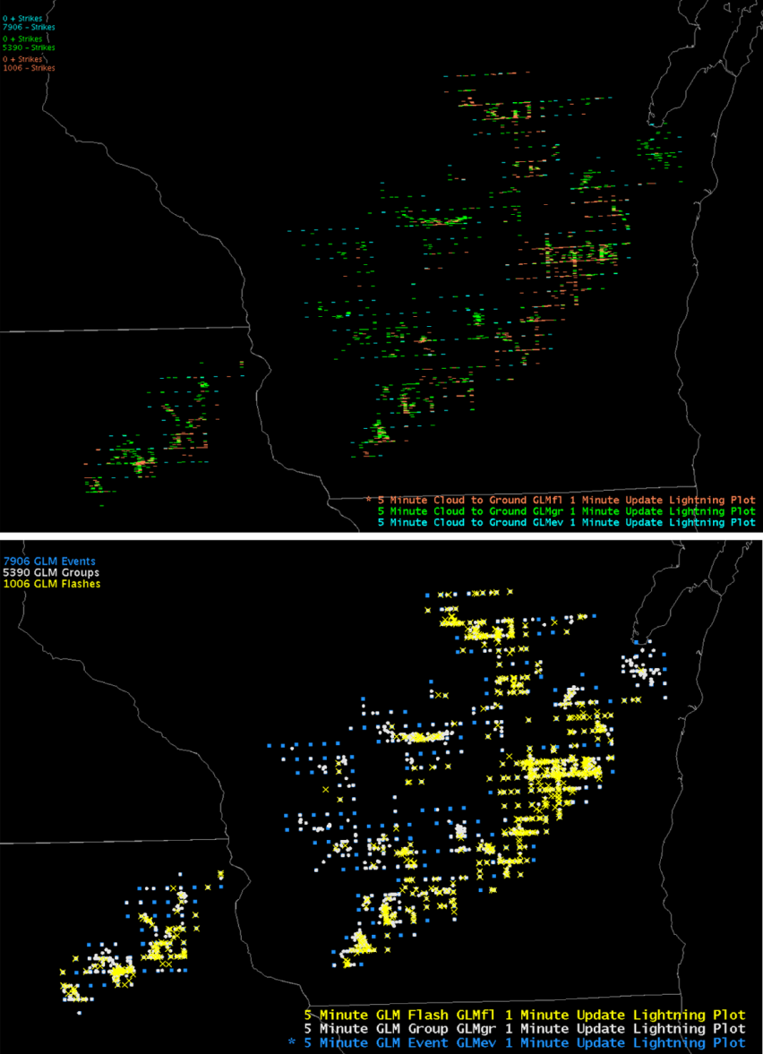
NWS GLM Three-Things Memo
Memo: Critical OT&E Findings Related to GOES-16 GLM Data
Series of critical issues and recommendations (7/11/17)
Data Quality Issues
Erroneous Plotting of GLM Data
Erroneous Geo-Location
AWIPS Issues
GLM Grid Resolutions and AWIPS Menu Choices
Visualization Issues Associated with Misaligned Grid Domains
Visualization Problems Associated with Erroneous Labeling
Original
Revised

Slide 20
Three-Things Memo Response
Data Quality Issue | Status/Update
Event spikes | Corrections applied and majority of spikes removed [some sources of spikes persist (e.g., glint/blooming)]
Spurious/False Events | Corrective filter applied; essentially all spurious/false events removed [some concern that a small number of actual single-event lightning flashes may be discarded]
Navigation/geolocation | Corrective measures reduced errors from 10-20 km down to “sub GLM pixel” scale (generally < 4 km)
Parallax | No corrective measures applied; needs further exploration and analysis of alternatives
Zig-zag pattern | Correction applied and confirmed to be fully effective
Data quality has improved enough that the only remaining issues involve AWIPS development and distribution.

Slide 21
Three-Things Memo Response
AWIPS Rendering Issues and Their Planned Resolution
Short-term GLM product to become available during early CY2018 (~April), with companion products following later in CY2018
Long-term GLM product available within an approximately 2.5 year time period, will employ early prototyping and standard NESDIS/GOES-R Ground Segment and AWIPS development
Recommended the formation of an Integrated Work Team (IWT) to plan, coordinate, and guide the development, implementation, and deployment of the short- and especially the long-term NWS/GLM projects

Slide 22
Potential New L2 GLM Products
Gridded GLM product (user requested)
NWS solution is temporary, also GEONETCast Americas
Data Quality product (strongly recommended)
Alert users to known data quality issues
Bolide/Meteor/Fireball product (see next slide)
Engage one of the most interested communities
Community Toolkit (shared via Github)
Promote community data access and usage
Website (demo – http://lightning.umd.edu/glm)
Provide visualizations and basic data access

Slide 23
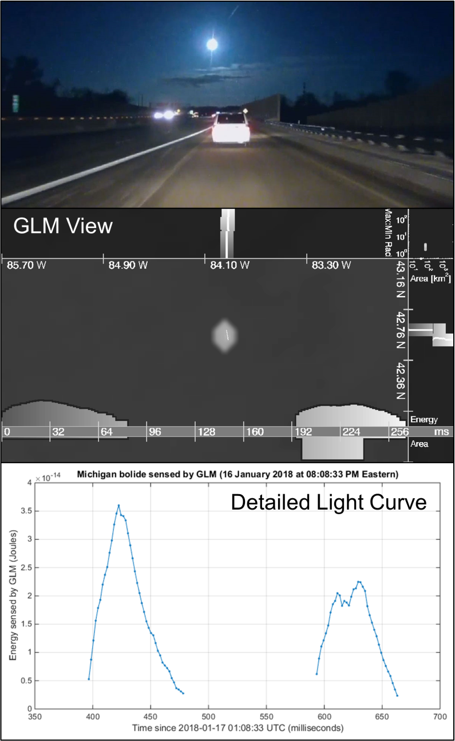
Potential New L2 GLM Products
Should we call it the Geostationary Lightning (and Meteor) Mapper?
The GLM observed a fireball near Detroit, MI on January 16th, 2018 at 8:08:33 PM
Not a particularly large meteor, but widely reported because of dense population
The GLM observes fireballs with equal sensitivity throughout its coverage area
GLM images Earth 500 times per second and measures the shape of the meteor “light curve” with millisecond precision
Largest fireball observed by the GLM so far occurred over the Atlantic Ocean on March 11th, 2017 and was reported as equivalent to an explosion of 2.9 kilotons of TNT
The GLM fireball light curve observations help study meteor threats to Earth

Slide 24
Provisional Maturity Assessment
GOES-16 GLM L2 Product Provisional PS-PVR

Slide 25
Provisional Validation
Preparation Activities | Assessment
Validation activities are ongoing and the general research community is now encouraged to participate. | Validation activities are ongoing. The general research community has been participating and providing feedback.
Severe algorithm anomalies are identified and under analysis. Solutions to anomalies are in development and testing. | Operational and algorithm anomalies have been identified. Critical ones have been resolved; others in various stages of implementation; a few under investigation.
Incremental product improvements may still be occurring. | Incremental product improvements are expected.

Slide 26
Provisional Validation
End State | Assessment
Product performance has been demonstrated through analysis of a small number of independent measurements obtained from select locations, periods, and associated ground truth or field campaign efforts. | This has been demonstrated.
Product analysis is sufficient to communicate product performance to users relative to expectations (Performance Baseline). | This has been communicated in PS-PVR.
Documentation of product performance exists that includes recommended remediation strategies for all anomalies and weaknesses. Any algorithm changes associated with severe anomalies have been documented, implemented, tested, and shared with the user community. | These have been documented, for example test report and ReadMe file.
Testing has been fully documented. | Testing has been fully documented in PLPT Report.
Product is ready for operational use and for use in comprehensive cal/val activities and product optimization. | We concur.

Slide 27
Recommendation
CWG believes that the GOES-16 GLM L2 product (events, groups, flashes) has reached the Provisional Maturity as defined by the GOES-R Program

Slide 28
Path to full Validation Maturity
GOES-16 GLM L2 Product Provisional PS-PVR

Slide 29
WRs Needing Resolution for Full VAL
WR | Title | Build
5399 | The GLM L1 EFRC service periodically crashes when processing live GRB data (allows us to turn the data burst filter back on) | DO.06.03.00 (April 2018)
3407 (flight) | GLM Background Image Metadata doesn’t match PUG | DO.07.00.00 (~ June 2018; all ADR inputs/analyses due by 23 Mar 2018 to meet this June 2018 date)
3561 | Update GLM EFRC Algorithm to use updated CALINR format provided by GLM Flight | DO.07.00.00
4371 | Incorrect GLM packet usec values | --
4477 | GLM L2 LCFA product has ‘n/a’ for production_data_source | DO.07.00.00
4507 | Use adjusted event times in Lightning L2+ product-ADR 338 (TOF & associated) | DO.07.00.00
4696 | Group and flash areas GLM L2 - ADR 382 (Discrepancy 20% between GS & LM) | DO.07.00.00
4697 (flight) | Blooming Filter for GLM L2 (blooming from solar instrusion or glint) | --
4705 | Time Order, GLM L2 – ADR 375 | --
4758 | GLM Event Geolocation Does Not Match Vendor Results – ADR 373 | Algorithm
Items in blue text are considered more important.

Slide 30
WRs Needing Resolution for Full VAL (cont.)
WR (or ADR) | Title | Build
5016 | GLM Coastline algorithm falls behind, BG images are missed | DO.07.00.00
5232 | GLM Clustering Errors – ADR 460 – PRO Release Type 2 (flash splitting) | Algorithm (not closed per CQ)
5244 | Non ABI instruments metadata contain non-ascii quote marks – PRO Rel Type 1 | --
5426 | GLM L1b Overshoot and Second Level Issues – ADR 502 PRO Release Type 1 | (went live 1/10/18 – 21:46 UTC in PR06.05.00 but to be verified)
5480 | GLM Lightning L2 Radiation filter threshold - ADR 519 (just an enhancement to WR 4762 regarding radiation dots removal) | --
5481 | GLM L1b update to CDRL 80 Rev G – ADR 520 (this is just a book-keeping update to the CDRL with no expected code changes) | --
5525 | Orphan and childless events and groups in GLM L2 – ADR 376 | --
5545 | GLM L1b LUT Update for East – ADR 538 PRO Type Rel 1 (turns off data burst filter to avoid crashes that produced empty GLM files. Also Includes update to spot amplification and contrast leakage GS parameters. | (went live 12/15/17 – 15:10 UTC in PR06.02.03 but to be verified)
5570 (flight) | Eliminate GLM L1b dependency on APIDs 384 and 385 – ADR 549 | --
(ADR 204 ) | “_unsigned integer” issue for multiple instruments (swallowed ADR 384 & its WR 5170 regarding negative flash areas) | DO.07.00.00 pilot project for EXIS (ADR355/WR4598)
Items in blue text are considered more important.

Slide 31
Other Actions Needed for Full VAL
Action | Title | Desired Implementation Date into OE
Complete PR.06.05 | SOLAR GLINT BOX | ≧1 month prior to PS-PVR FULL
New ADR(s) needed | FURTHER REDUCE FALSE EVENTS (Update following filters: CCD Frame Transfer, Data Formatter Burst, Glint, 2nd Level Threshold, Coherency, Contrast Leakage Jitter, L2) | ≧1 month prior to PS-PVR FULL
ADR 461 (on hold) | GLM L2 DATA QUALITY PRODUCT (is new so requires SPSRB approval which takes time … so interim solution will be a simplified version using only L2 data) | ≧1 month prior to PS-PVR FULL
New ADR needed (or add to WR 4758) | PARAMETER REFINEMENT FOR CDRL79: DIURNAL VARIATION INR COMPENSATION | ≧1 month prior to PS-PVR FULL
New ADR needed (or add to WR 4758) | PARAMETER UPDATES FOR CDRL79: PARALLAX COMPENSATION | ≧1 month prior to PS-PVR FULL
New ADR needed | SHOULD SAVE INR PARAMETERS SO THAT SYSTEM CRASH DOESN’T REQUIRE RE-DOING 7 DAY INR AVERAGING | ≧1 month prior to PS-PVR FULL
New ADRs need to be submitted & analysis already completed by 23 March 2018 in order to make it into DO.07.
Items in blue text are considered more important.

Slide 32
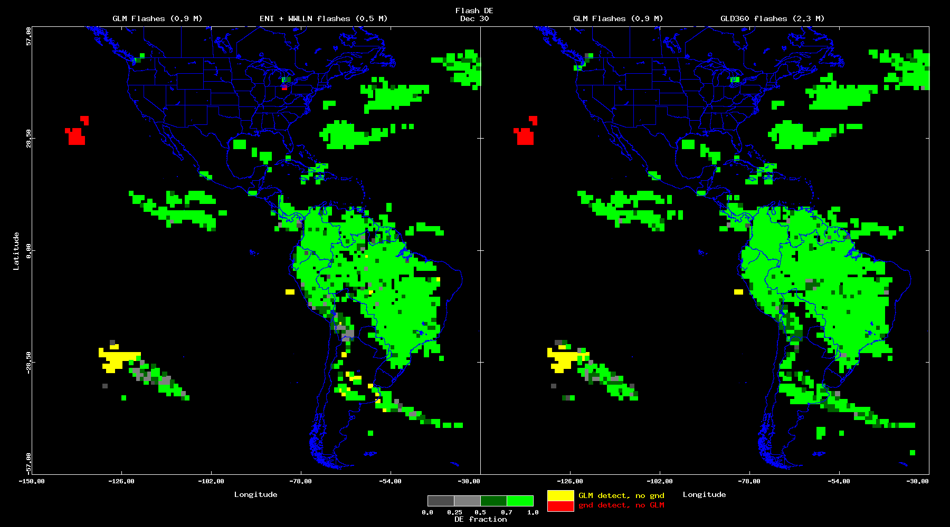
Another Blooming Example (WR 4697)
30 Dec 2017
Large yellow region over S. Pacific example of blooming
Longer time periods (multiple days) completed & gap fill nicely
analyses: Bateman (VaLiD tool)
These GOES-16 data are preliminary, non-operational data and are undergoing testing. Users bear
all responsibility for inspecting the data prior to use and for the manner in which the data are utilized.

Slide 33
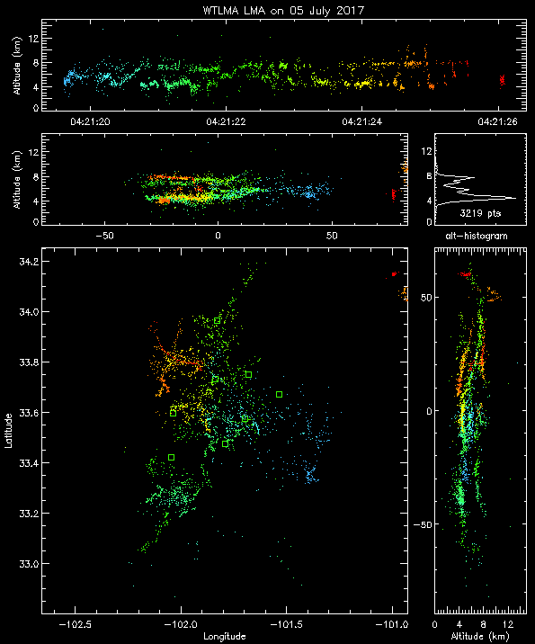
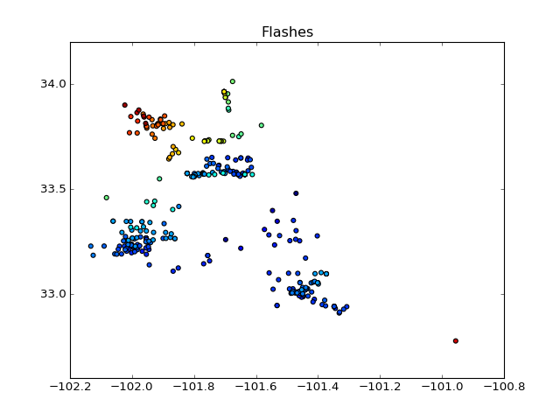
Flash Splitting Example (WR 5232)
05 Jul 2017
WTLMA (One 6s flash)
GLM (307 flashes!)
… some of the flash splitting has been fixed, but we still need to see how well
analyses: Mach
These GOES-16 data are preliminary, non-operational data and are undergoing testing. Users bear
all responsibility for inspecting the data prior to use and for the manner in which the data are utilized.

Slide 34
Path to Full Validation – PLPT
Given the unique temporal/geographical variability of lightning, the same PLPTs will continue to be carried out along the pathway to FULL, as possible, on “LIGHTNING TARGETS OF OPPORTUNITY”:
Test ID | Abbreviated Test Titles for GLM
PLPT-GLM-001 | Validate DE/FAR using med/long-range networks (e.g., NLDN, EN, GLD360)
PLPT-GLM-002 | Validate DE/FAR using short-range networks (e.g., LMAs)
PLPT-GLM-003 | Validate Storm DE and Storm FAR using very long range systems (WWLLN, NEXRAD)
PLPT-GLM-004 | Validate DE/FAR using very short range optical systems (FEGS)
PLPT-GLM-005 | Validate DE/FAR using orbit-based optical systems (e.g., ISS/LIS)
PLPT-GLM-006 | Validate DE/FAR using ground-based E-field networks (e.g. HAMMA)
PLPT-GLM-009 | Validate L1b-L2 Cluster/Filter by comparing w/Spec (i.e. Mach) code
PLPT-GLM-010 | Validate L0-L1b Filter Algorithms by comparing w/Spec (i.e. Mach) code
PLPT-GLM-011 | Validate GLM INR w/comparisons to well-located ground points
PLPT-GLM-012 | Validate GLM BG DCC radiances with trendings & comparisons
PLPT-GLM-013 | Validate GLM Event Energies with trendings & comparisons

Slide 35
Performance Baseline Status
The following baselines have reasonably been met for the CWG analyses performed. Specific
examples of this success given in this presentation and in the report GLM_prov_19Jan2018.docx :
Flash Detection Efficiency
GLMPORD74: The flash detection probability shall be at least 70% after L1b processing.
The time span for this computation is 24 hours.
(MRD1261)
Flash False Alarm Rate
GLMPORD75: The flash false alarm probability shall be less than 5% after L1b processing.
The time span for this computation is 24 hours.
(MRD1264)
Location Accuracy
GLMPORD94: The GLM navigation error shall not exceed ±112 µrad ∼ ½ pixel
(MRD1259, pg. 46: Product Mapping Accuracy 5 km)
Time Accuracy
GLMPORD98: The GLM shall time tag each event to an accuracy of 1 msec
(related MRDs include MRD2112 & MRD637)
… also benchmarking for Deep Convective Clouds (DCC) and lightning energy has begun.
Reference: GLM PORD (Performance and Operational Requirements Document) V2.16, 4 Aug 2016

Slide 36
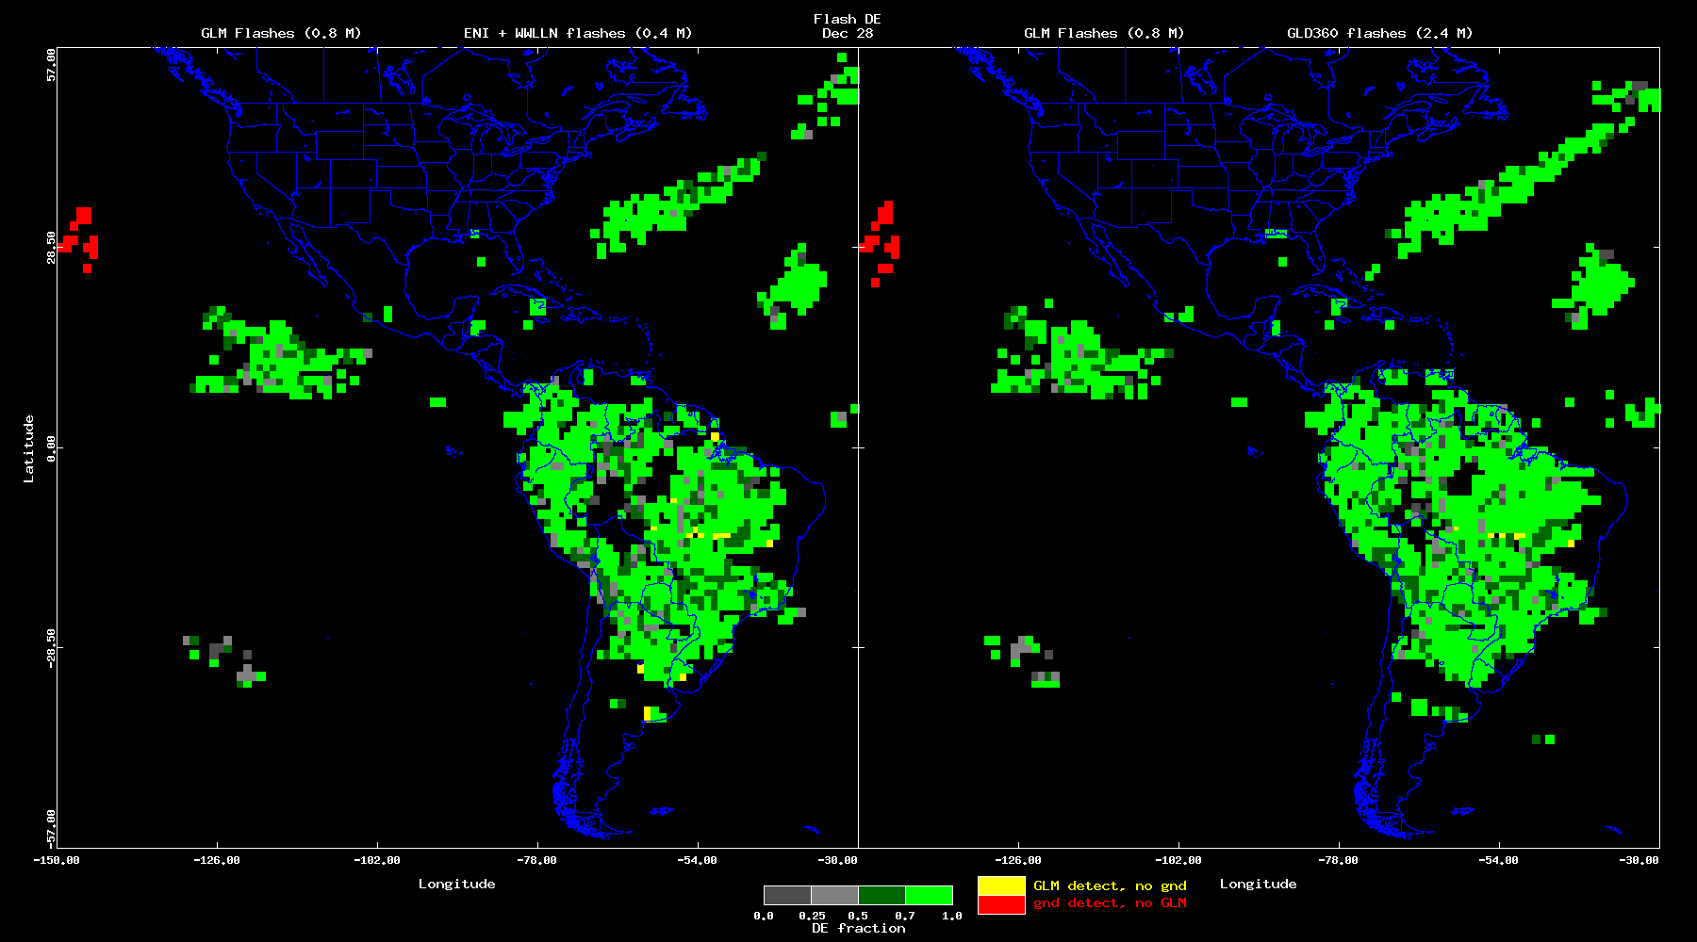
Performance: Flash DE & FAR (PLPTs: 001, 003)
PASSED
These GOES-16 data are preliminary, non-operational data and are undergoing testing. Users bear
all responsibility for inspecting the data prior to use and for the manner in which the data are utilized.
28 Dec 2017
Large Regions exceeding 70% Flash DE (green); longer periods exist to gap fill
Ground network misses on some cloud boundaries typical (yellow)
GLM FOV in East park results in misses to the West (red)
analyses: Bateman

Slide 37
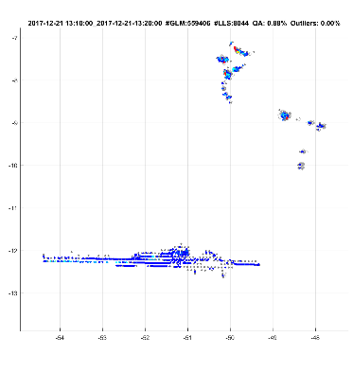
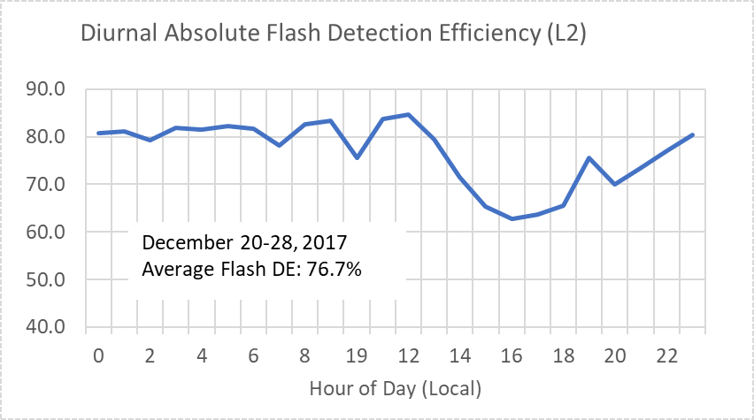
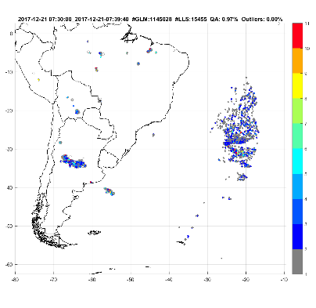
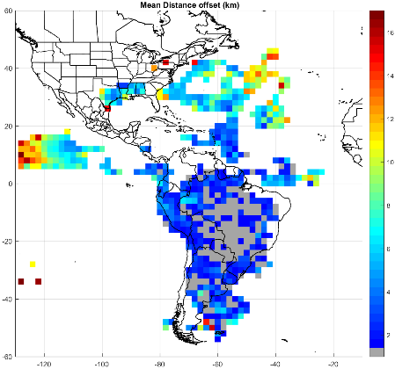
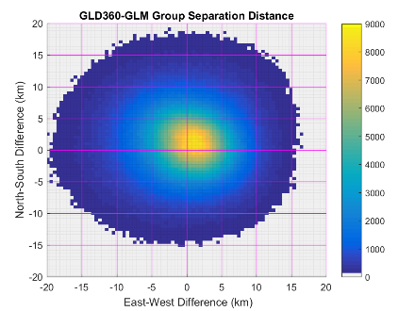
Performance: DE/FAR, INR (PLPTs: 001, 003, 011)
PASSED
December 20-27 GLM vs. GLD360 (full domain)
Much improved location accuracy (mean < 10 km)
GLM “Absolute” Flash DE
71-81% (day-to-day variation)
8-day average: 76.7%
Diurnal Variation: 20%
Time-of-Flight errors are correctable to <1 ms
Concerns:
False flashes in some regions
Location offsets at lat/lon extremes
8-day Diurnal Average Flash Analysis
( Whole Domain for Dec. 20-27, 2017)
Examples of GLM L2 False Flashes
Good Data
False
False
Spatial Bias
Group Position Differences (Full Domain)
Sample Histogram Bias (Complete Dataset)
analyses: Cummins/UA
These GOES-16 data are preliminary, non-operational data and are undergoing testing. Users bear
all responsibility for inspecting the data prior to use and for the manner in which the data are utilized.

Slide 38
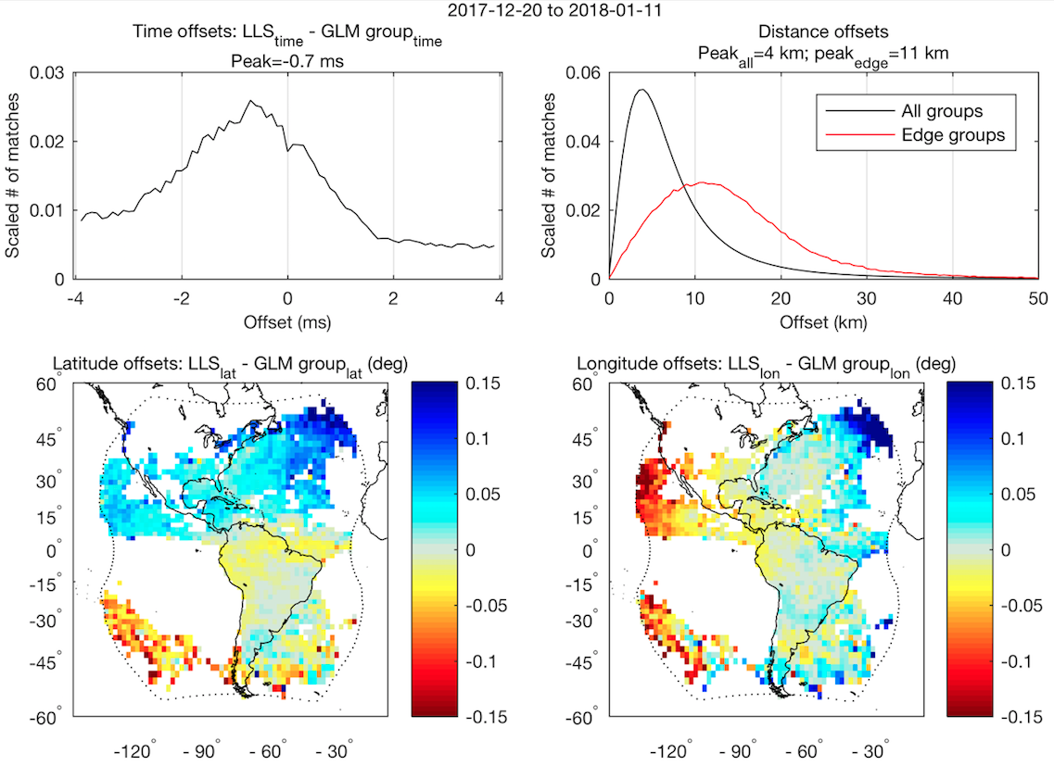
Performance: INR/time (PLPTs: 011)
PASSED
Offsets between GLM and “best” reference match
(ENGLN & GLD360)
Sub-ms timing accuracy after correcting for origination time
Sub-pixel location accuracy over most of domain
analyses: Virts
These GOES-16 data are preliminary, non-operational data and are undergoing testing. Users bear
all responsibility for inspecting the data prior to use and for the manner in which the data are utilized.

Slide 39
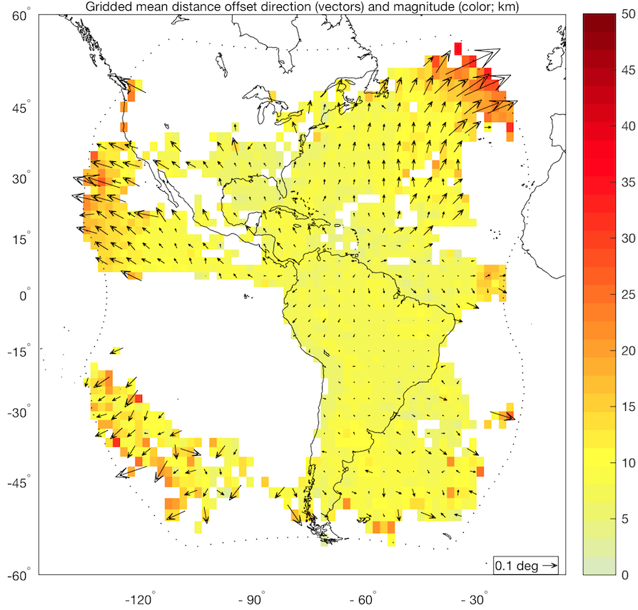
Performance: INR/time (PLPTs: 011)
PASSED
Sub-pixel location accuracy over most of domain
Groups near limb must be shifted outward to match reference data
Large errors near limb consistent with side cloud illumination
analyses: Virts
These GOES-16 data are preliminary, non-operational data and are undergoing testing. Users bear
all responsibility for inspecting the data prior to use and for the manner in which the data are utilized.

Slide 40

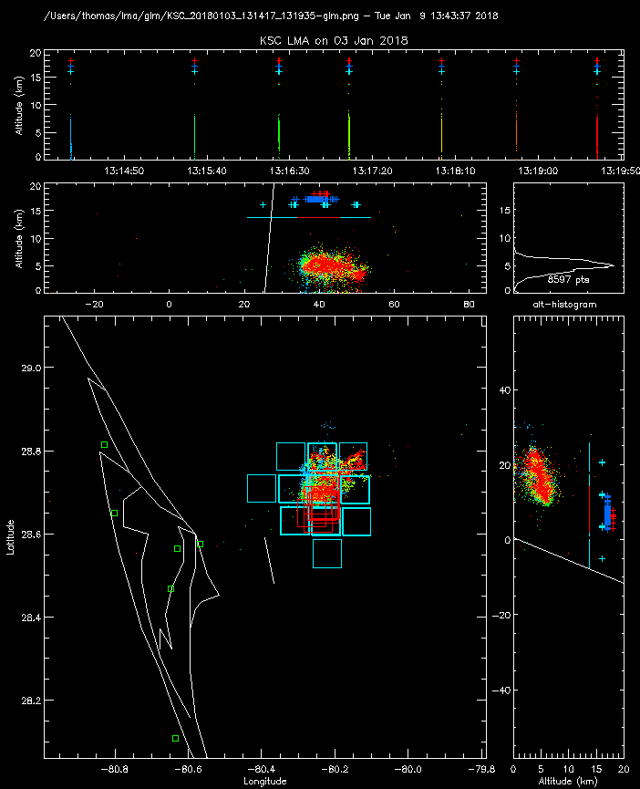
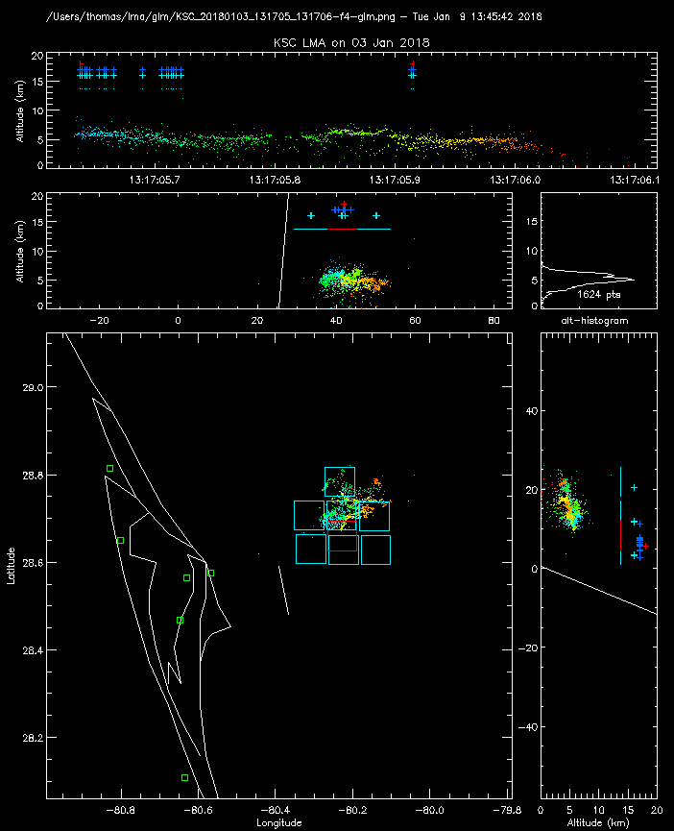
Performance: DE/FAR, INR/time (PLPTs: 002, 011)
PASSED
KSCLMA
3 January 2018 Small storm 40 km ENE of Kennedy Space Center
GLM detected all 7 flashes (DE=100%)
(7 min time interval)
GLM locates the flashes
7 km to the south due to
parallax & clouds being at
low altitude
GLM correctly grouped events into flashes
First GLM event about
5 ms after LMA start
Single flash
GLM Flash-red
groups-dark blue
events-light blue
Entire Period
(7 flashes)
These GOES-16 data are preliminary, non-operational data and are undergoing testing. Users bear all responsibility for inspecting the data prior to use and for the manner in which the data are utilized.
analyses: Thomas/NMT
40

Slide 41
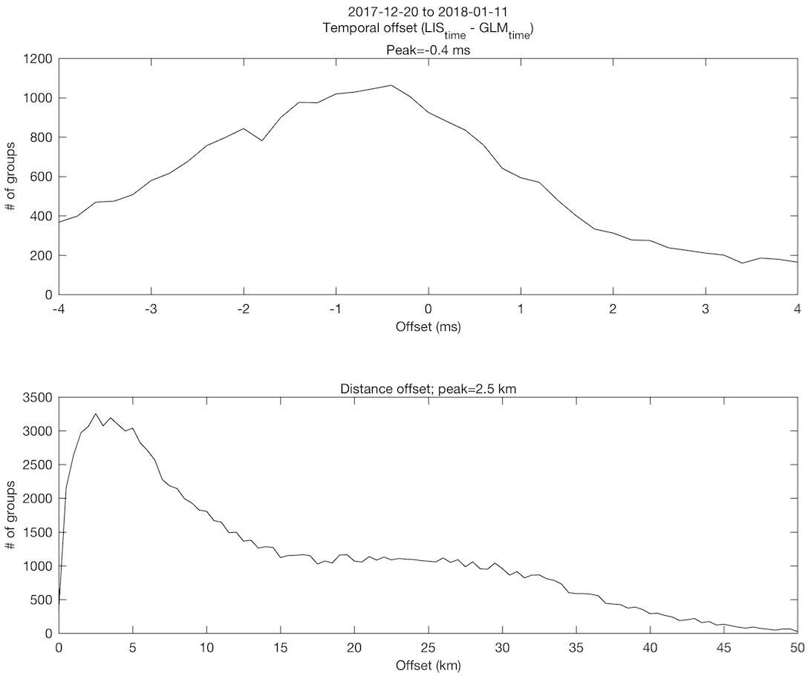
Performance: INR/time (GLM vs. ISS/LIS) (PLPTs: 005, 011)
PASSED
Comparison between group data from two space-based optical sensors
Sub-ms timing accuracy after correcting for origination time
Peak distance errors < 3 km, but larger errors also observed
analyses: Virts
These GOES-16 data are preliminary, non-operational data and are undergoing testing. Users bear
all responsibility for inspecting the data prior to use and for the manner in which the data are utilized.

Slide 42
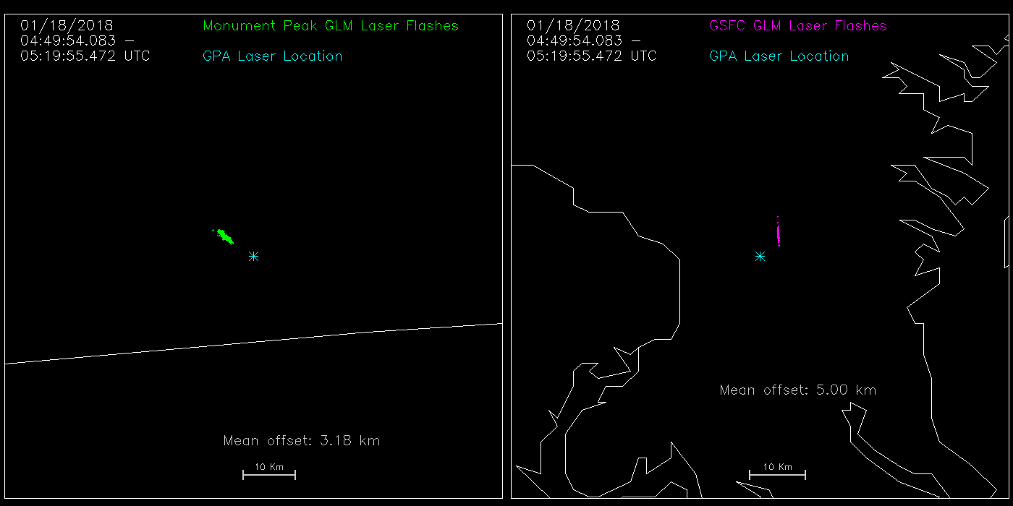
Performance: INR (Laser Beacon) (PLPTs: 011)
PASSED
Laser Beacon Test 01/18/2018
Latest Nav params in GPA
Mean distance between laser beacon location and GLM L2 “flash detections” are within 5 km
analyses: Buechler
These GOES-16 data are preliminary, non-operational data and are undergoing testing. Users bear
all responsibility for inspecting the data prior to use and for the manner in which the data are utilized.

Slide 43
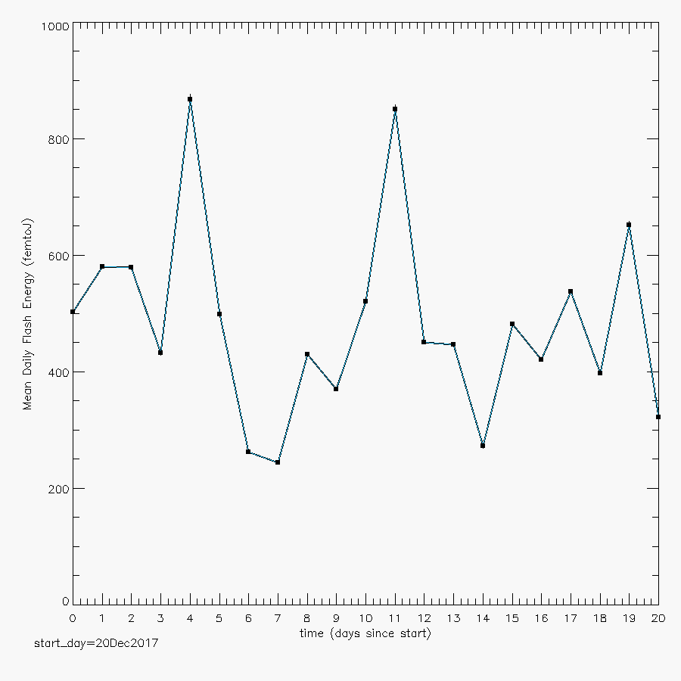
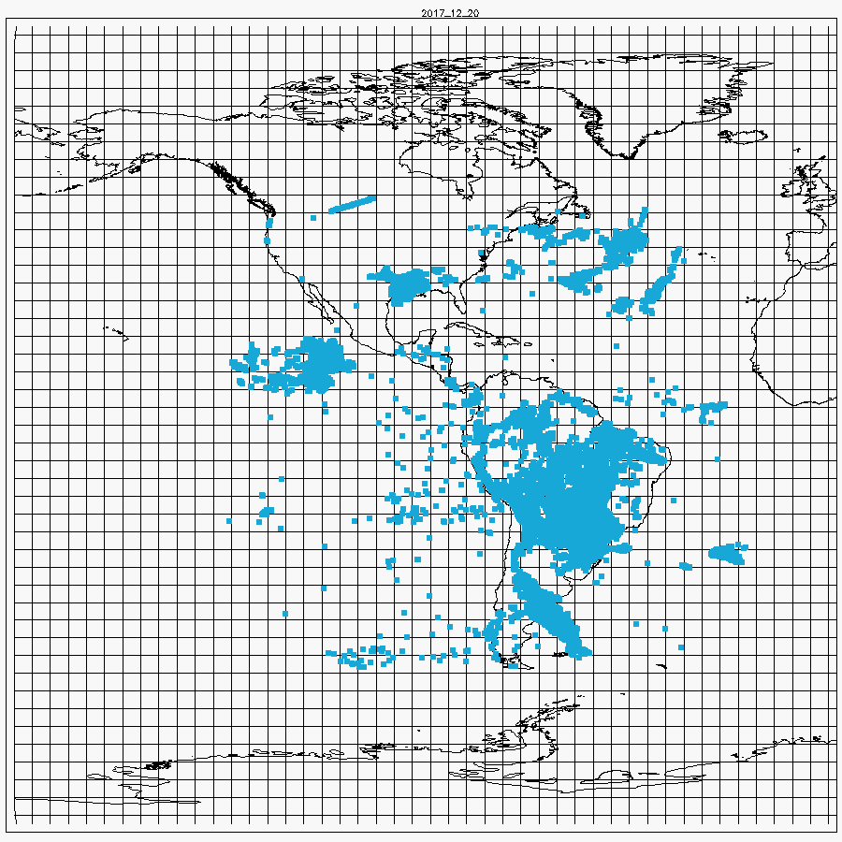
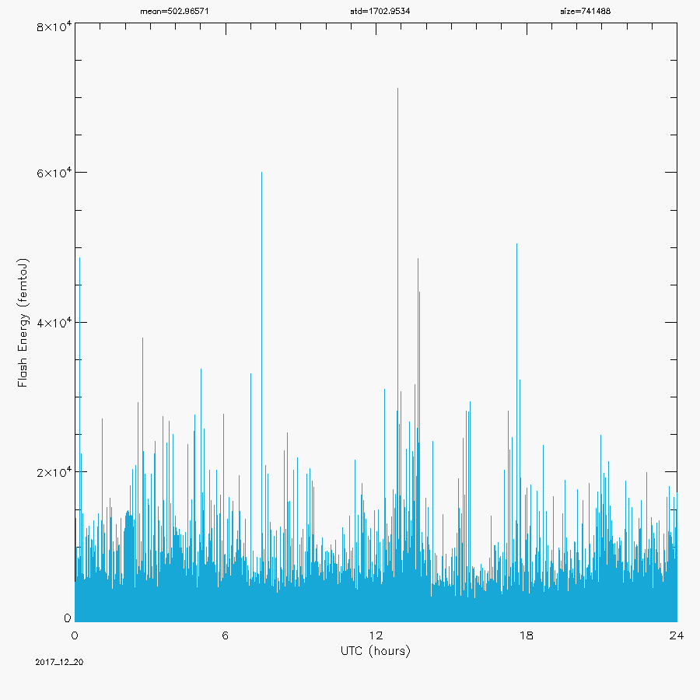
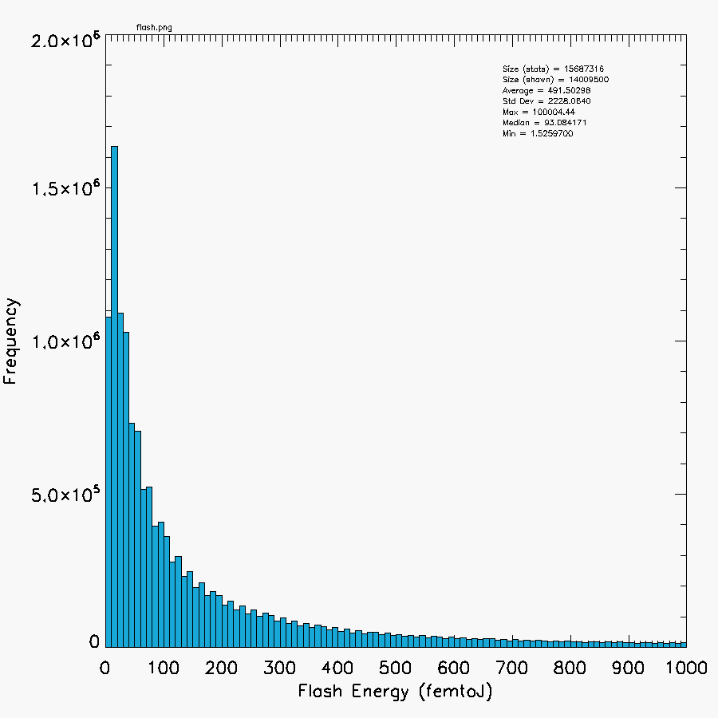
Performance: Energy Trending (PLPTs: 013)
PASSED
20 Dec 2017 to 9 Jan 2018 (21 days)
Results for flashes shown (also have results for events, groups)
Some non-lightning spikes bias results high
Energy Histogram:
Flash Locations
Daily Means
High Res in day
mean = 491.5 fJ
size:
~ 15.7M flashes
~ 332.6M groups
~ 756.9M events
analyses: Koshak
These GOES-16 data are preliminary, non-operational data and are undergoing testing. Users bear
all responsibility for inspecting the data prior to use and for the manner in which the data are utilized.

Slide 44
INR Priorities/Status (WR 4758)
1. Complete the validation efforts between instrument vendor and GS subcontractor (Carr Astronautics) regarding the INR implementation by GS. We have had very fruitful meetings with Shu Yang (Carr), and the remaining items seem to be relatively small. The INR differences between the Carr test code and LM code outputs are quite small (+/- 5 micro-radians in vertical and horizontal displacements). From our perspective of the rate of the validation effort, we anticipate the validated INR code will be implemented in DO.07.00. Parameter updates for CDRL079 (no WR or code change needed):
Updated non-nominal distortion & other parameters based on Carr GLM/ABI analysis
Diurnal variation INR compensation (specific add-on; no algorithm change)
Improved cloud height ellipsoid values (pole and equator parameters); includes Virts analyses
Parallax Compensation (specific add-on; no algorithm change)
2. Make certain that all parties agree with the timestamps provided in the L2+ data products. LMATC has confirmed that the timestamps in the L1b data products are correct, but the connection to the L2+ product has not been completed. Our understanding is that the correct timestamps in L2+ will be a part of the DO.07.00 build.
3. Use validation data to show correlation between ground truth and GLM locations. (This is the obvious statement for full validation of INR, as well as DE & FAR.) We have been told that the instrument will not be laser-beacon illuminated after reaching provisional status.
analyses: Edgington/Tillier/Yang/Armstrong

Slide 45
Path to Full Validation – Risks
Risk Name | Description | Impact | Mitigation and Schedule
Mission Data | IF CWG lacks many critical meta data | THEN CWG cannot function properly | Raise awareness Work with Ground
Operation Stability | IF corrections for known anomalies cannot be implemented timely | THEN the operation will not reach steady state for evaluation | Raise awareness Work with Ground
Data Quality Product | as discussed; Priority 1 | Moderate | ADR 461 (on hold)
blooming filter | as discussed; Priority 2 | Moderate | WR 4697 (need GS WR for this)
Overshoot & 2nd Level Threshold | as discussed; Priority 3 | Moderate | WR 5426 (fixed 1/10/18 – 21:46 UTC in PR06.05.00 but to be verified)
Solar Glint Box | as discussed; Priority 4 | Moderate | PR.06.05 (fix needs to be verified)
TOF & associated | as discussed; Priority 5 | Moderate | WR 4507
orphan/childless | as discussed; Priority 6 | Moderate | WR 5525
time order | as discussed; Priority 7 | Moderate | WR 4705
various (19 items) | as discussed; Priority 8 and lower | Little | (see remaining entries in slides 29-31)
Scale:
Little Impact
Moderate Impact
Severe Impact

Slide 46
Summary & Recommendations
GOES-16 GLM L2 Product Provisional PS-PVR

Slide 47
Summary
Flash DE acceptable, and note:
Difficult to exactly compute GLM Flash DE given that DE associated with reference data is below 100%. But, many examples of high GLM Flash DE wrt LMAs & FEGS.
Flash splitting to be cleaned up (WR 5232; some of it already fixed)
Difficult to detect flashes in inverted polarity (i.e. anomalous) storms.
FAR adequately low, but some clean-up:
Blooming filter needed (WR 4697 flight … need GS version)
Further reduce noise by updating various L0-L1b filters (new ADR(s) needed)
Further optimize Radiation “Dot” Removal; e.g. L2 Put Back Filter and/or L0-L1b approach … so this can also improve DE further. (new ADR(s) needed, WR 5480)
INR accuracy acceptable, but some issues to optimize (as detailed in slide 45)
Compensation of Diurnal Variation & Parallax (2 new ADRs needed)
Timing accuracy acceptable, but some items to clean up
e.g., Time-Of-Flight (TOF), and time-order (WR 4507, and WR 4705, respectively)
Family Links: still have orphans & barrenness, but rare (WR 5525)
Data Quality Product: on hold, needs to get done (ADR 461 on hold)
Other Issues: as given in the tables (slides 29-31)

Slide 48
Recommendation
CWG believes that the GOES-16 GLM L2 product (events, groups, flashes) has reached the Provisional Maturity as defined by the GOES-R Program

Slide 49
Backup – HIGHLIGHTS OF INDIVIDUAL PLPTs
GOES-16 GLM L2 Product Provisional PS-PVR

Slide 50
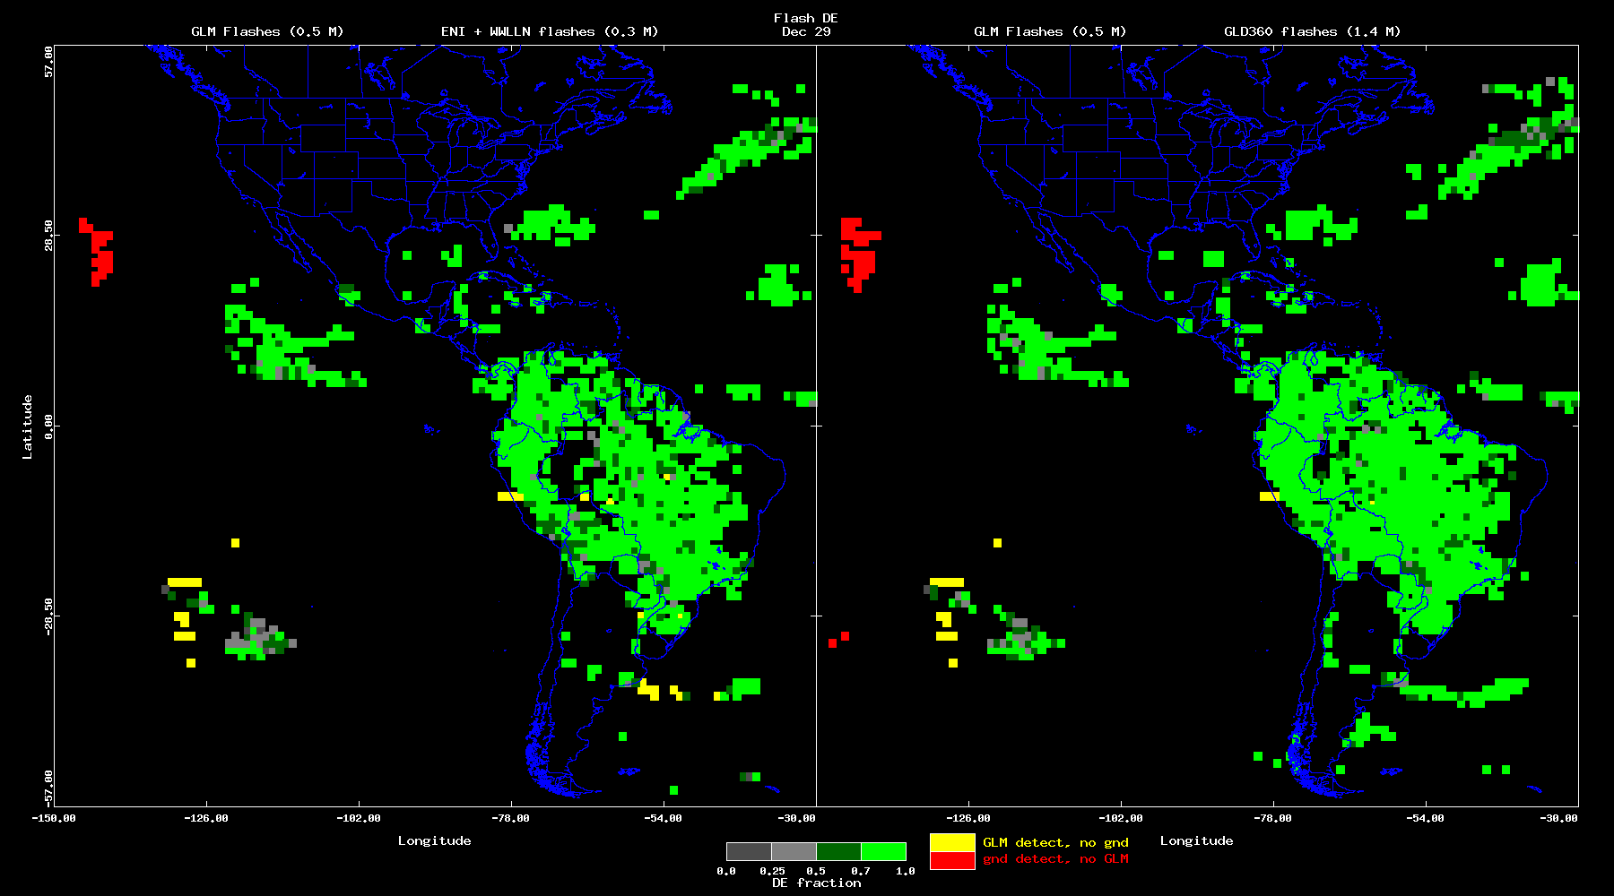
Performance: Flash DE & FAR (PLPTs: 001, 003)
PASSED
28 Dec 2017
analyses: Bateman
These GOES-16 data are preliminary, non-operational data and are undergoing testing. Users bear
all responsibility for inspecting the data prior to use and for the manner in which the data are utilized.

Slide 51
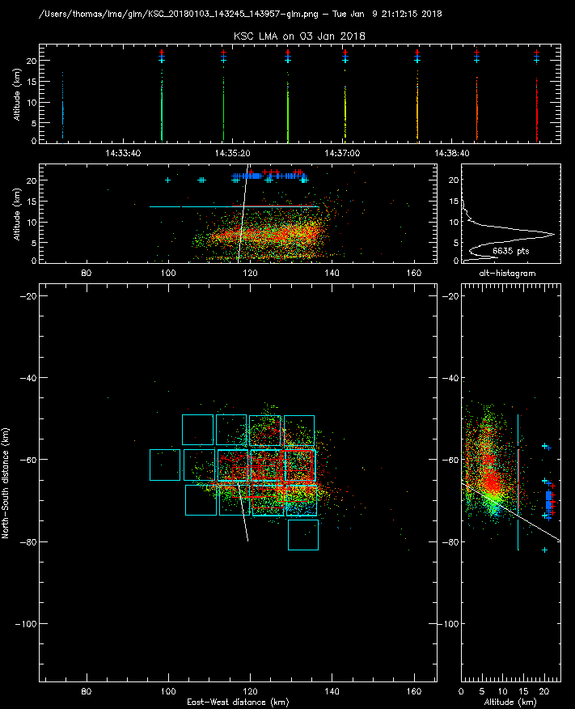
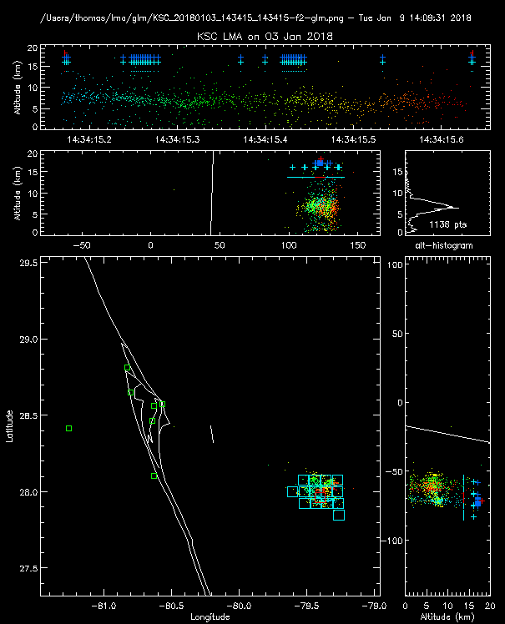
Performance: DE/FAR, INR/time (PLPTs: 002, 011)
PASSED
KSCLMA
3 January 2018 small
storm 135 km SE of
Kennedy Space Center
GLM detected 7 of 8 flashes (DE=88%)
(7 min time interval)
GLM locates the flashes 3 km to the south due to parallax and cloud tops being at higher altitude
Storm over open water
First GLM event about
5 ms after LMA start
Single flash
GLM Flash-red
groups-dark blue
events-light blue
Entire Period
(8 flashes)
These GOES-16 data are preliminary, non-operational data and are undergoing testing. Users bear all responsibility for inspecting the data prior to use and for the manner in which the data are utilized.
analyses: Thomas/NMT
51

Slide 52
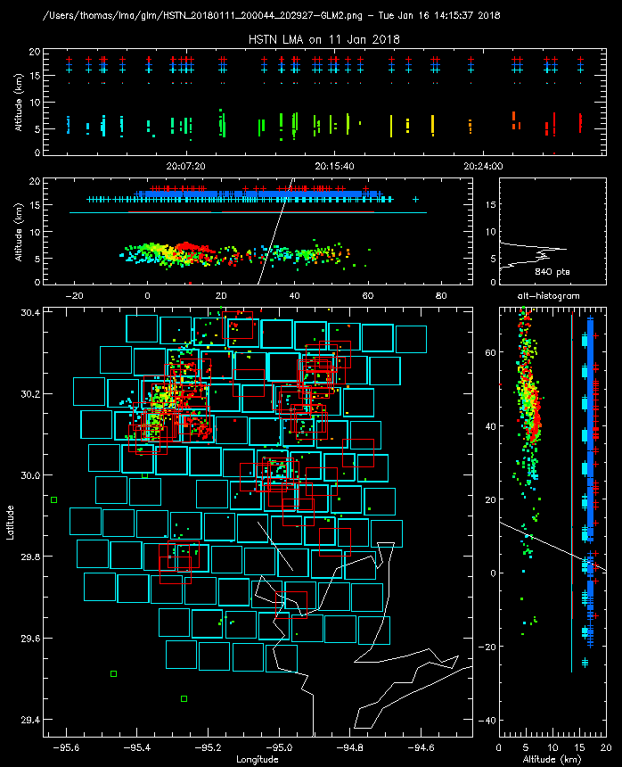
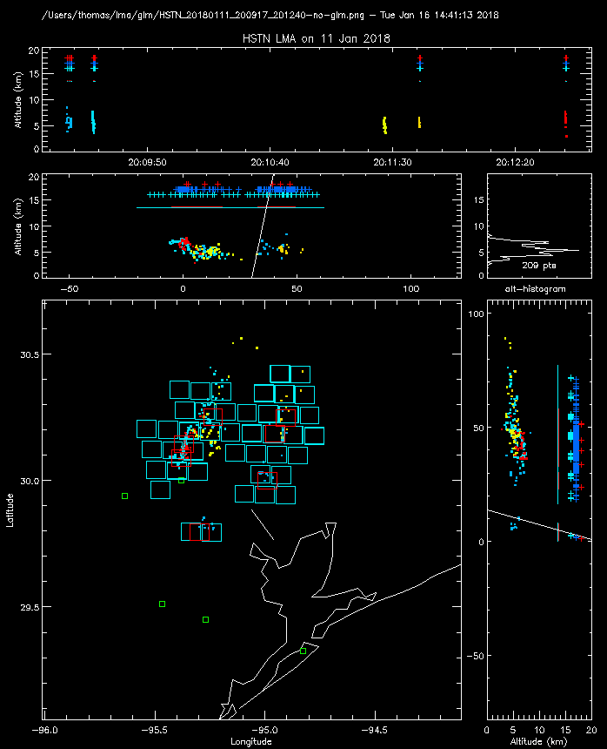
Performance: DE/FAR, INR/time (PLPTs: 002, 011)
PASSED
HSTLMA
11 January 2018 Small storm over Houston, TX
GLM detected 19 0f 20 flashes (DE=95%) False Alarm rate 7%
(30 min time interval)
GLM locates the flashes 2 km to the south and 3 km to the west due to parallax & clouds being at
low altitude
flash not detected by GLM
GLM Flash-red
groups-dark blue
events-light blue
30 Minutes
20 flashes
analyses: Thomas/NMT
These GOES-16 data are preliminary, non-operational data and are undergoing testing. Users bear all responsibility for inspecting the data prior to use and for the manner in which the data are utilized.
1
52

Slide 53
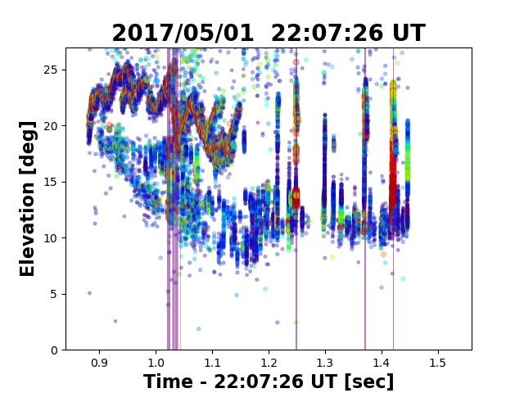
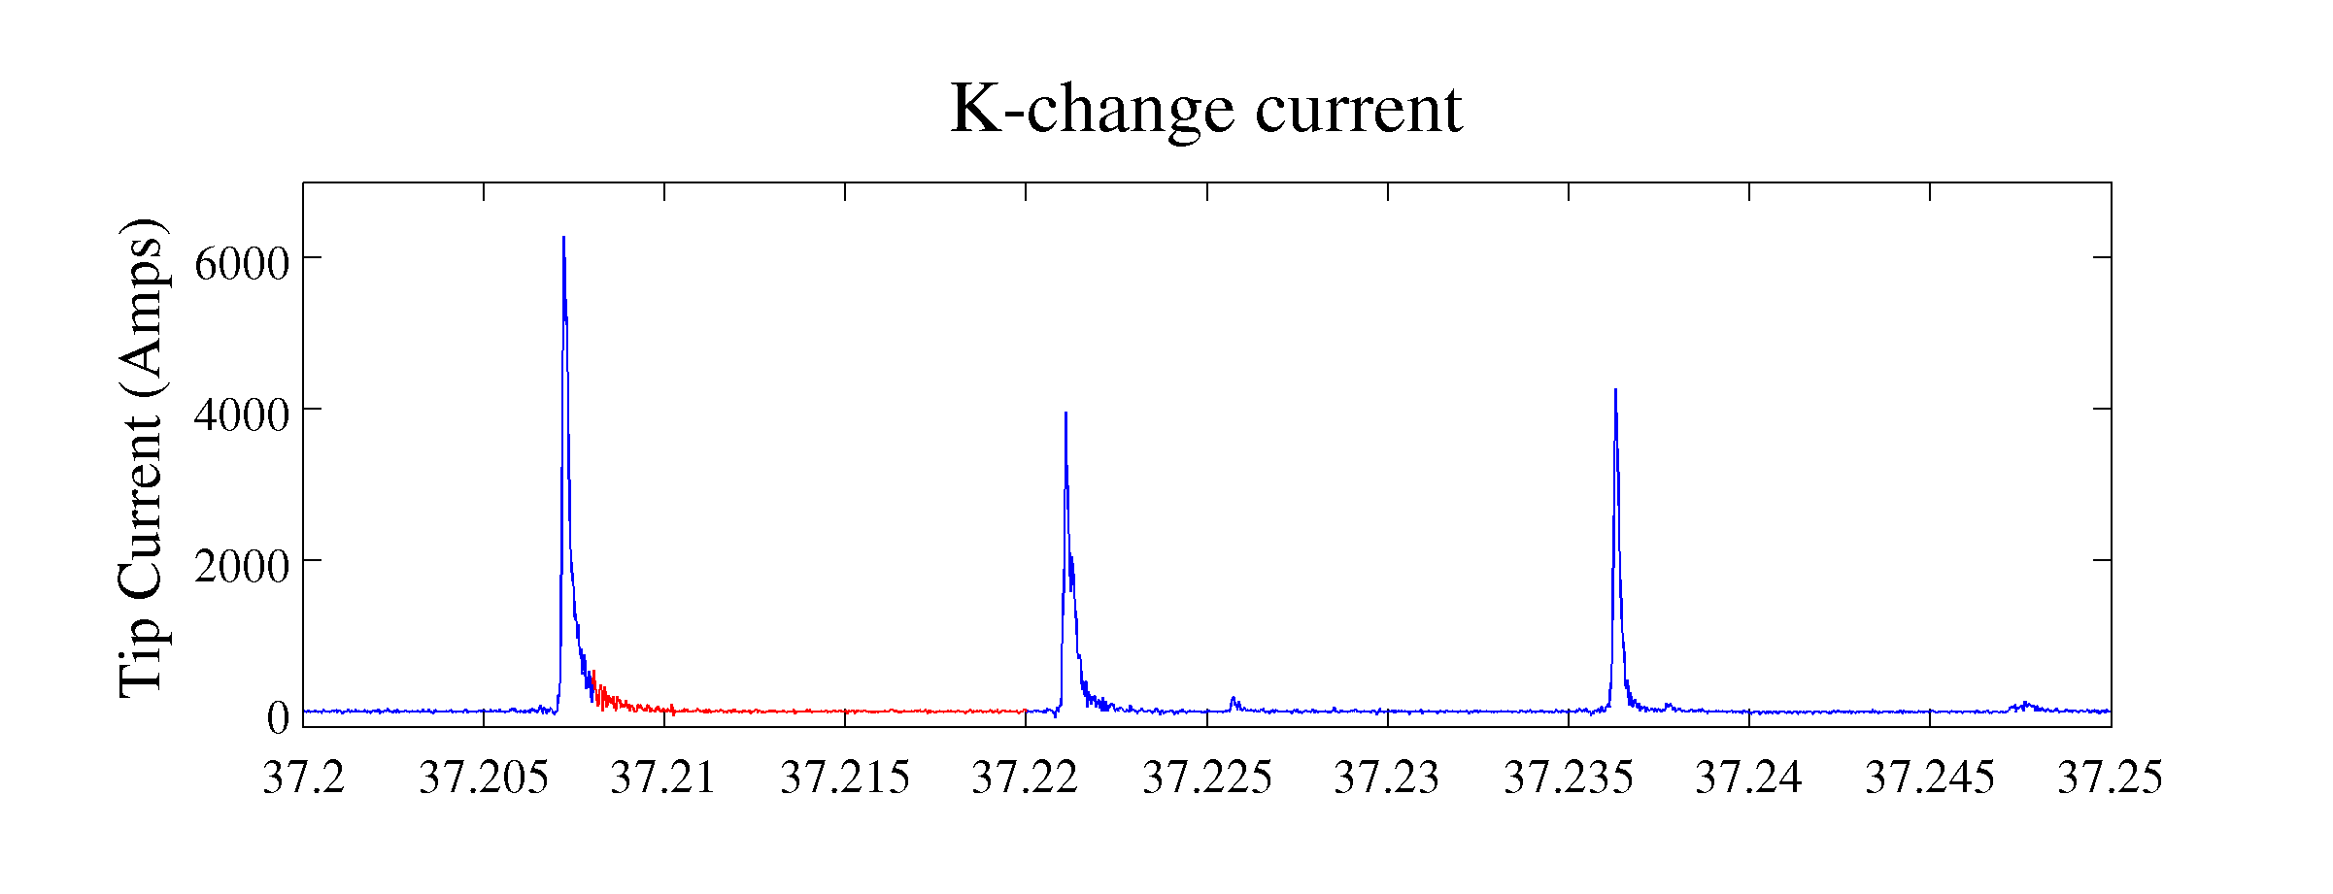
Why GLM sees K-changes: (Sonnenfeld/NMT) LL LMA/INTF
Stanley showed that GLM often picks up K-changes
Using INTF+LMA+ Field-change, we are able to convert INTF data to K-change current profiles.
Current magnitude and duration are similar to small return strokes. Also, K-changes tend to light up whole channel (large area)
←Stanley data
53
These GOES-16 data are preliminary, non-operational data and are undergoing testing.
Users bear all responsibility for inspecting the data prior to use and for the manner in which the data are utilized.
Notes:
53

Slide 54
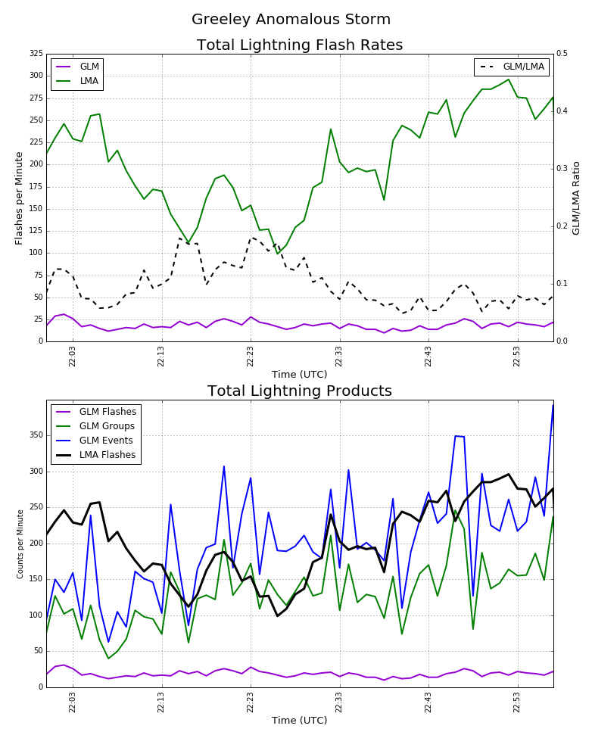
Performance: DE (difficulty with detecting flashes in inverted polarity storms) (PLPTs: 002)
GLM Cal/Val Field Campaign
May 8, 2017 ”Gold Mine” mission over Colorado
NASA ER-2 on station from 22:00 to 01:00 UTC
CSU-CHILL radar and NE CO LMA network utilized
Both anomalous and normal polarity storms observed during the ER-2 mission period
Figure shown is for inverted polarity storm in Greeley, CO
GLM/LMA ratio (~ DE) is 0.1-0.2
Largest DE during min flash rate.
analyses: CSU (Rutledge, Reimel, Fuchs, Xu)
These GOES-16 data are preliminary, non-operational data and are undergoing testing. Users bear
all responsibility for inspecting the data prior to use and for the manner in which the data are utilized.

Slide 55
Performance: DE/FAR, INR/time (PLPTs: 002, 004, 011)
PASSED
Airborne Optical
(FEGS)
29 April 2017: 1.5 min period over Oklahoma
12 Flashes detected by FEGS
GLM flash DE 100%
GLM had a flash time delay of ~0.1s
Results from beta analyses
Confirmed a 0.1 sec offset in the GLM GS Data
analyses: Quick
These GOES-16 data are preliminary, non-operational data and are undergoing testing. Users bear
all responsibility for inspecting the data prior to use and for the manner in which the data are utilized.

Slide 56
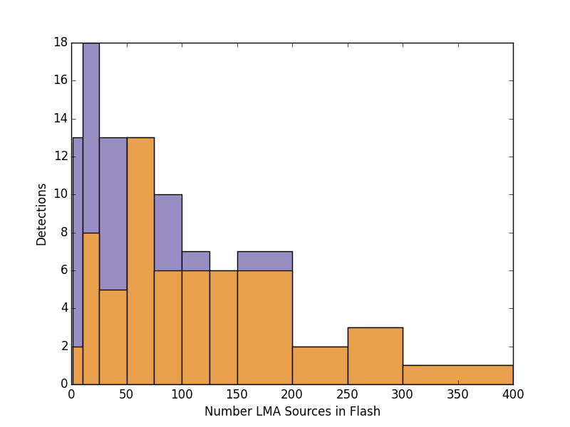
Performance: DE (PLPTs: 002, 006)
PASSED
100 flashes detected by either/both LMA and GLM w/in 100km of HSV supersite
GLM detected 58/93 (0.624) of the LMA flashes
Of the 35 flashes not detected by GLM, 24 did not trigger HAMMA, implying weak flashes
58/(93-24) = 58/69 = 84% DE
Most flashes not detected had less than 25 LMA sources
GLM detected 7 flashes not detected by LMA
All flashes detected by GLM and not detected by LMA are multi-group (not noise)
Results from beta analyses
analyses: Bitzer
These GOES-16 data are preliminary, non-operational data and are undergoing testing. Users bear
all responsibility for inspecting the data prior to use and for the manner in which the data are utilized.

Slide 57
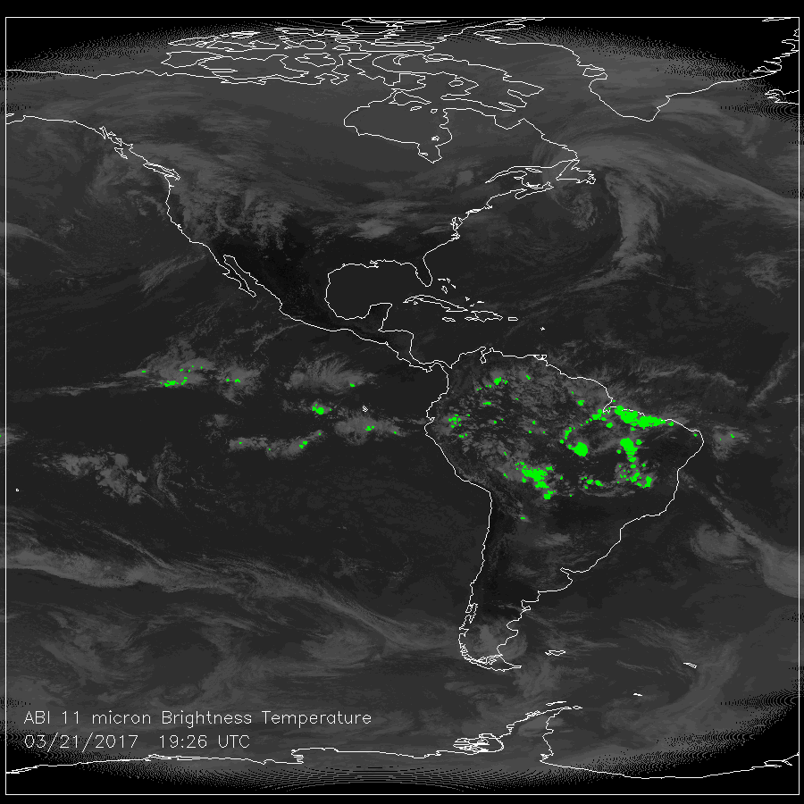
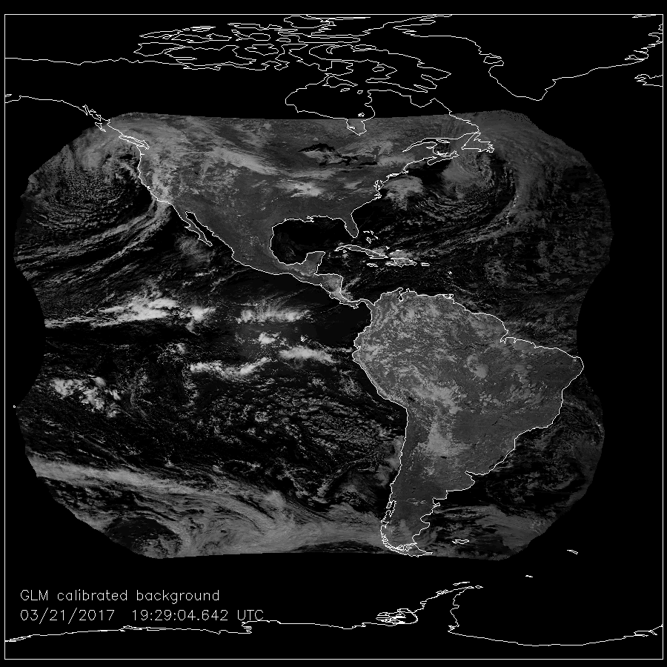
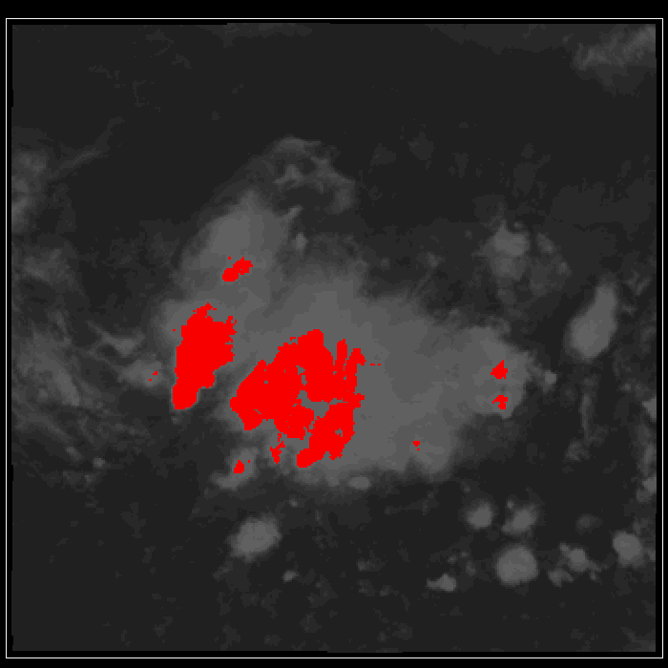
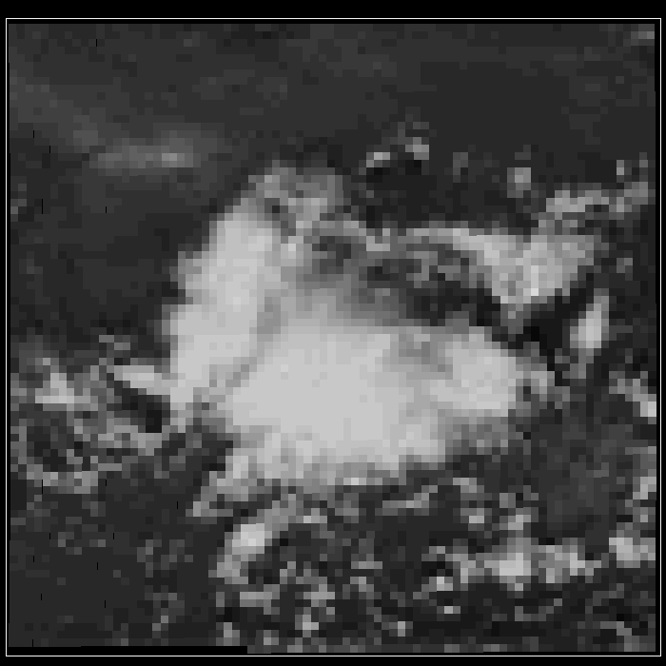
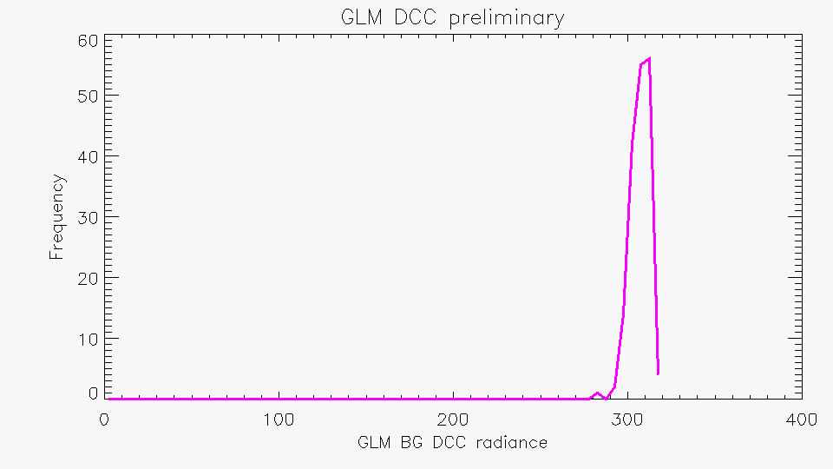
Performance: DCC Trending (PLPTs: 012)
PASSED
ABI IR 11 μm
GLM BG
Values are lower than LIS but it’s a small sample size
Will check that cal is properly applied to the BG images & correctly account for overshoot
Results from beta analyses
analyses: Buechler

Slide 58
GLM Level 2 Filtering (LCFA)
Douglas Mach
(PLPTs: 009, 010)
PASSED

Slide 59
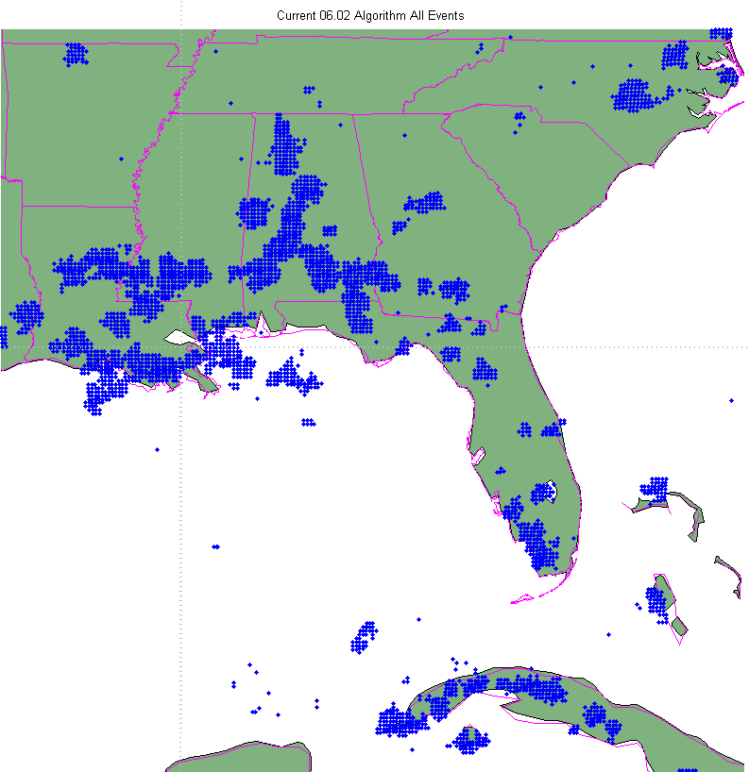
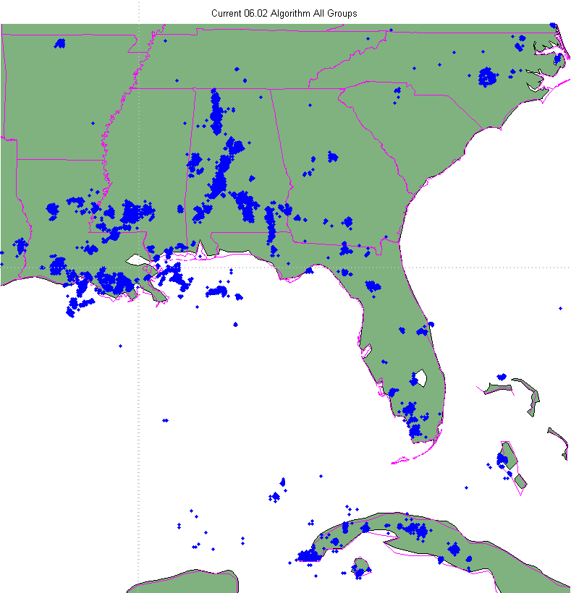
Current L2 Filtering
In the current algorithm (06.02), most filtering is performed at L0-L1b
The only L2 filter is the removal of single group flashes
The plots on the right show the events (and clustered groups) handed to the LCFA for processing
These GOES-16 data are preliminary, non-operational data and are undergoing testing. Users bear
all responsibility for inspecting the data prior to use and for the manner in which the data are utilized.

Slide 60
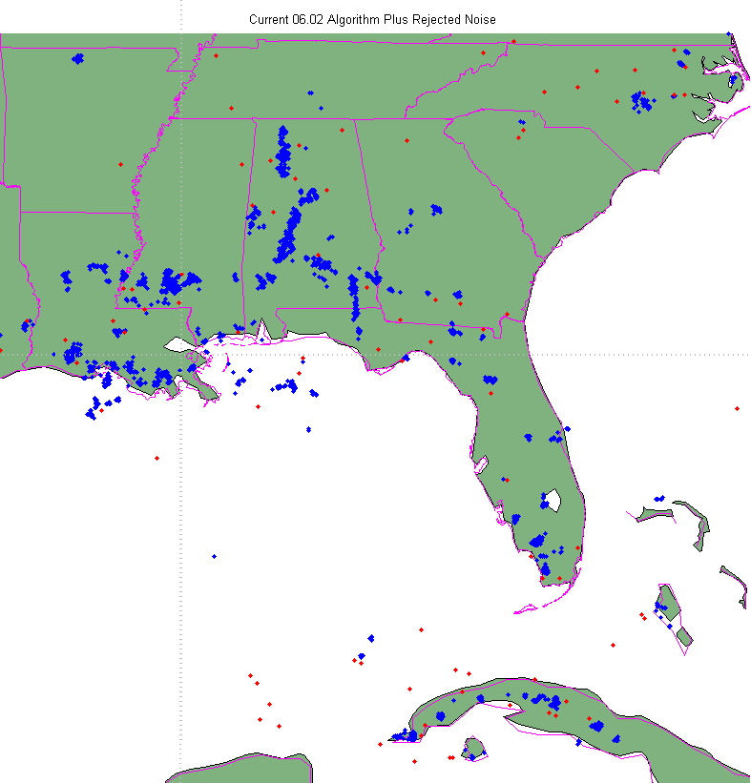
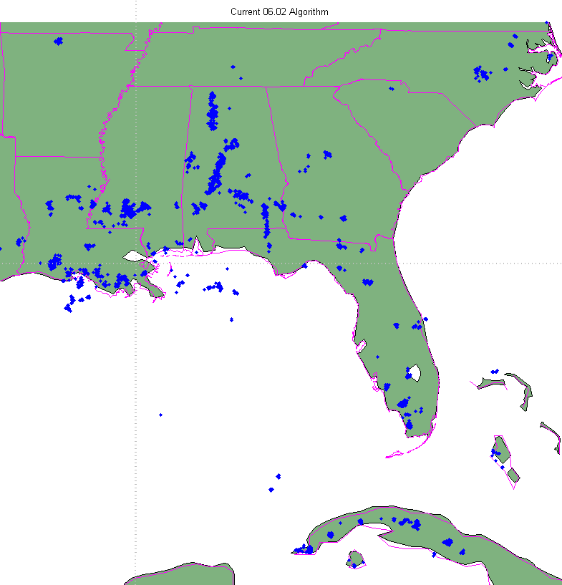
Current L2 Filtering (cont.)
The events are clustered into groups and then flashes
Any single group flash (regardless of event count) is removed
Note: A quick analysis showed that there is little to no correlation between the number of events in a group and its association with other lightning
In other words, using the number of events in a group to determine the likelihood of the single group flash being noise does not work
The top plot is all flashes (with single group flashes marked in red)
The bottom plot shows the remaining flashes with 2 or more groups
This is the output of the current 06.02 algorithm
These GOES-16 data are preliminary, non-operational data and are undergoing testing. Users bear
all responsibility for inspecting the data prior to use and for the manner in which the data are utilized.

Slide 61
Concept of New L2 Filtering
Not all single group flashes are created equal
Isolated single group flashes are more likely to be noise than single group flashes that are near other lightning
Background noise rate estimation is the critical factor
At first, one must assume that ALL GLM data is noise
With that assumption, ALL single group flashes should be considered noise
However, once some lightning in a region has been detected, the estimated noise rate is reduced by the amount of lightning found
At that point SOME of the previously rejected single group flashes are now more likely to be due to lightning (and so should be “put back” into the output
In practice, this means that in regions where there is lightning, the single group flashes should be put back into the output data if the flash density exceeds some value
An exact solution could be found, but it is more practical to simply pick a value that makes sense, based on the distribution of the data

Slide 62
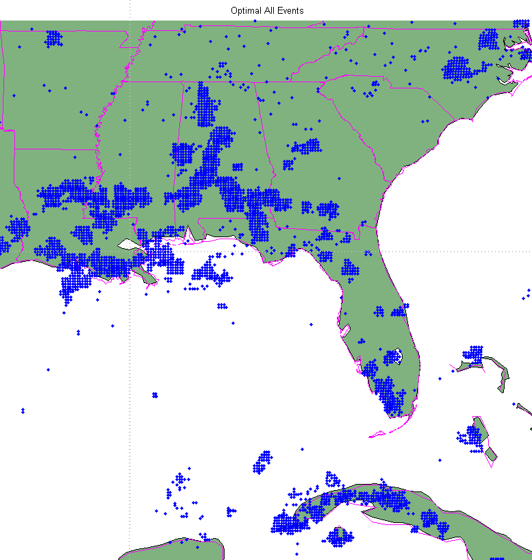
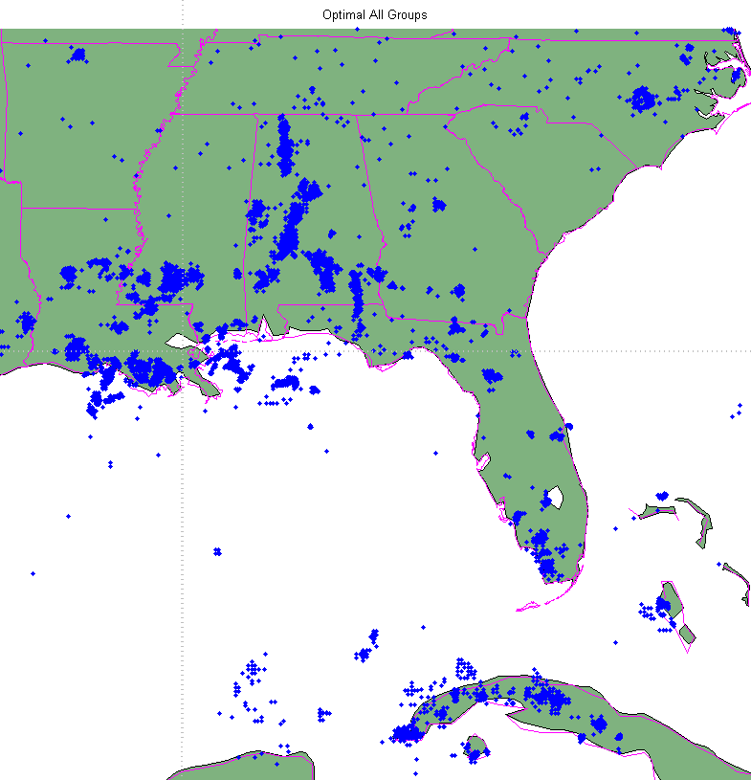


Datasets
10 minutes of GLM data from 8-15-2017 20:30 to 8-15-2017 20:40
L1b input data is filtered at three different levels
Filtered using the current 06.02 parameters (top two plots)
Filtered using the optimal Coherency values determined in PLT, per CDRL121 GLM06593 (middle two plots)
Filtered using “extreme” Coherency values, well beyond “optimal” (bottom two plots)
These GOES-16 data are preliminary, non-operational data and are undergoing testing. Users bear
all responsibility for inspecting the data prior to use and for the manner in which the data are utilized.

Slide 63

LCFA Putback Algorithm
Calculated the flash density (using ALL flashes, including single group flashes) on a 0.2° grid, centered on the sub-satellite point, modified to maintain equal area as abs Latitude increased
Grid shown on the right
Determined a cutoff density of flashes in the grid before single group flashes are to be “putback”
Plot results
These GOES-16 data are preliminary, non-operational data and are undergoing testing. Users bear
all responsibility for inspecting the data prior to use and for the manner in which the data are utilized.

Slide 64


Putback Algorithm Results
Results with current 06.02 algorithm
29033 total flashes
24017 flashes with 2 or more groups (good flashes)
4423 single group flashes “putback”
593 single group flashes “rejected”
Upper plot is good flashes (blue), plus “putback” single group flashes (red)
Lower plot is good flash plus putback flashes (blue), plus rejected single group flashes (red)
Increased overall flash count by 19%
These GOES-16 data are preliminary, non-operational data and are undergoing testing. Users bear
all responsibility for inspecting the data prior to use and for the manner in which the data are utilized.

Slide 65


Putback Algorithm Results (cont)
Results with “optimal” coherency algorithm
35946 total flashes (24% more flashes than the current algorithm)
24962 flashes with 2 or more groups (4% more “good” flashes than the current algorithm)
6703 single group flashes “putback” (52% more putback than current algorithm)
4281 single group flashes “rejected” (720% more rejected flashes than current algorithm)
Upper plot is good flashes (blue), plus “putback” single group flashes (red)
Lower plot is good flash plus putback flashes (blue), plus rejected single group flashes (red)
Increased overall flash count (from current algorithm) by 32%
These GOES-16 data are preliminary, non-operational data and are undergoing testing. Users bear
all responsibility for inspecting the data prior to use and for the manner in which the data are utilized.

Slide 66


Putback Algorithm Results (cont)
Results with “extreme” coherency algorithm
48247 total flashes (66% more flashes than the current algorithm)
25790 flashes with 2 or more groups (7% more “good” flashes than the current algorithm)
9845 single group flashes “putback” (223% more putback than current algorithm)
11533 single group flashes “rejected” (1945% more rejected flashes than current algorithm)
Upper plot is good flashes (blue), plus “putback” single group flashes (red)
Lower plot is good flash plus putback flashes (blue), plus rejected single group flashes (red)
Increased overall flash count (from current algorithm) by 48%
These GOES-16 data are preliminary, non-operational data and are undergoing testing. Users bear
all responsibility for inspecting the data prior to use and for the manner in which the data are utilized.

Slide 67


Summary
For the most part, the “putback” flashes are in the same areas as the “good” flashes (multiple groups)
There are a few exceptions, one of which I will detail here
It seems that the “optimal” and “extreme” settings on the L0-L1b coherency algorithm “adds” a new region of flashes just north of Cuba (see figure to the right)
Those single group flashes cluster like “real” flashes, but are made up of only single group flashes
If they are NOT lightning, then they are something else that clusters like lightning
These GOES-16 data are preliminary, non-operational data and are undergoing testing. Users bear
all responsibility for inspecting the data prior to use and for the manner in which the data are utilized.

Slide 68



Optimizing Coherency Algorithm
Current DO.06.02 Alg.
Optimal Alg.
Extreme Alg.
Goal: Increase DE as much as possible while maintaining low FAR
Results for 3 different settings of Coherency Algorithm
Left to Right: Allows more SGF through L0-L1b Coherency Algorithm
Leftmost Plot: Removes too many real flashes
Rightmost Plot: Passes too many false flashes
Center: Just Right … “Goldilocks”
These GOES-16 data are preliminary, non-operational data and are undergoing testing. Users bear
all responsibility for inspecting the data prior to use and for the manner in which the data are utilized.

